Slide 1
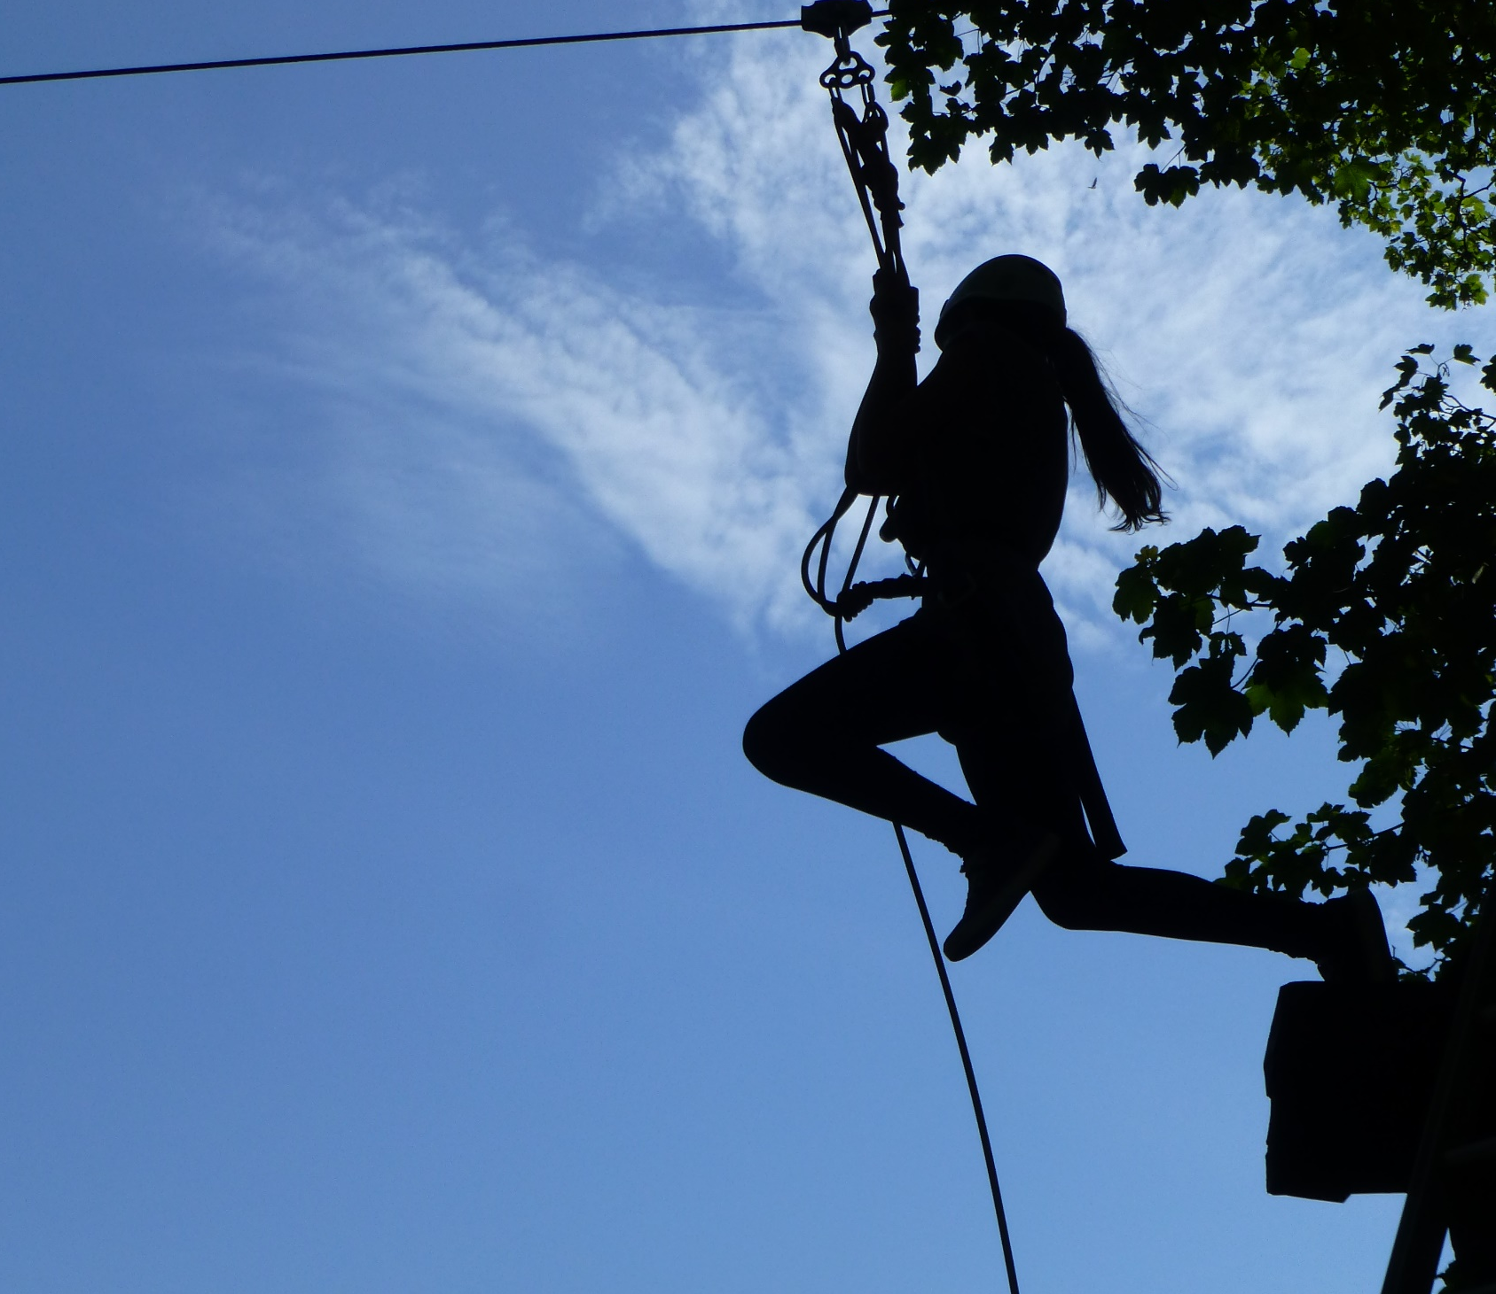
Zip Wire

Slide 2
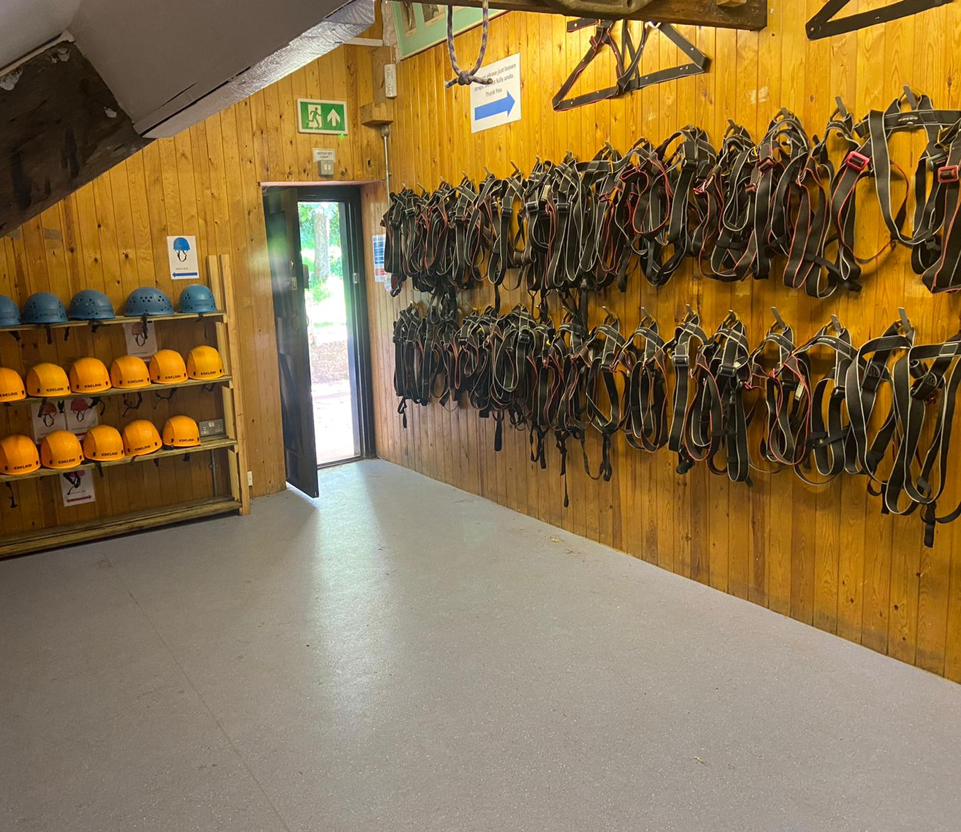
Zip wire
I will need to go to the rock store to get a harness and helmet
My instructor will show me how to put on my harness and helmet

Slide 3
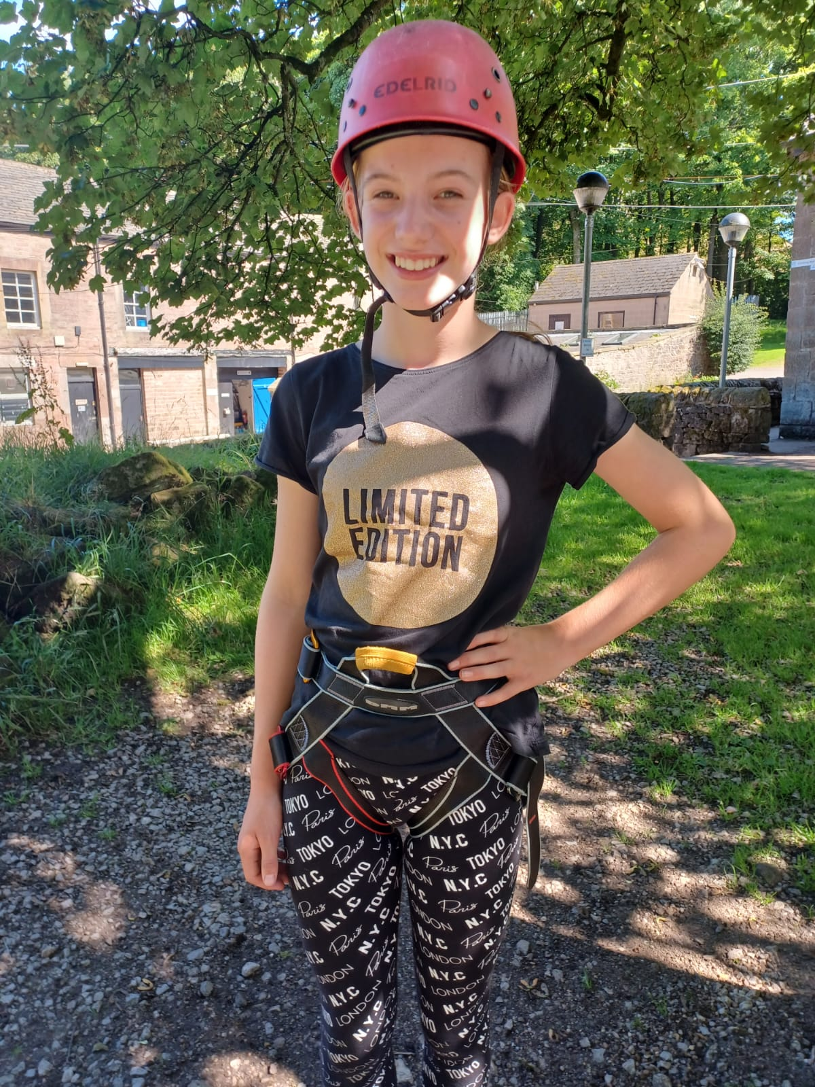
Zip wire
My instructor may need to get close to help me with my harness and helmet
The harness and helmet may feel tight but it will keep me safe

Slide 4
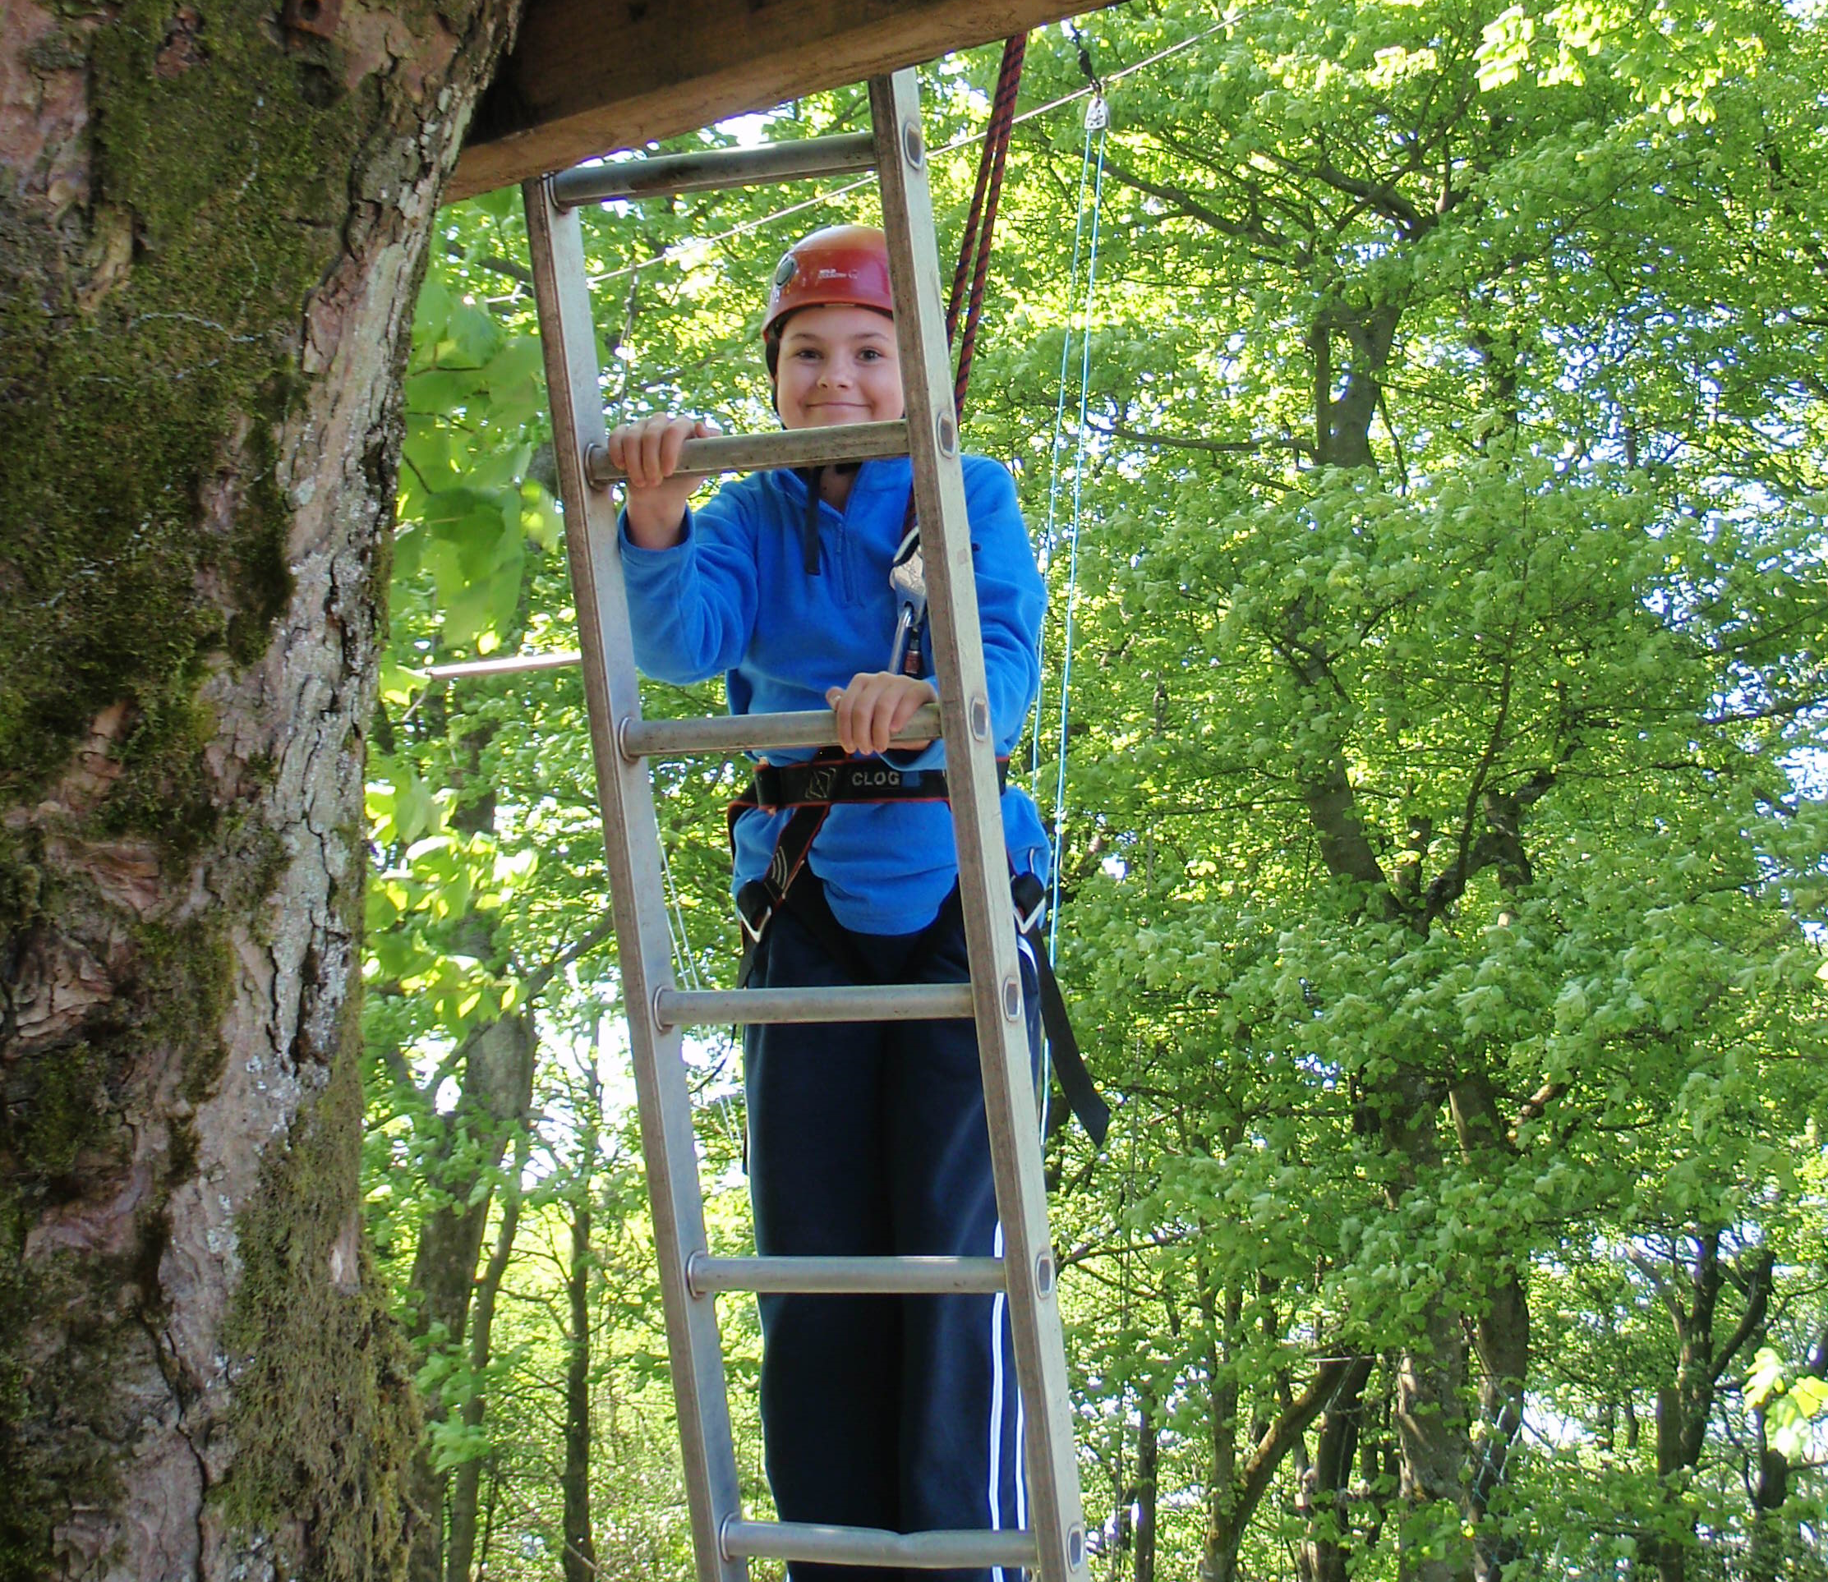
Zip wire
I’ll climb a ladder to get to the zip wire platform that’s in a tree
The ladder might feel a bit bouncy as I climb, but it is safe
The ladder might feel cold
I’m attached to a rope the whole time so I’m always safe

Slide 5
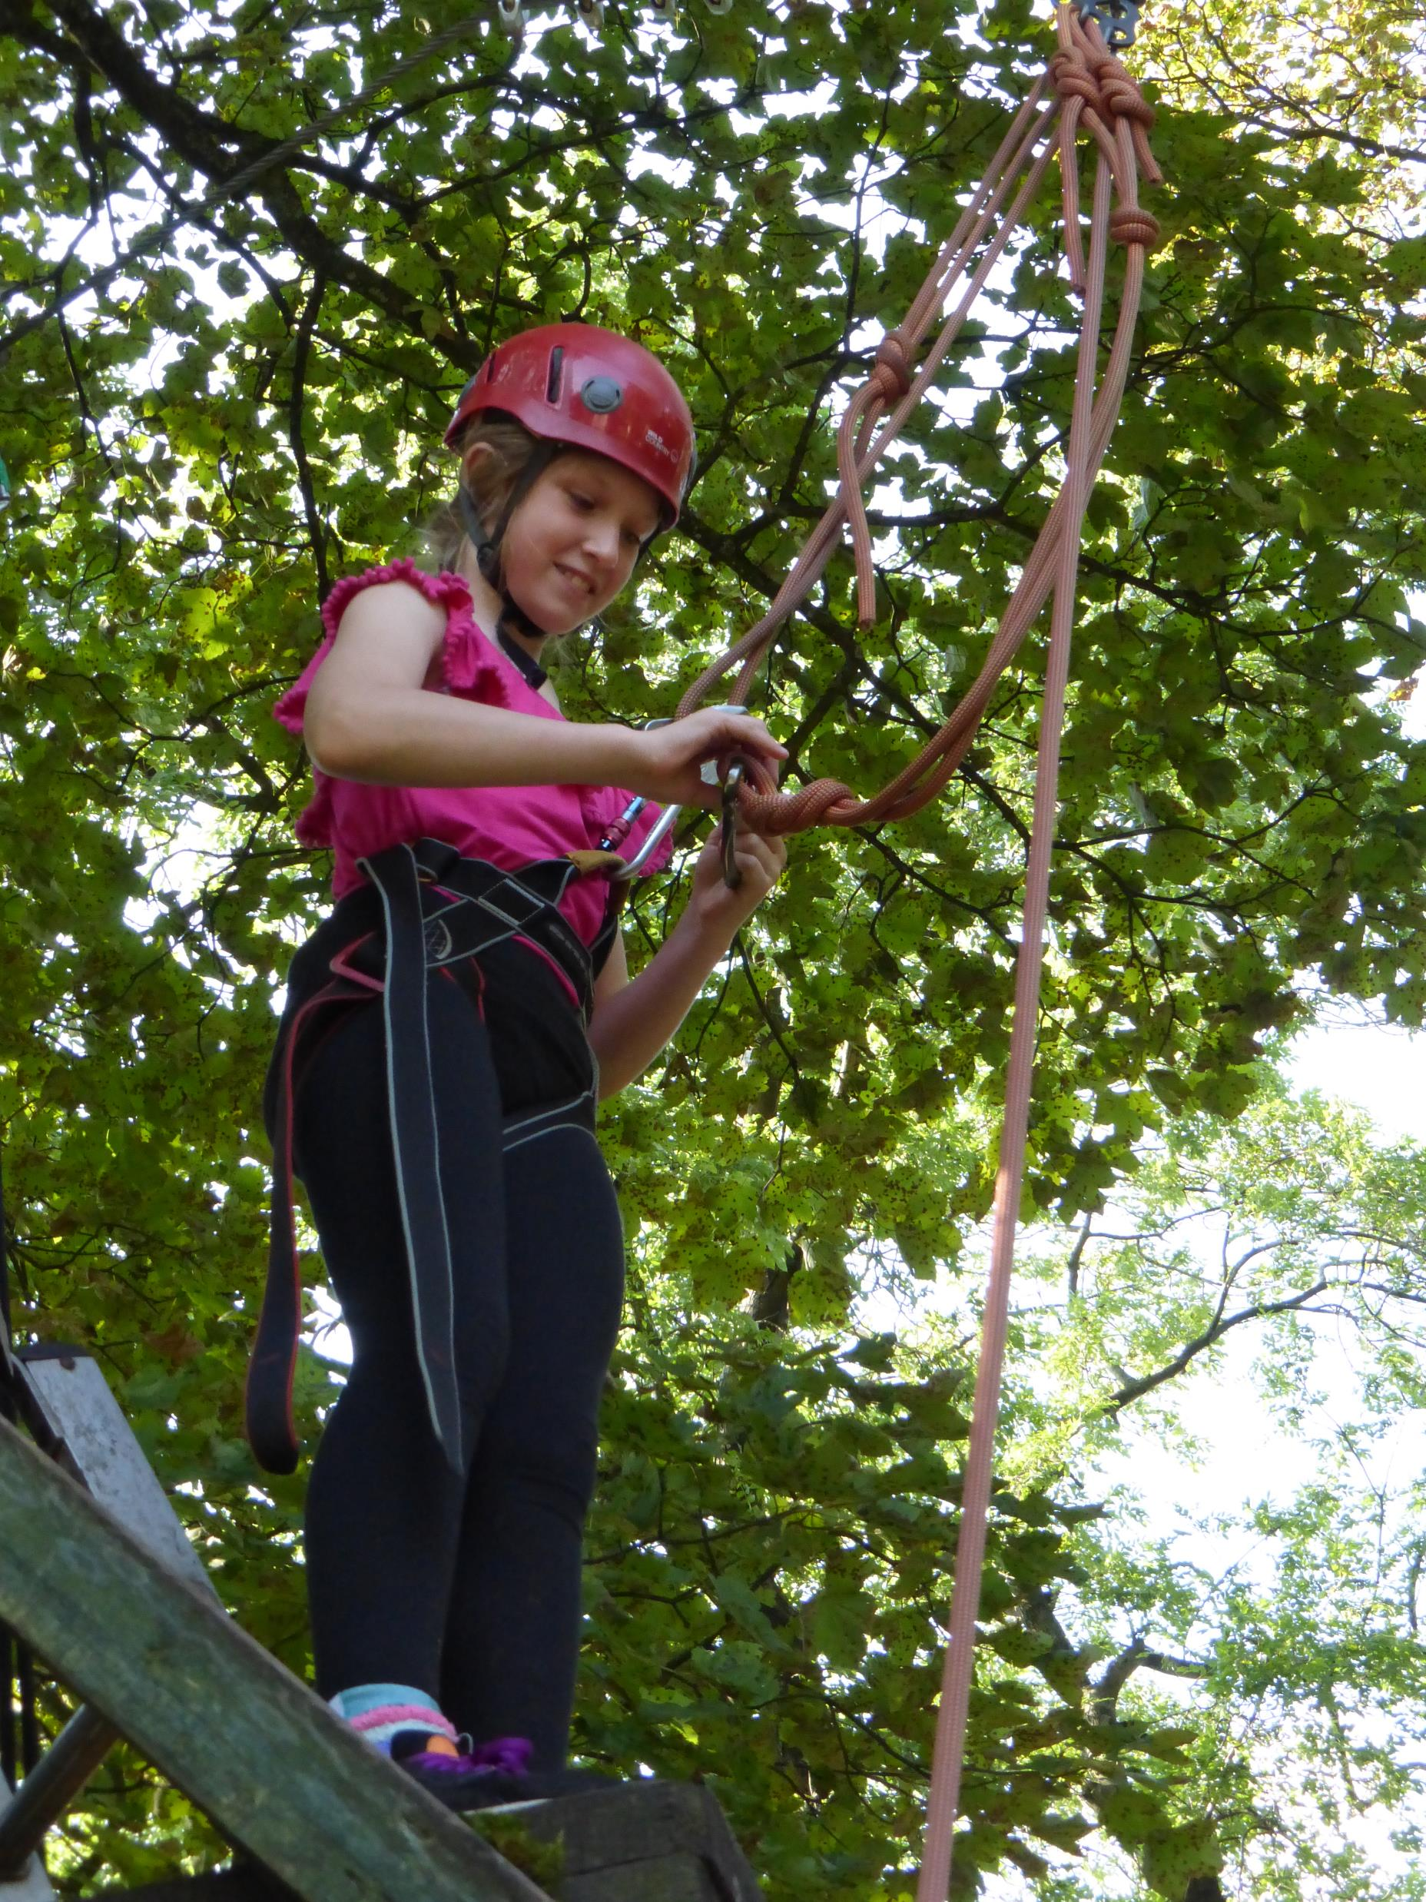
Zip wire
When I’m on the platform, I’ll have to attach another rope to my harness. My instructor will make sure I know how to do this before I have my turn
I’ll hear the leaves rustle in the trees and it might feel a bit windy

Slide 6
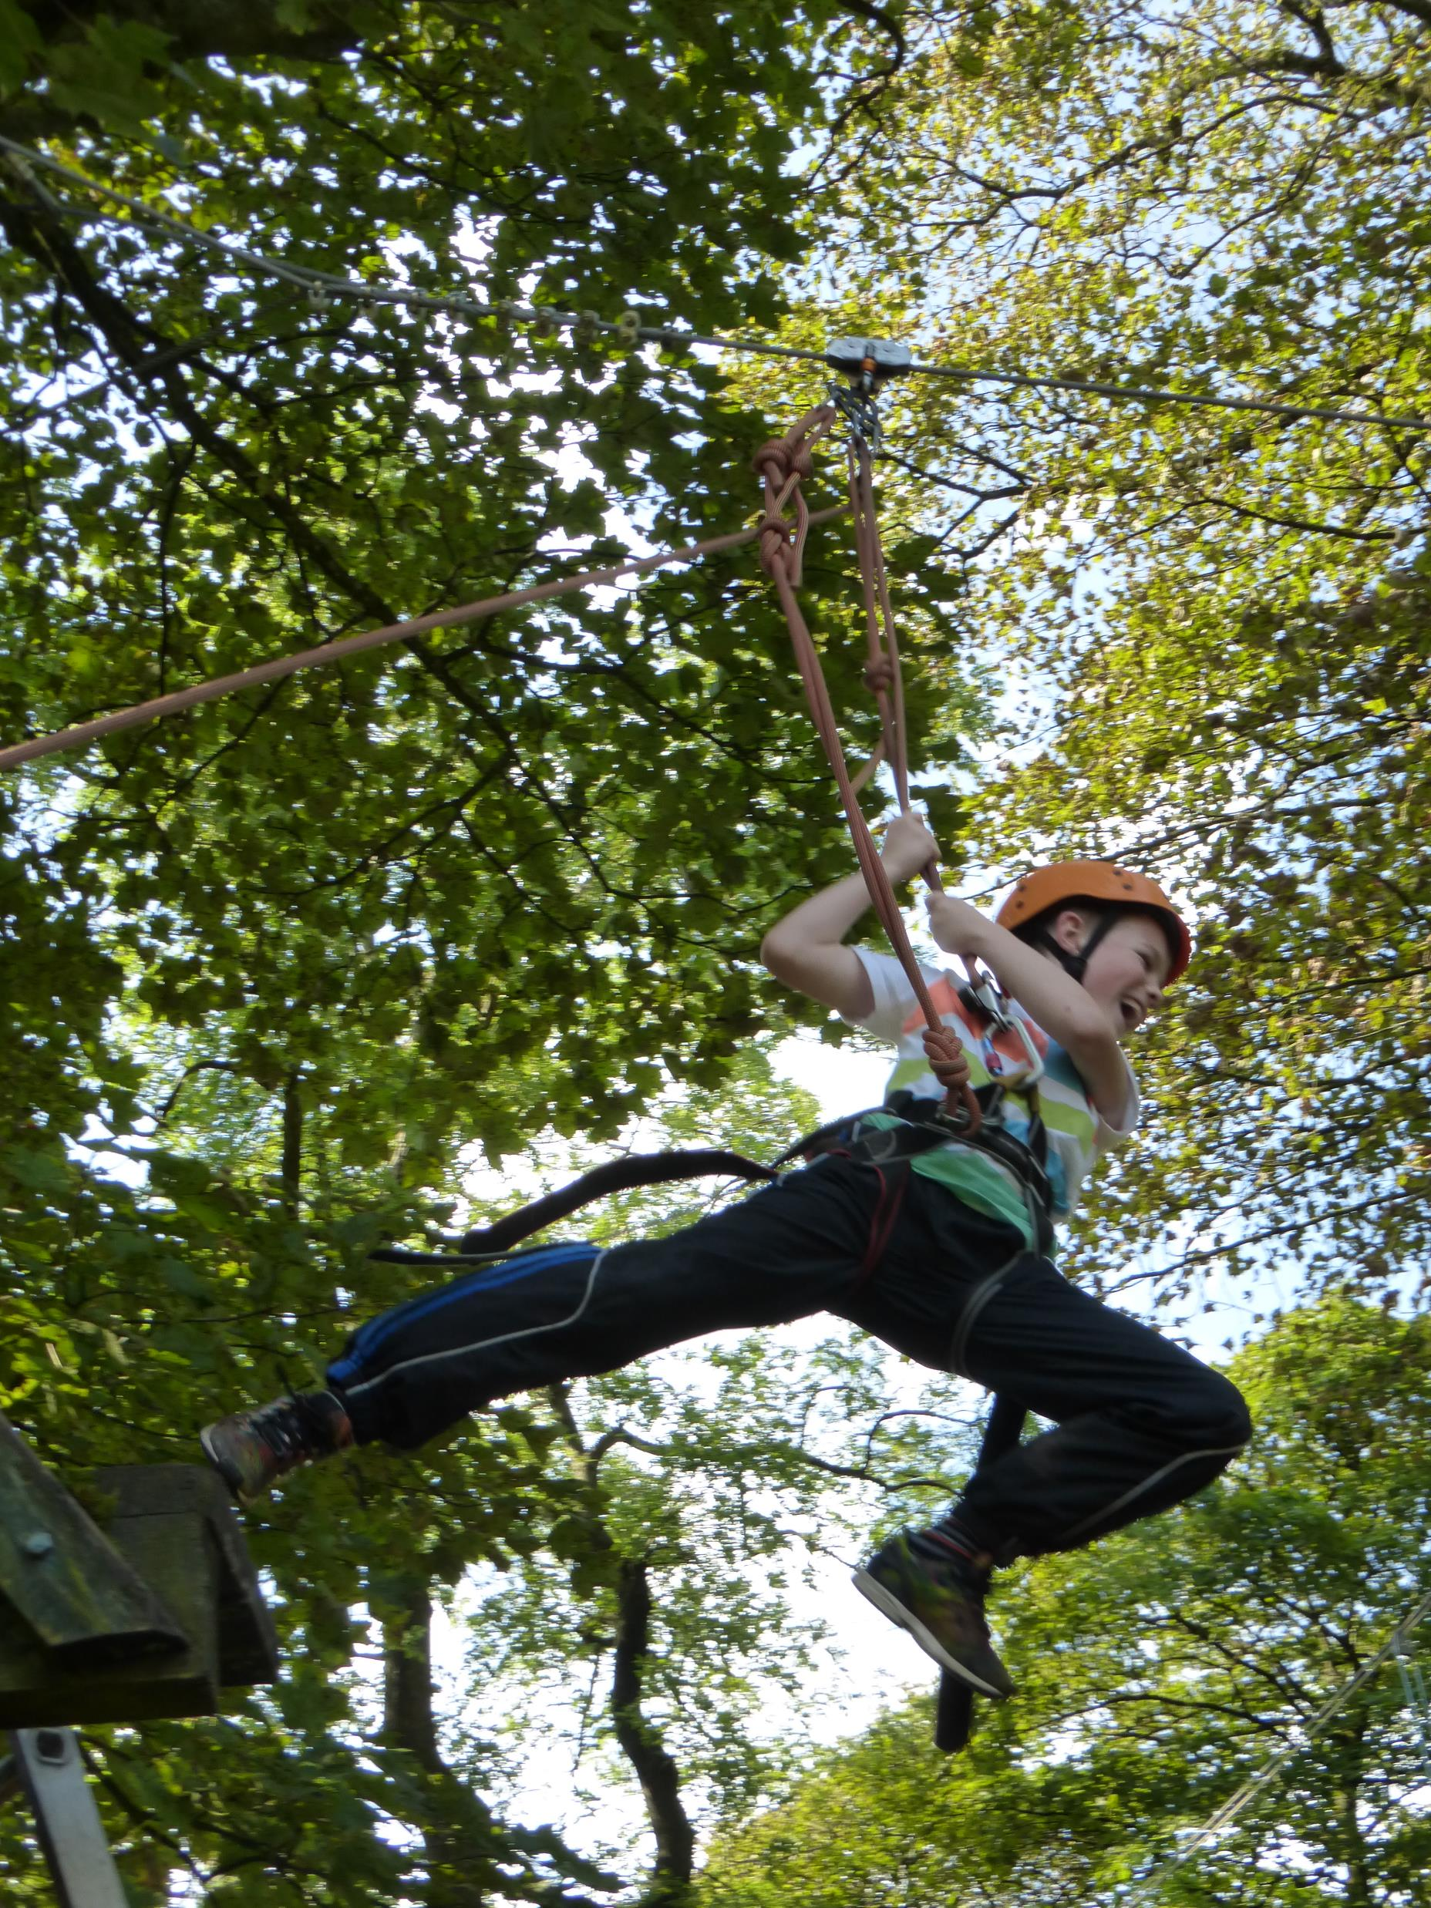
Zip wire
When my instructor tells me to, I can jump or step off the platform
If I want to go slow, I can ask my instructor and they’ll help me slow down

Slide 7
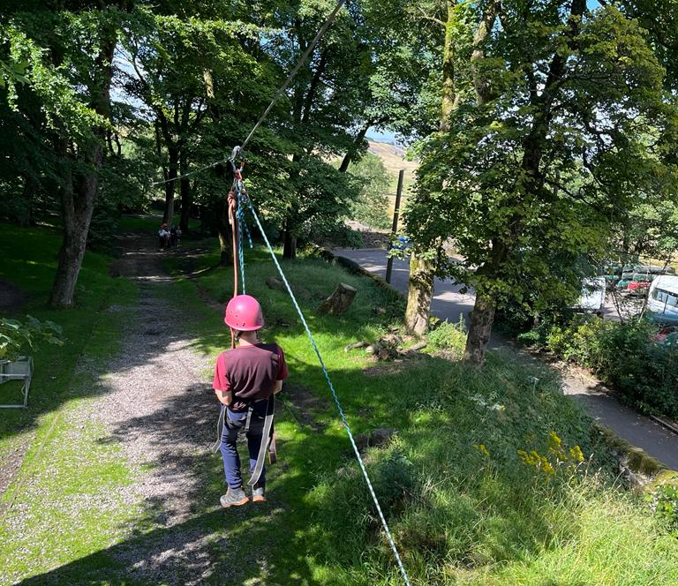
Zip Wire
My harness will attach me to the cable, so I don’t need to hold on
The wire is attached to big, strong trees at either end!

Slide 8
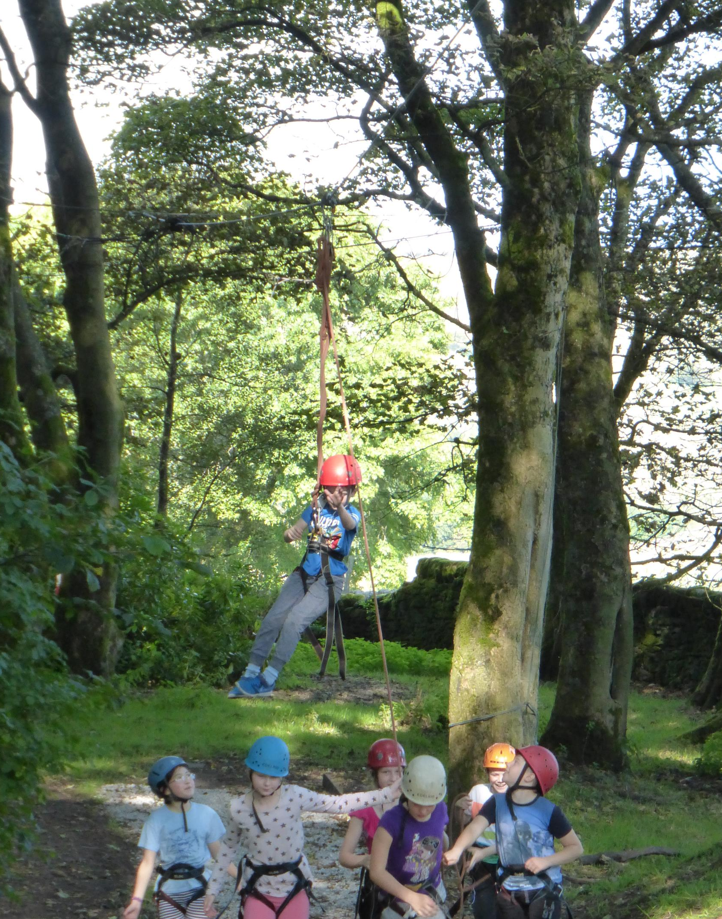
Zip wire
The other people in my group will help pull me back up the zip wire
My instructor will then help to lower me back down to the ground
I need to make sure I’m ready to help other people when it’s not my turn

