Slide 1
Stream Scrambling

Slide 2
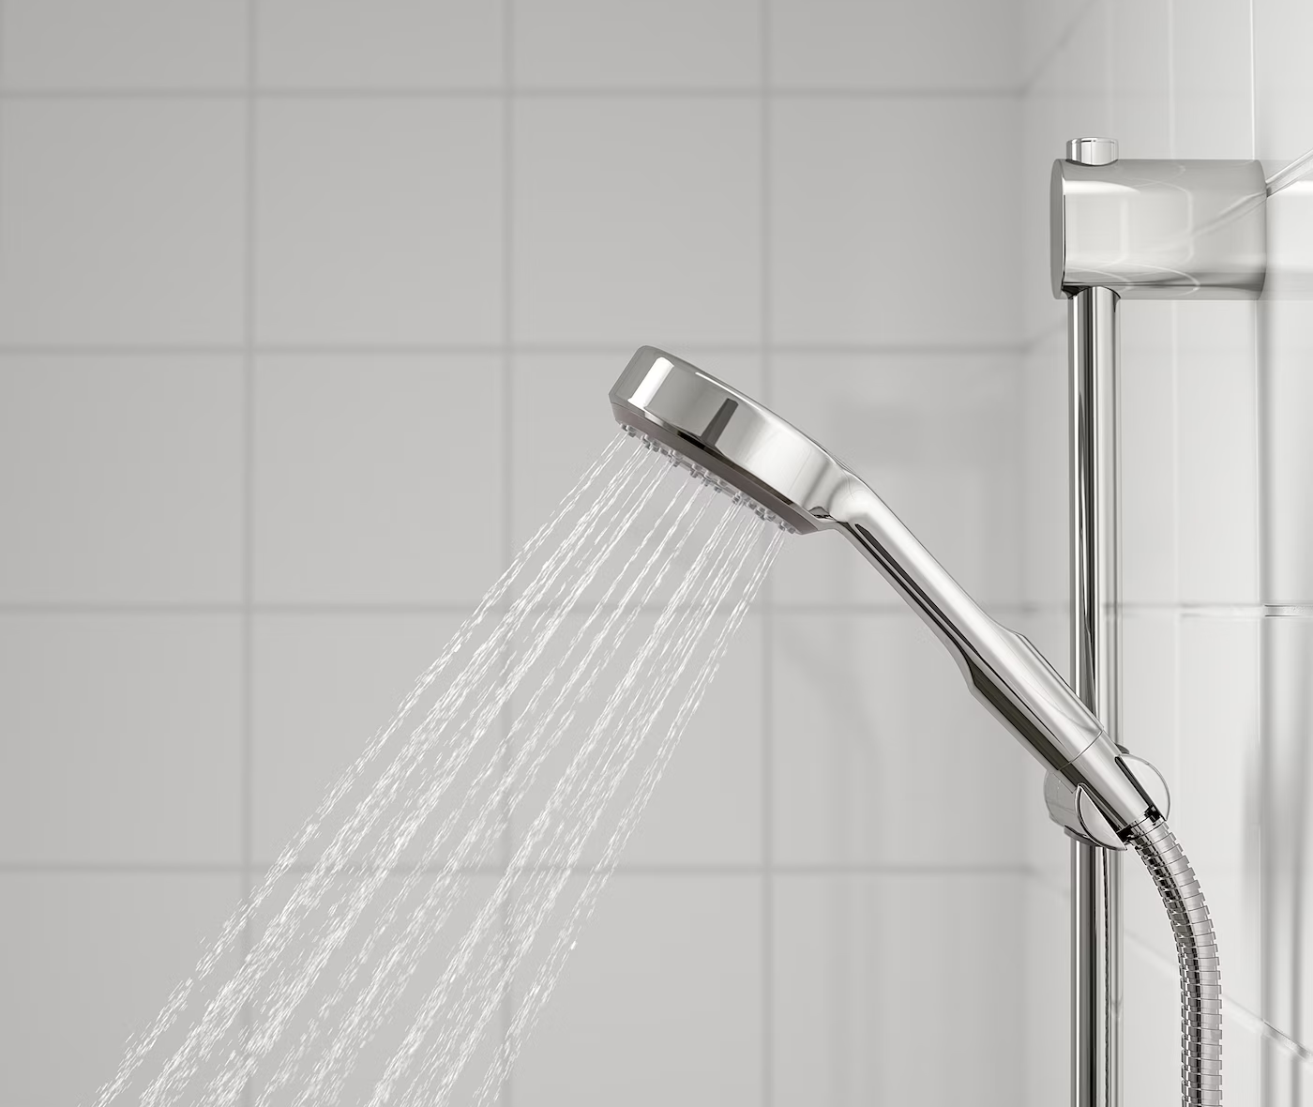
Stream scrambling
I will have to put a spare change of clothes and a towel in the shower room before we go, so I can have a shower afterwards if I get wet

Slide 3
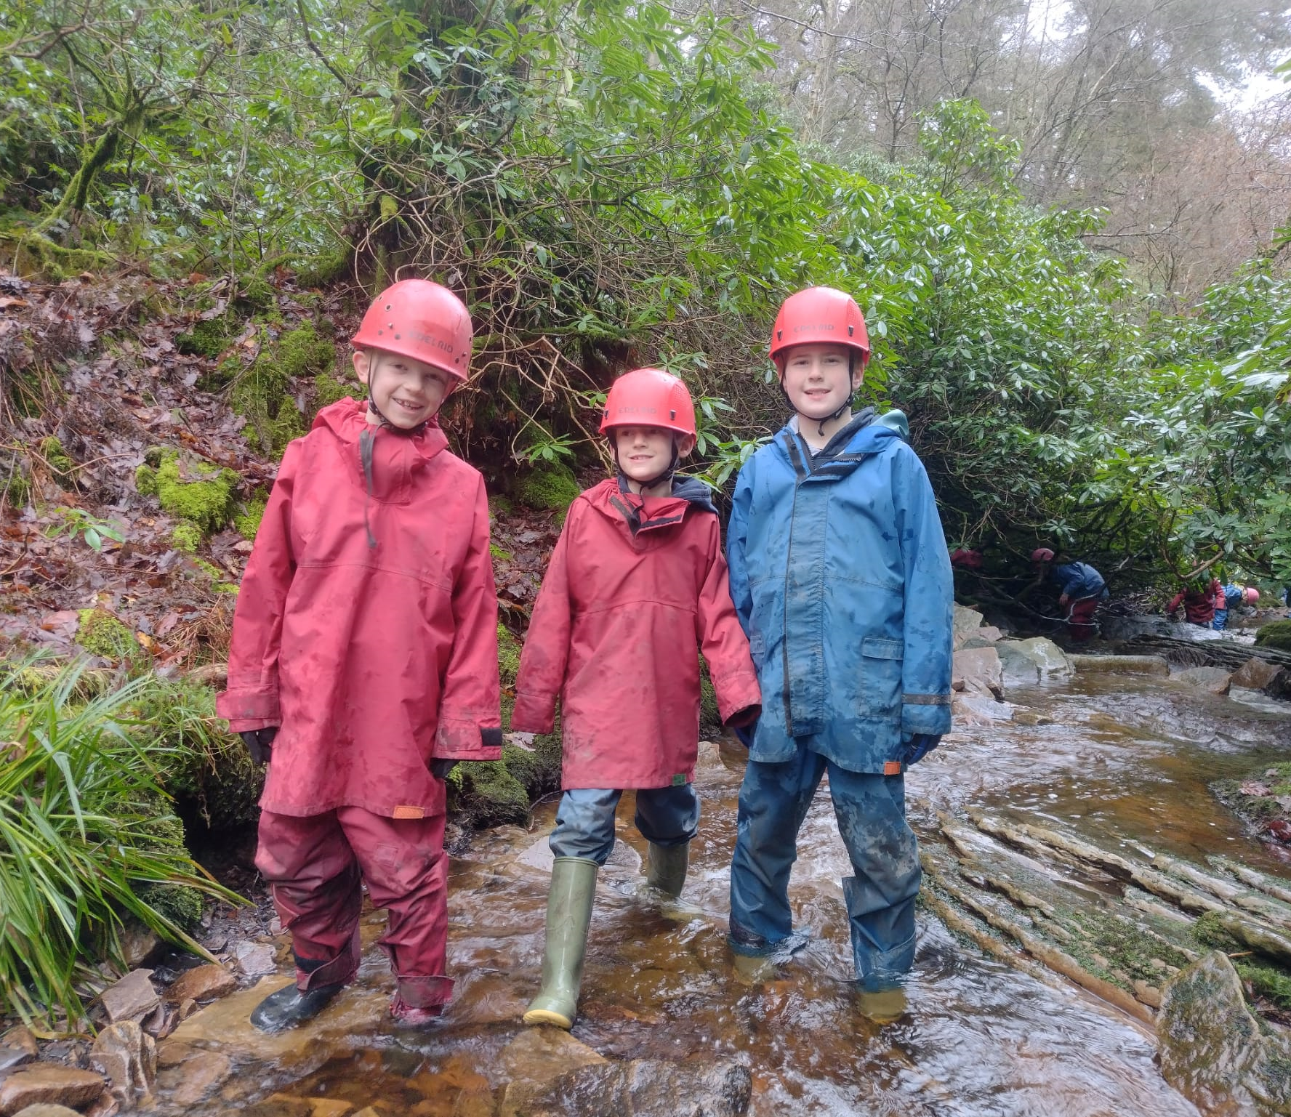
Stream Scramble
My instructor will tell me what clothes to wear
I might have to wear a waterproof coat and trousers over my clothes
I will need to wear wellies

Slide 4
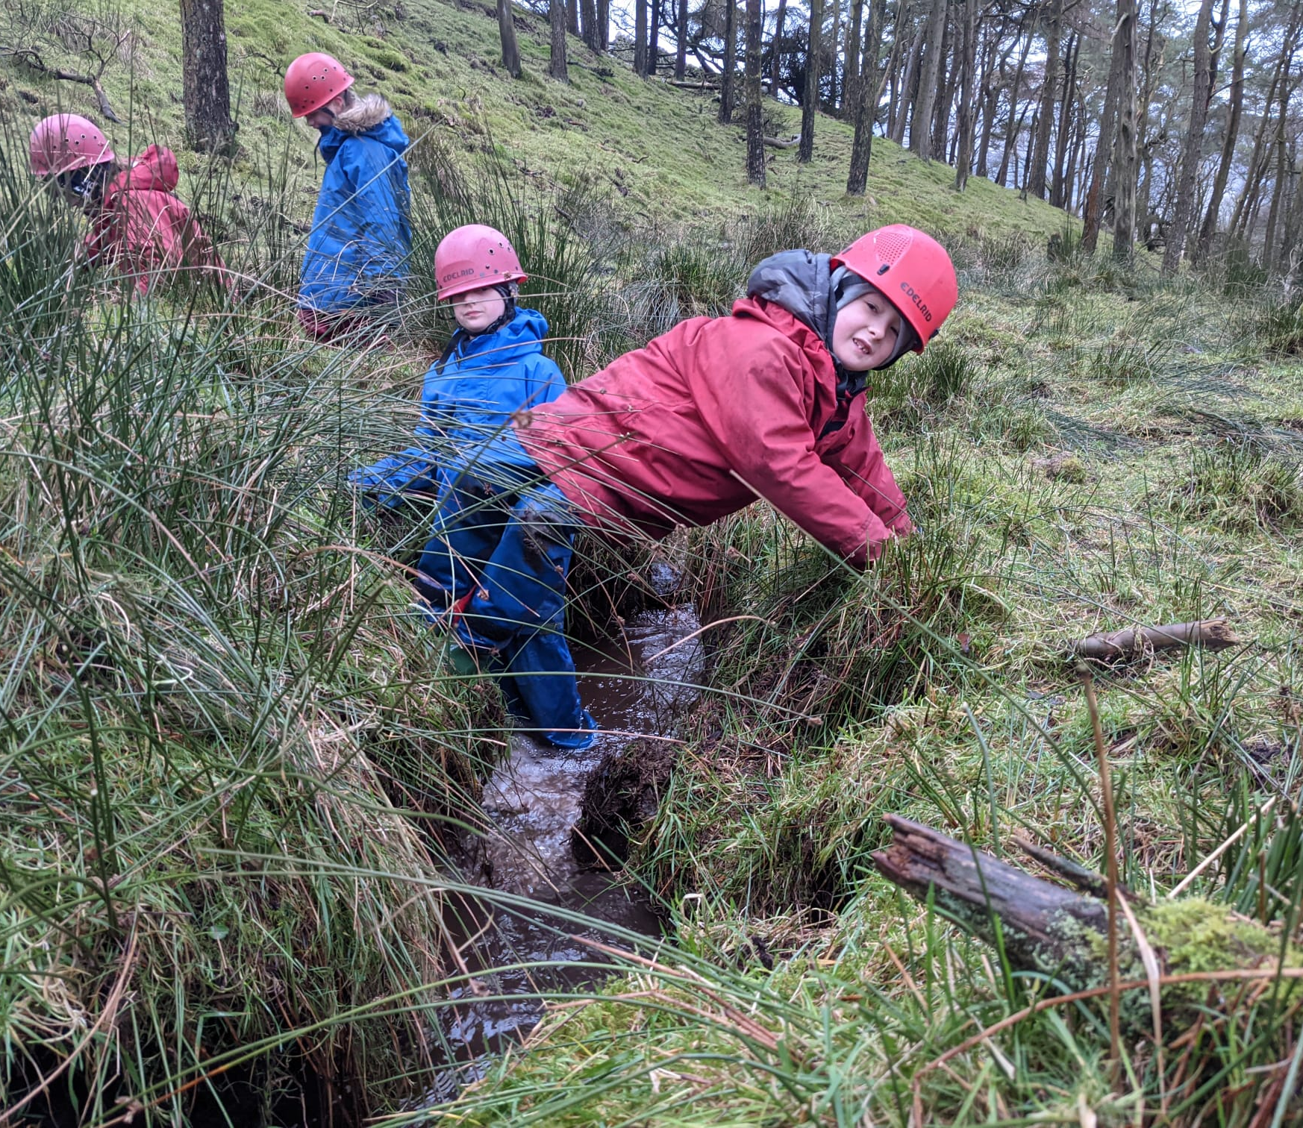
Stream Scramble
I’ll need to wear a helmet, it might feel tight, but it will keep me safe

Slide 5
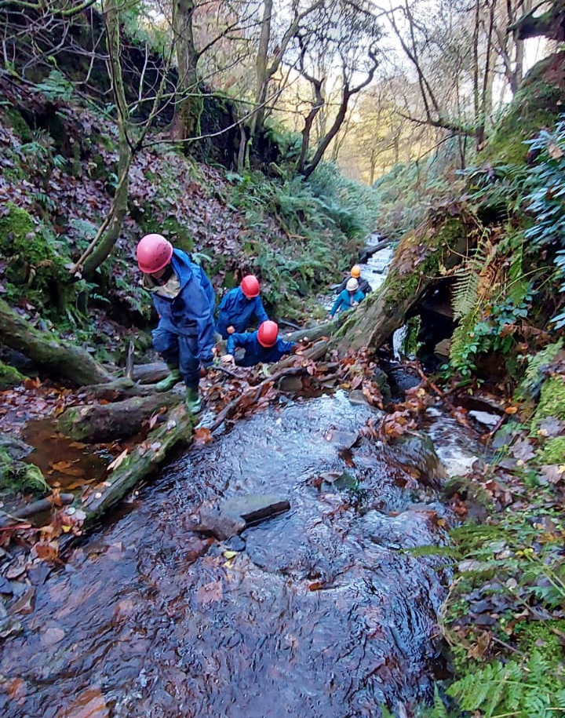
Stream Scramble
When I get to the stream, I will hear the water flowing, it might be quite loud
The water will probably be cold
I will probably get wet feet
If I don’t want to get wet, then I can tell my instructor

Slide 6
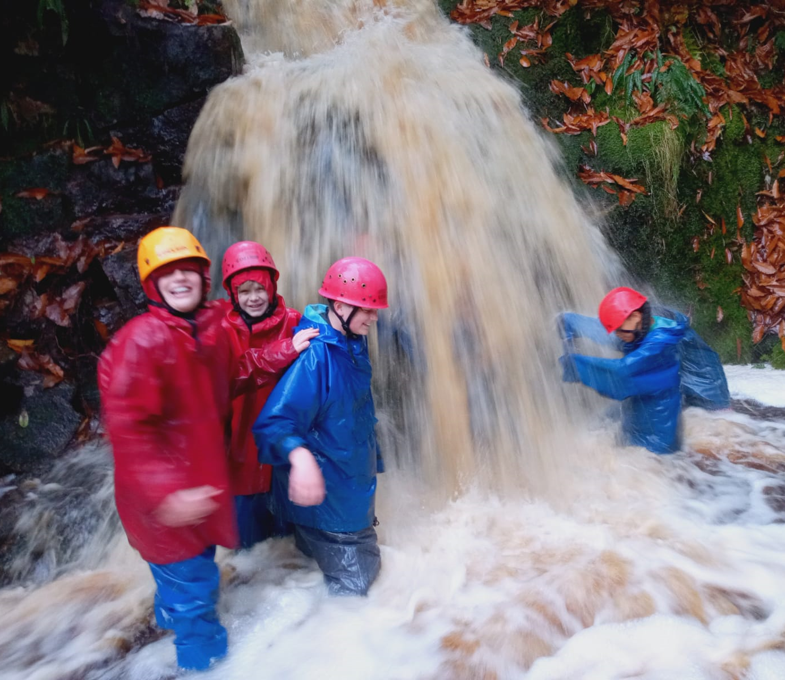
Stream Scramble
I need to make sure I stay with the group and that I listen to the instructor
The rocks may be slippery, and I might find it hard, but it’s ok to take my time. My instructor will help me

Slide 7
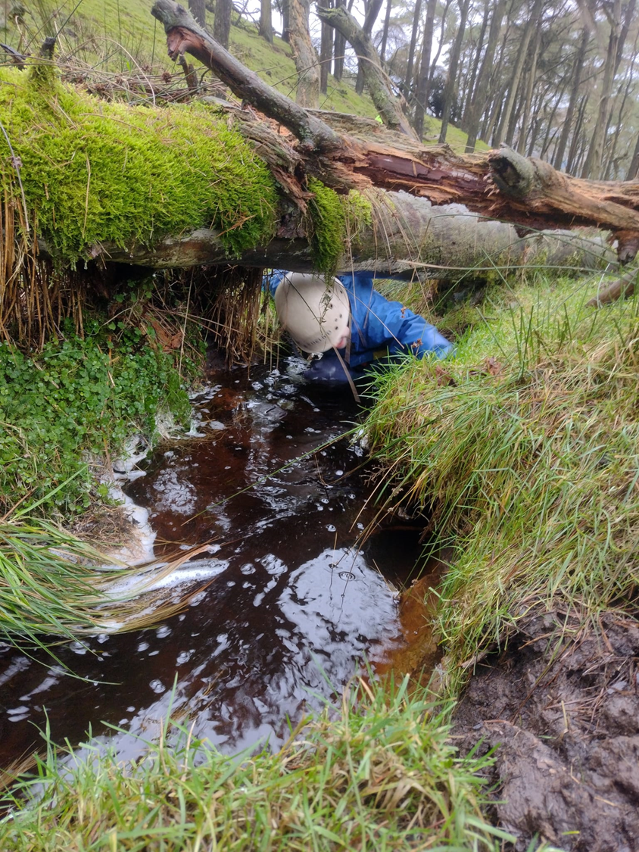
Stream Scramble
Once we have finished the stream scramble we will walk back to the mini-bus and drive back to White Hall to have a warm shower
I should feel proud that I have completed the session

