Slide 1
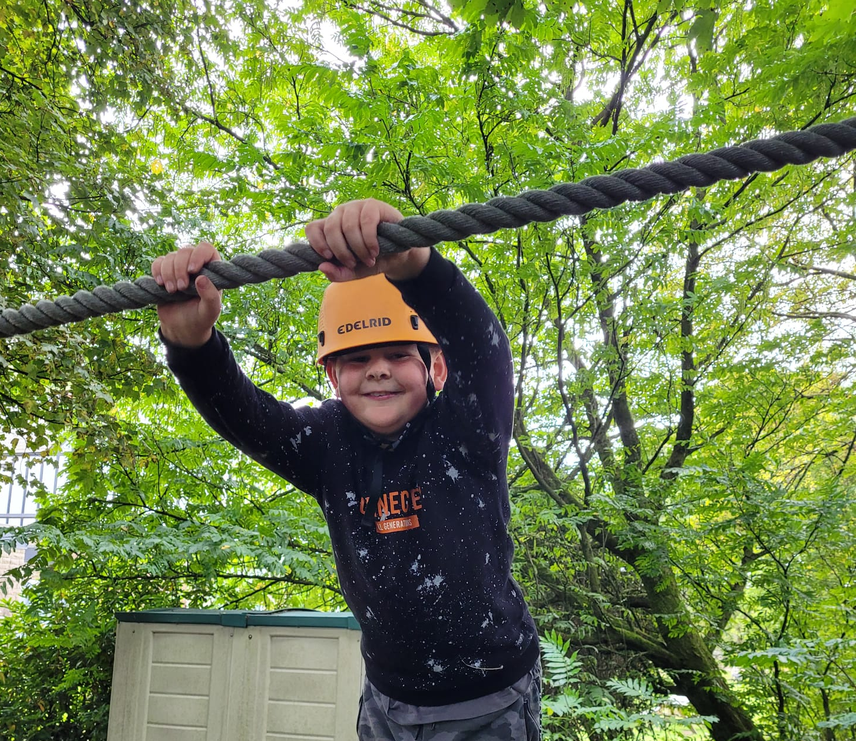
Ropes Course

Slide 2
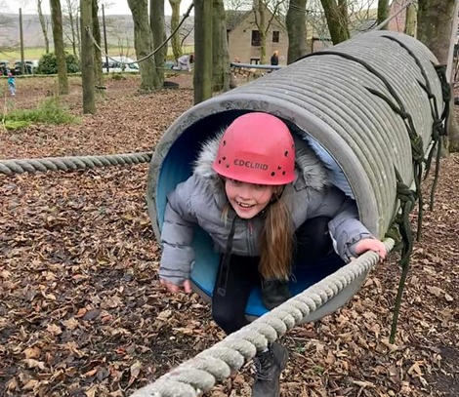
Ropes course
I’ll need to wear a helmet. It might feel tight
I will have to listen carefully to the safety instructions

Slide 3
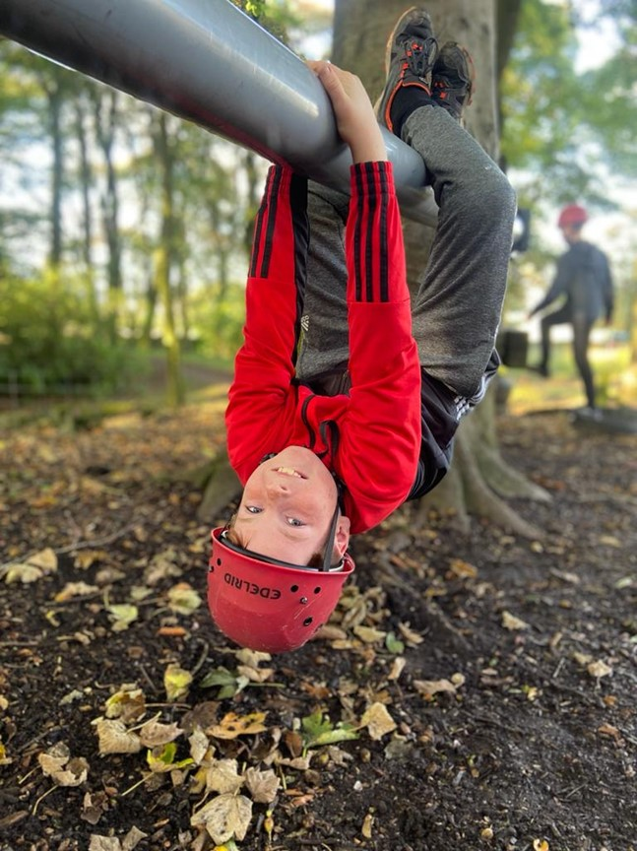
Ropes Course
There’s lots of fun challenges on the ropes course. It doesn’t matter if I can’t do them all

Slide 4
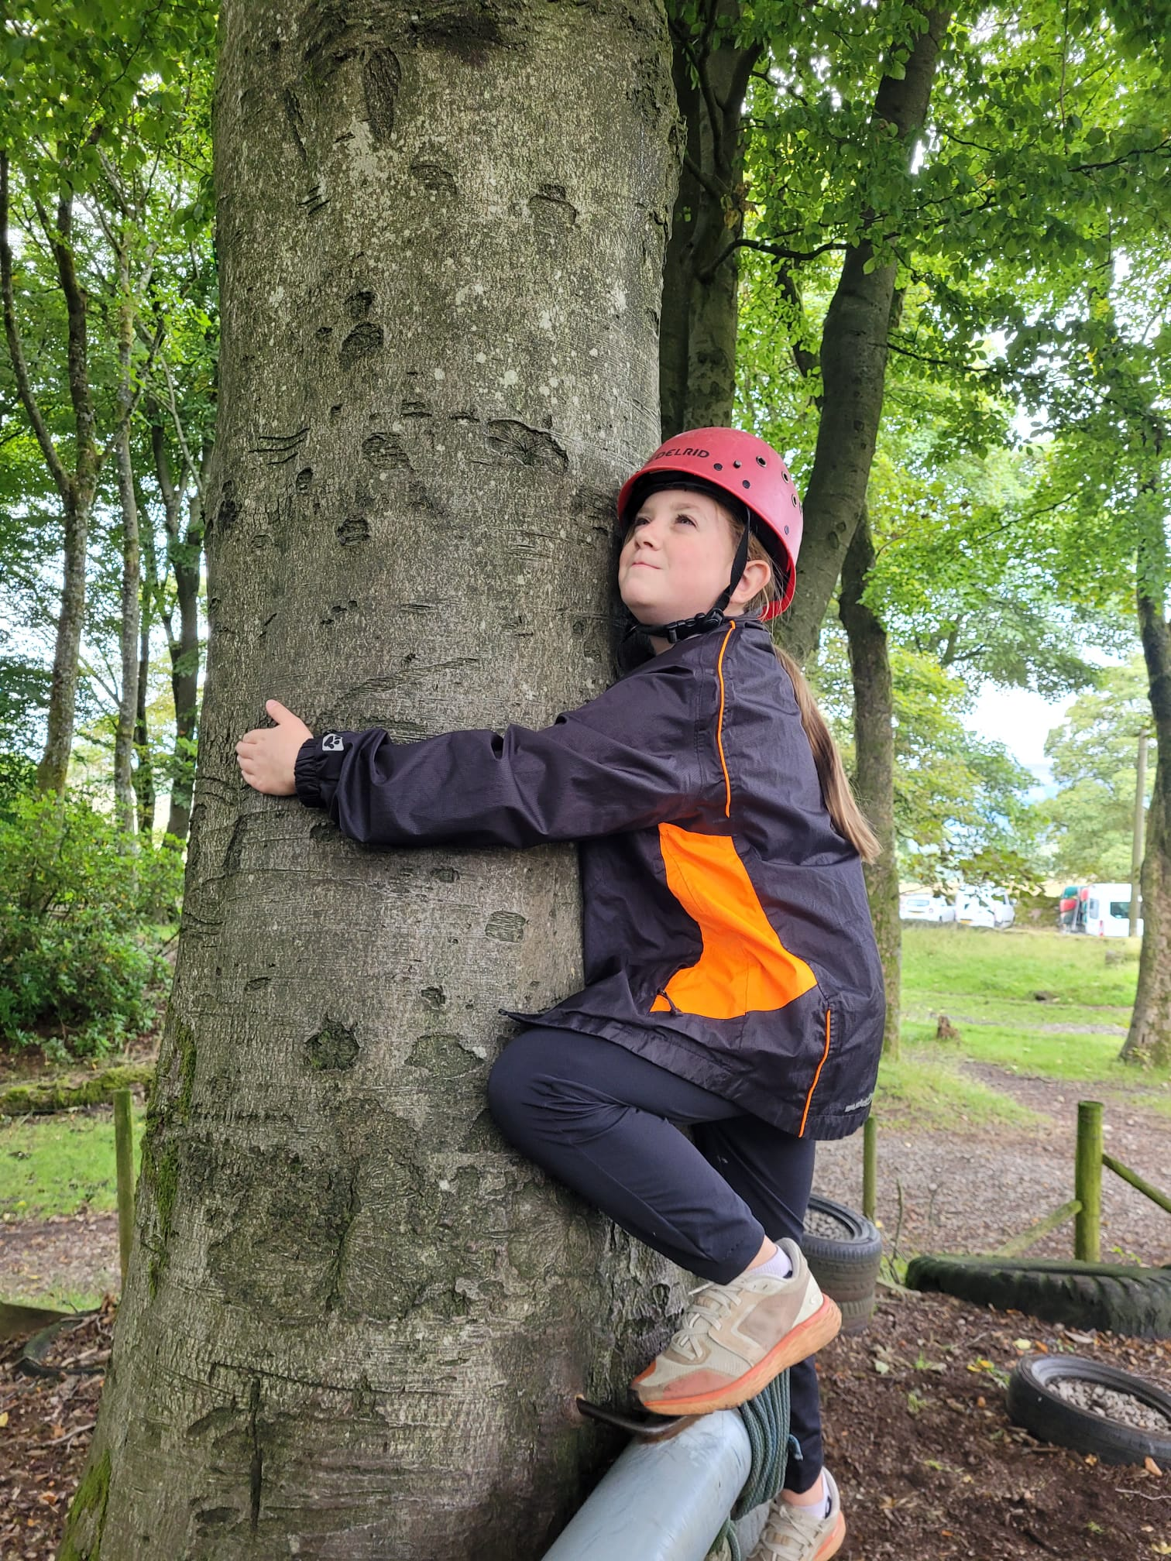
Ropes Course
There’s lots of different textures on the ropes course: trees, ropes, cables and more! They may feel cold, or warm, depending on the weather
If I don’t like the feel of something then I can just let my instructor know
I can work as a team and get help from my friends, or I can try by myself

Slide 5
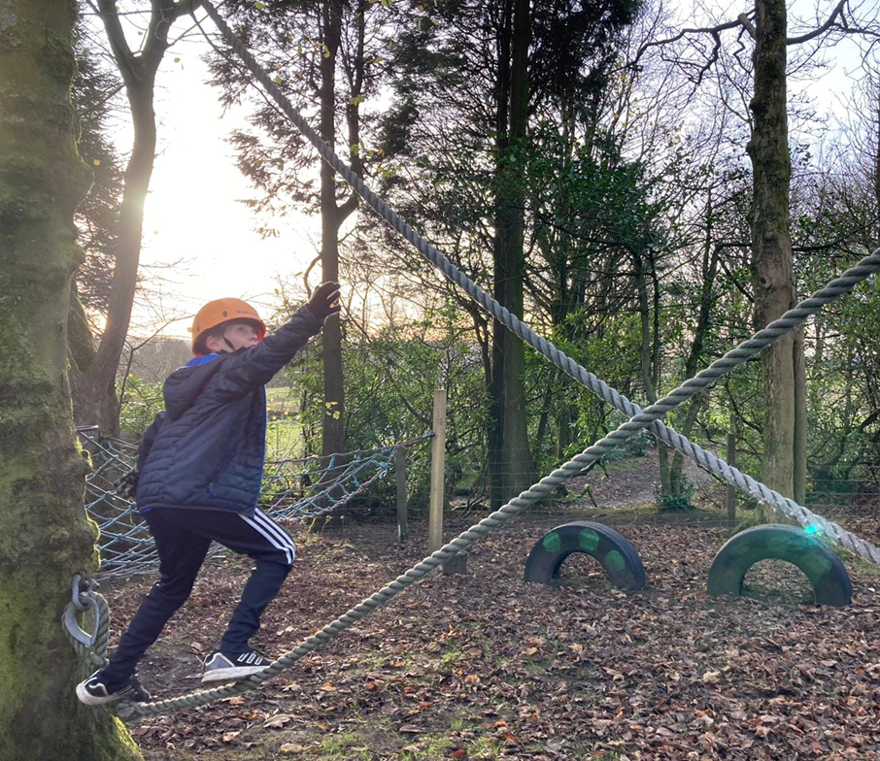
Ropes Course
There are three different ropes courses at White Hall, and they vary in difficulty and size
My instructor will help me if I ask
If I need to take a break from the ropes course, I can if I ask my instructor

Slide 6
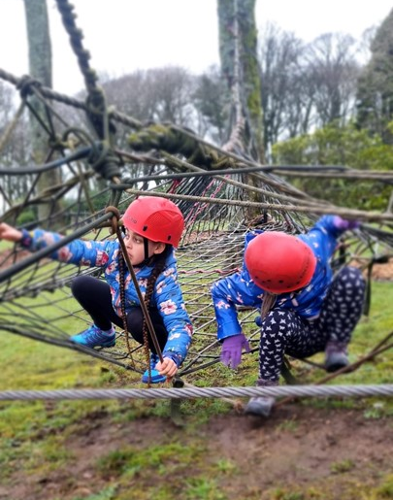
Ropes Course
I should feel proud that I have completed the session.

