Slide 1
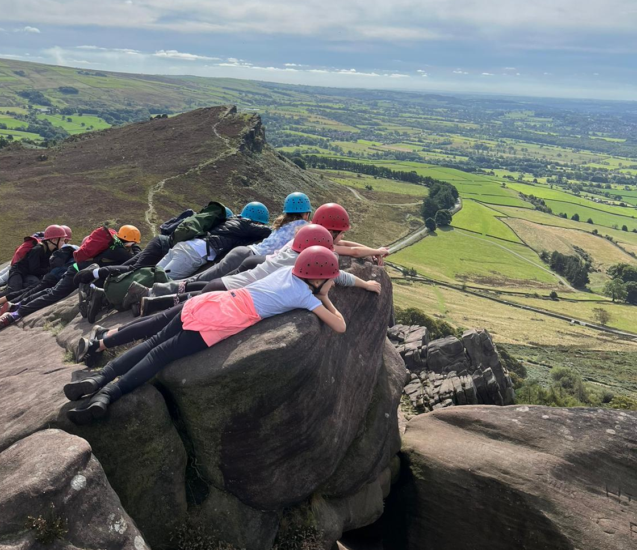
Rock Scrambling

Slide 2
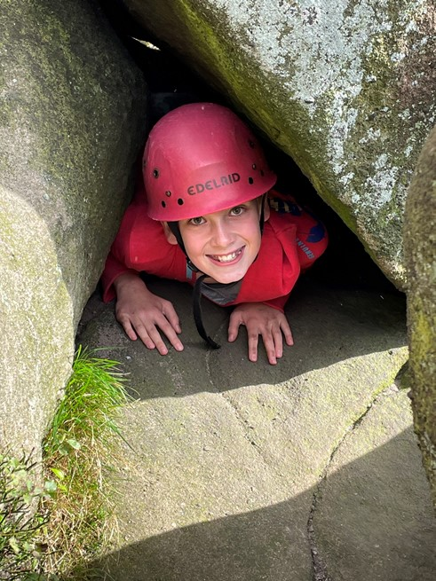
Rock Scrambling
I will need to wear a helmet. It might feel tight but it will keep me safe
We will travel on a minibus to go rock scrambling. I’ll need to wear my seatbelt

Slide 3
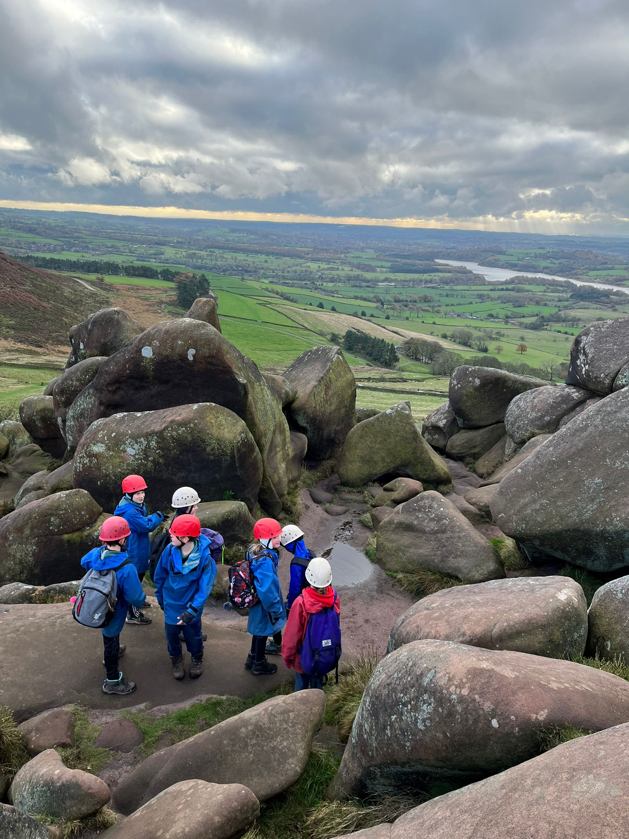
Rock Scrambling
I’ll need to wear long sleeves and trousers to protect my skin
If it’s cold or wet, I’ll probably be asked to wear waterproofs that I will borrow from White Hall

Slide 4
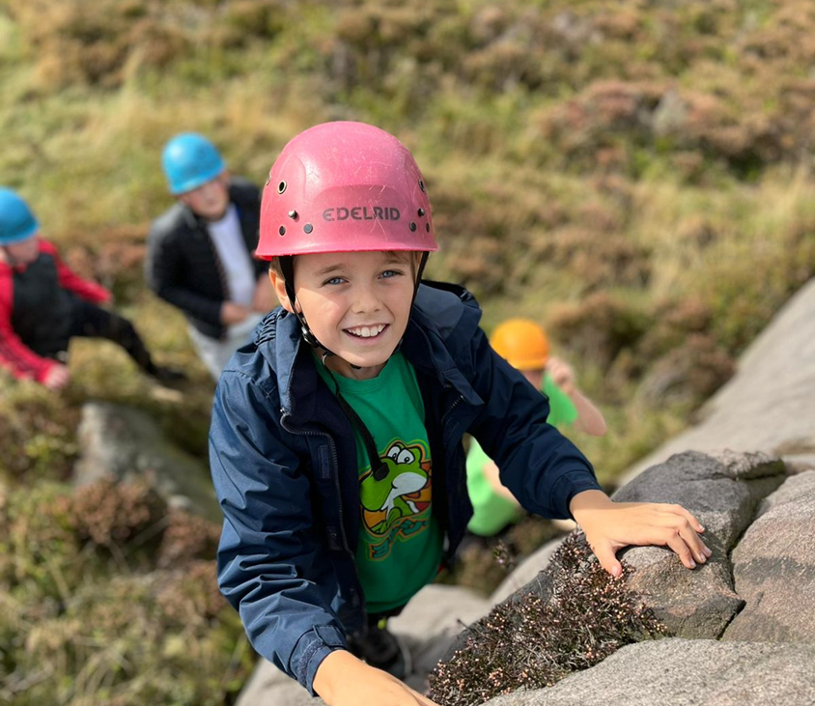
Rock Scrambling
I’ll need to listen to my instructor to make sure I stay safe
I must stay with my group and my instructor the whole time

Slide 5
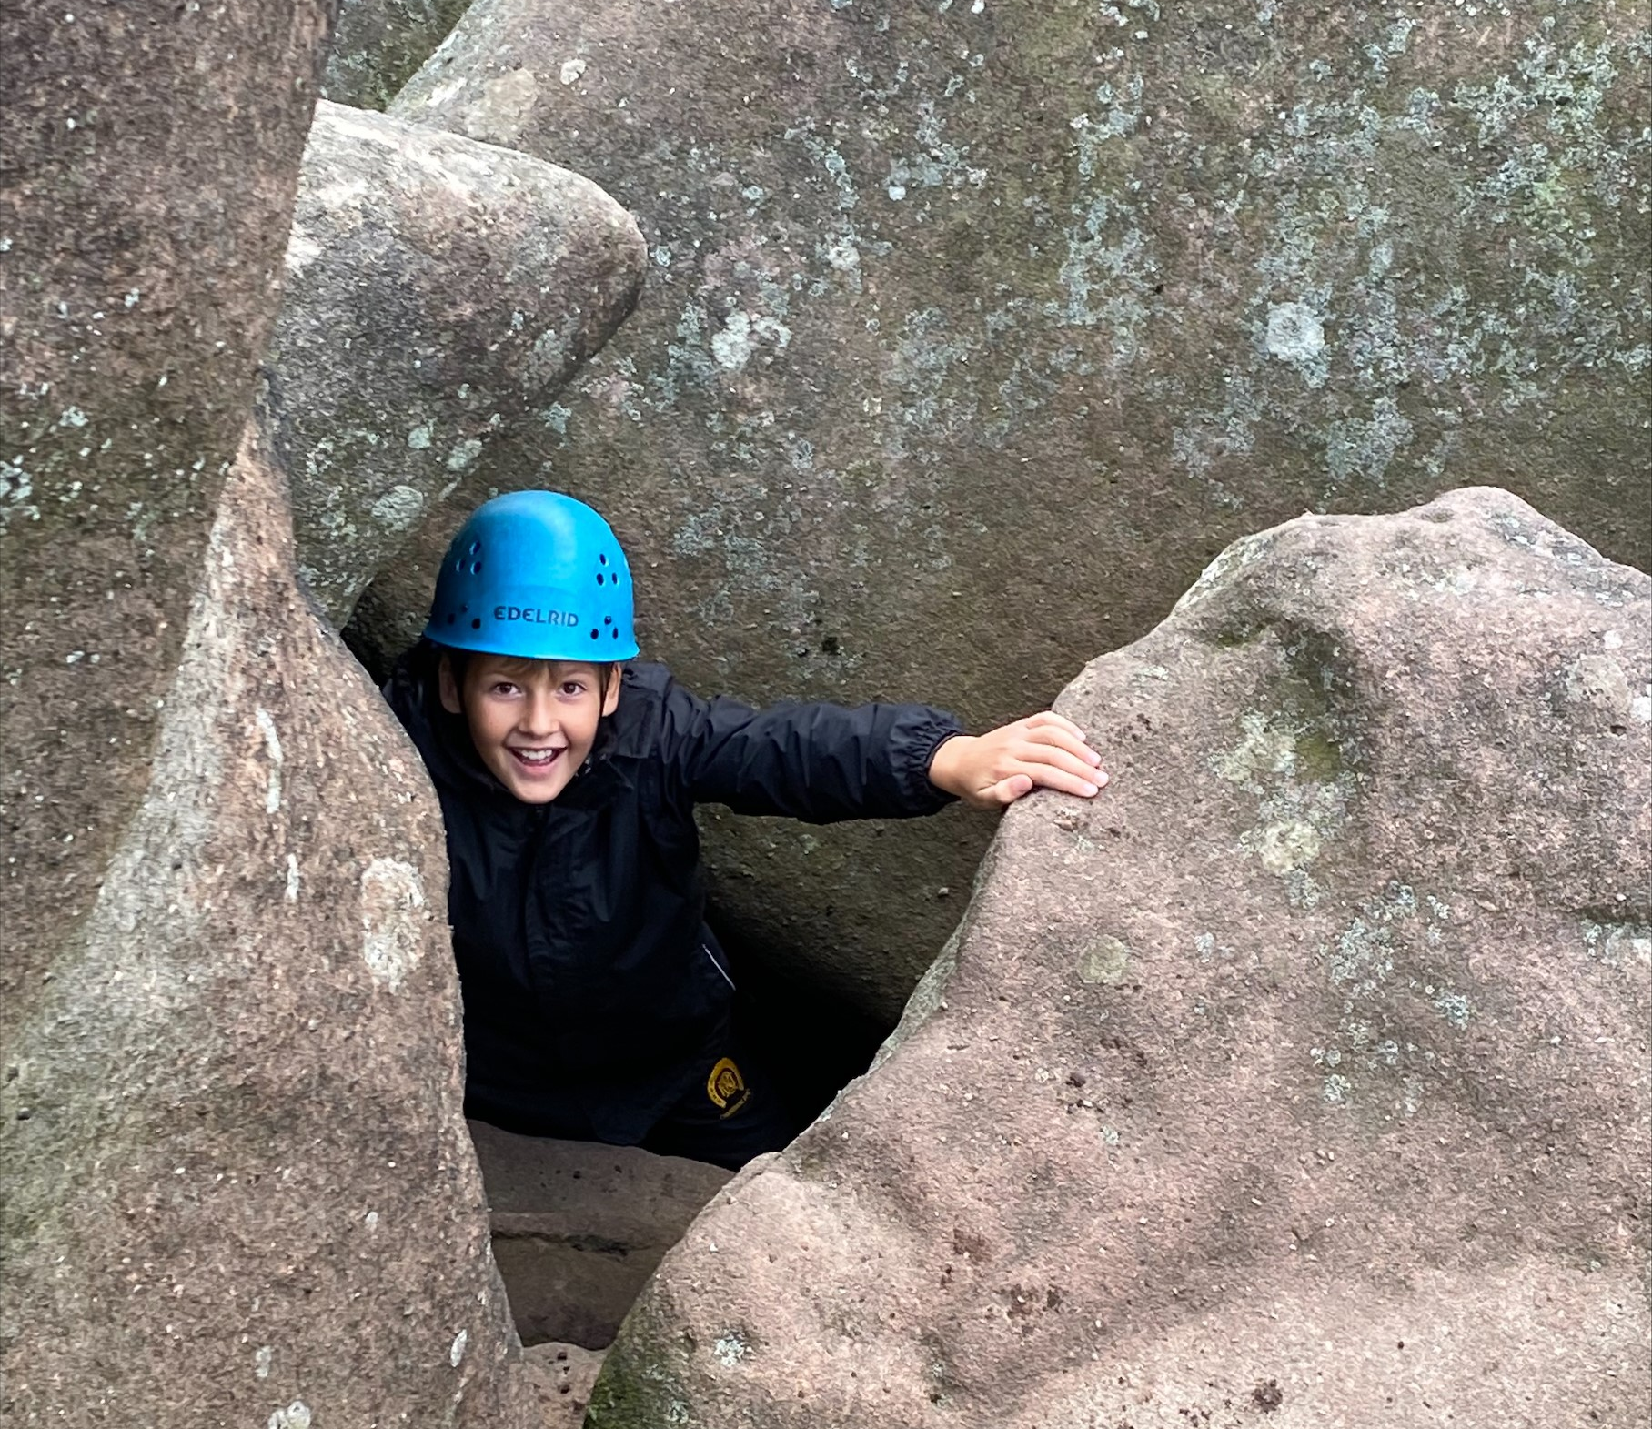
Rock Scrambling
There will be lots of fun challenges
The rocks will feel rough which will help you grip
My instructor will tell me where to go and what rocks to climb
If I don’t want to do something I can just tell my instructor

Slide 6
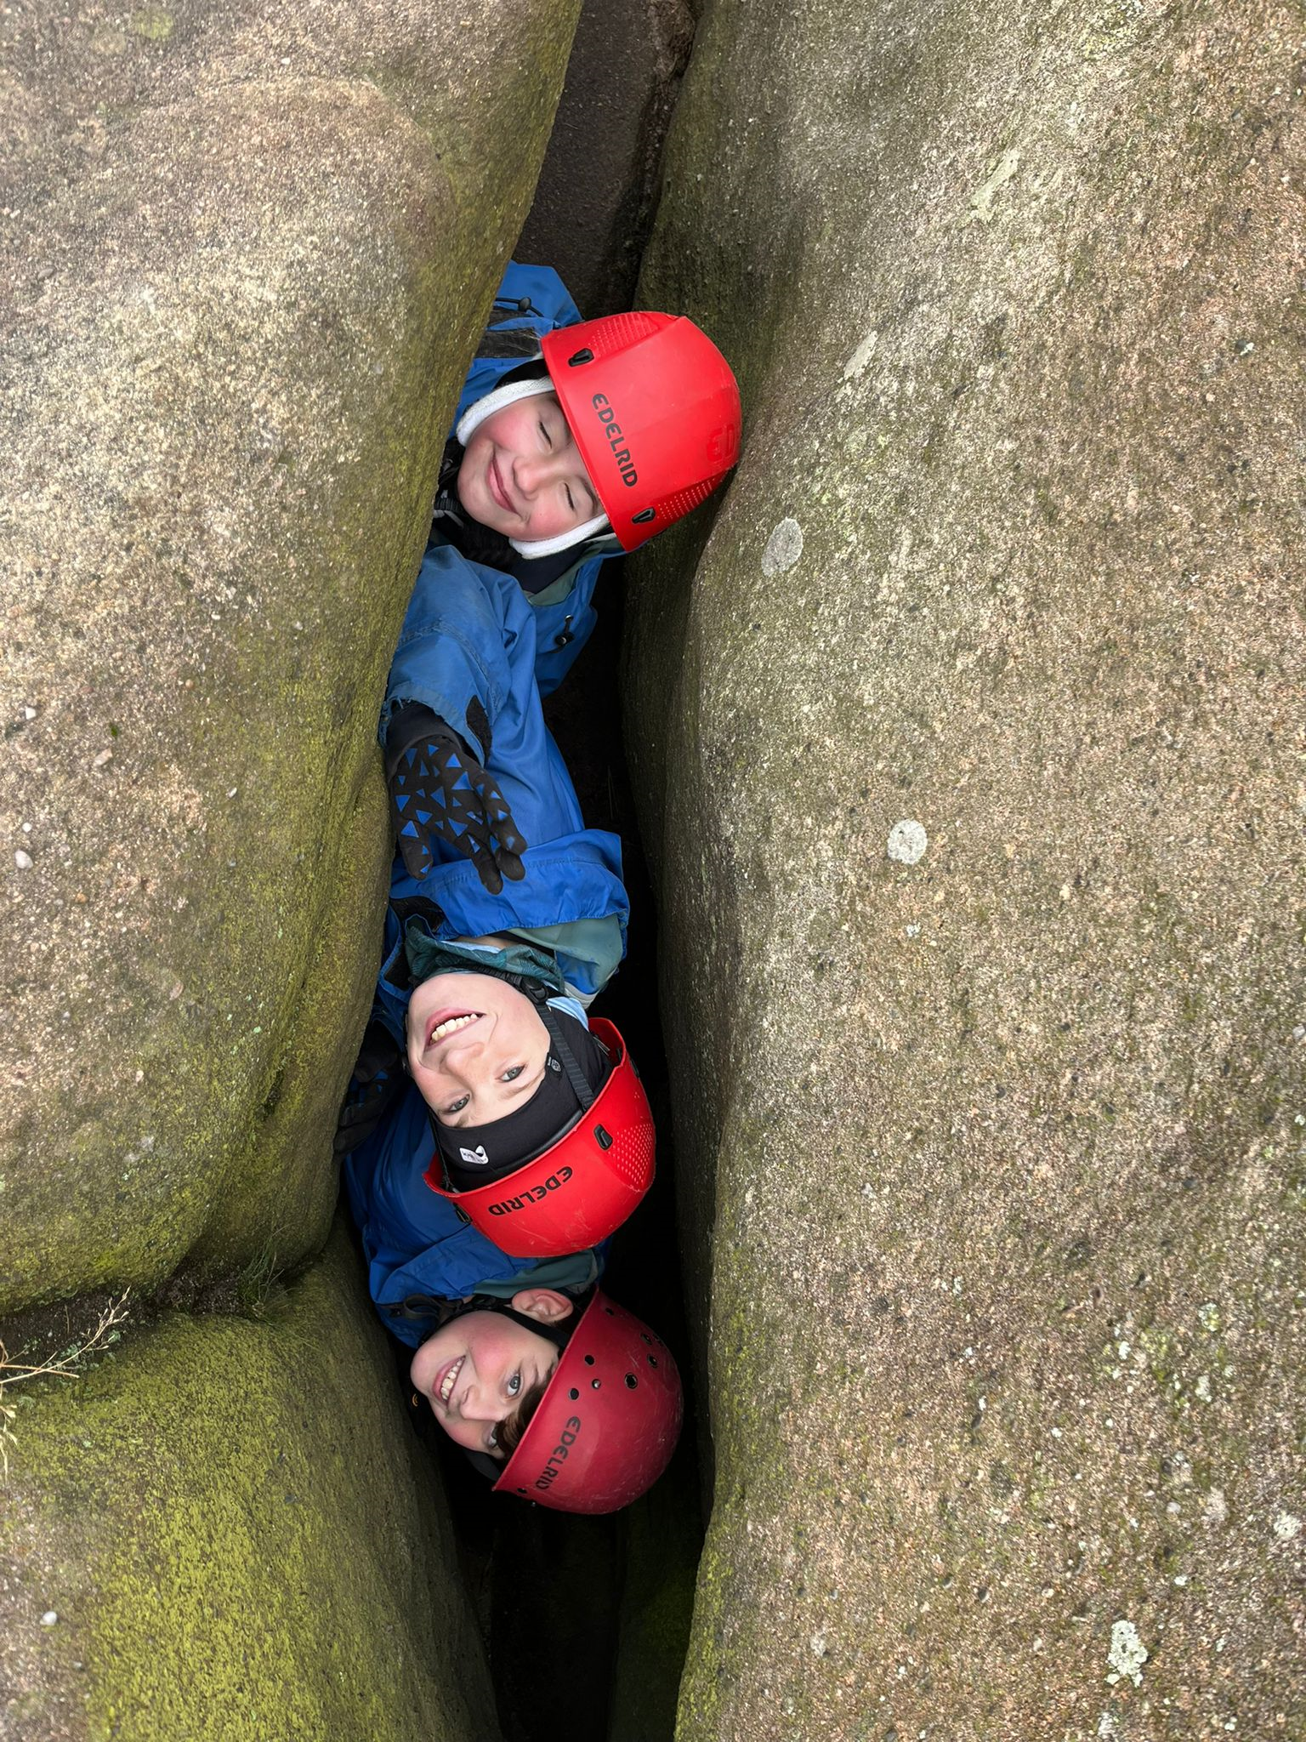
Rock Scrambling
Once we have finished the rock scramble we will head back to the mini-bus to drive back to White Hall
I should feel proud that I have completed the session

