Slide 1
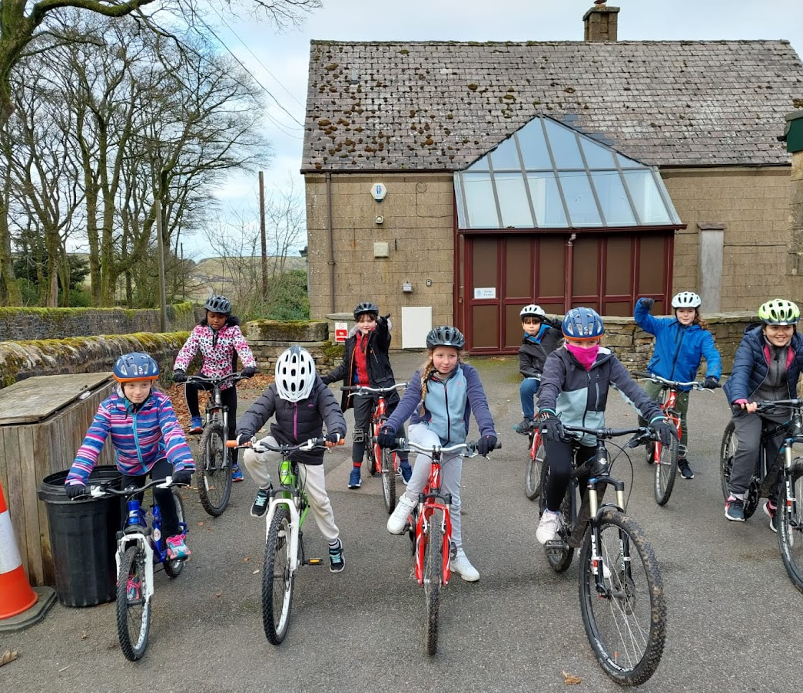
Mountain Biking

Slide 2
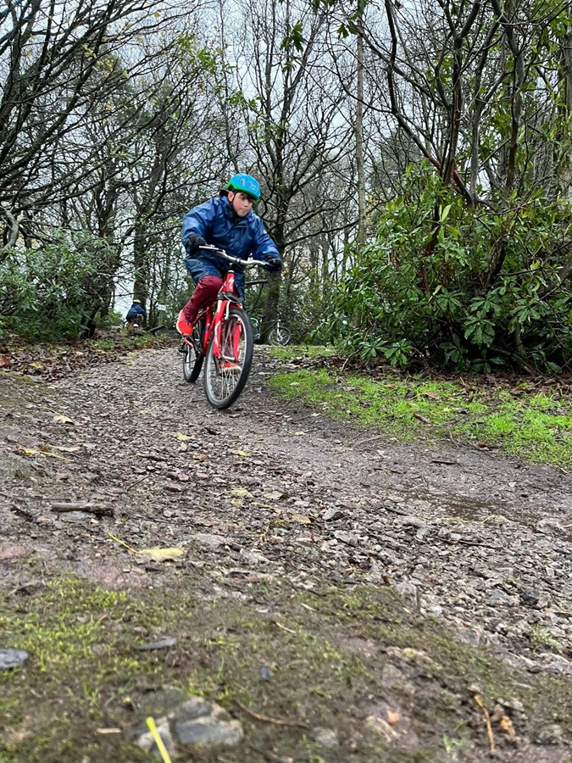
Mountain biking
I will borrow a helmet and biking gloves from White Hall
I will need to wear long sleeves and trousers to protect me
The Helmet and gloves may feel tight, this is to keep me safe

Slide 3
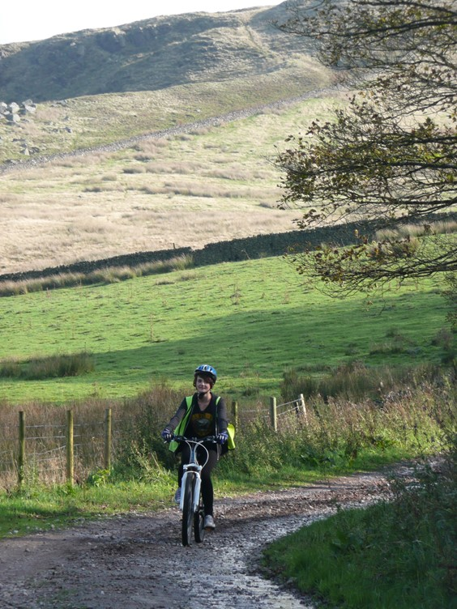
Mountain Biking
Before I go on the mountain bike I will have to listen carefully to my instructor
If I have any questions, I can ask my instructor

Slide 4
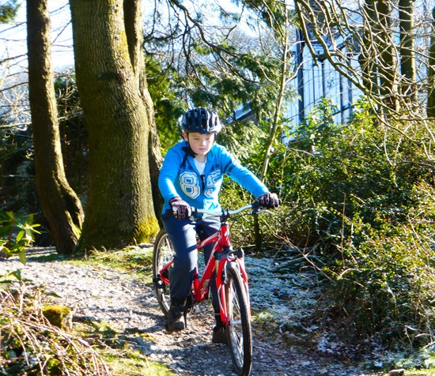
Mountain biking
My group will start by riding on flat ground so that we can practice on the bikes
We might then go onto the bike track which is a bit bumpier. My instructor will make sure I know what to do and that I am safe

Slide 5
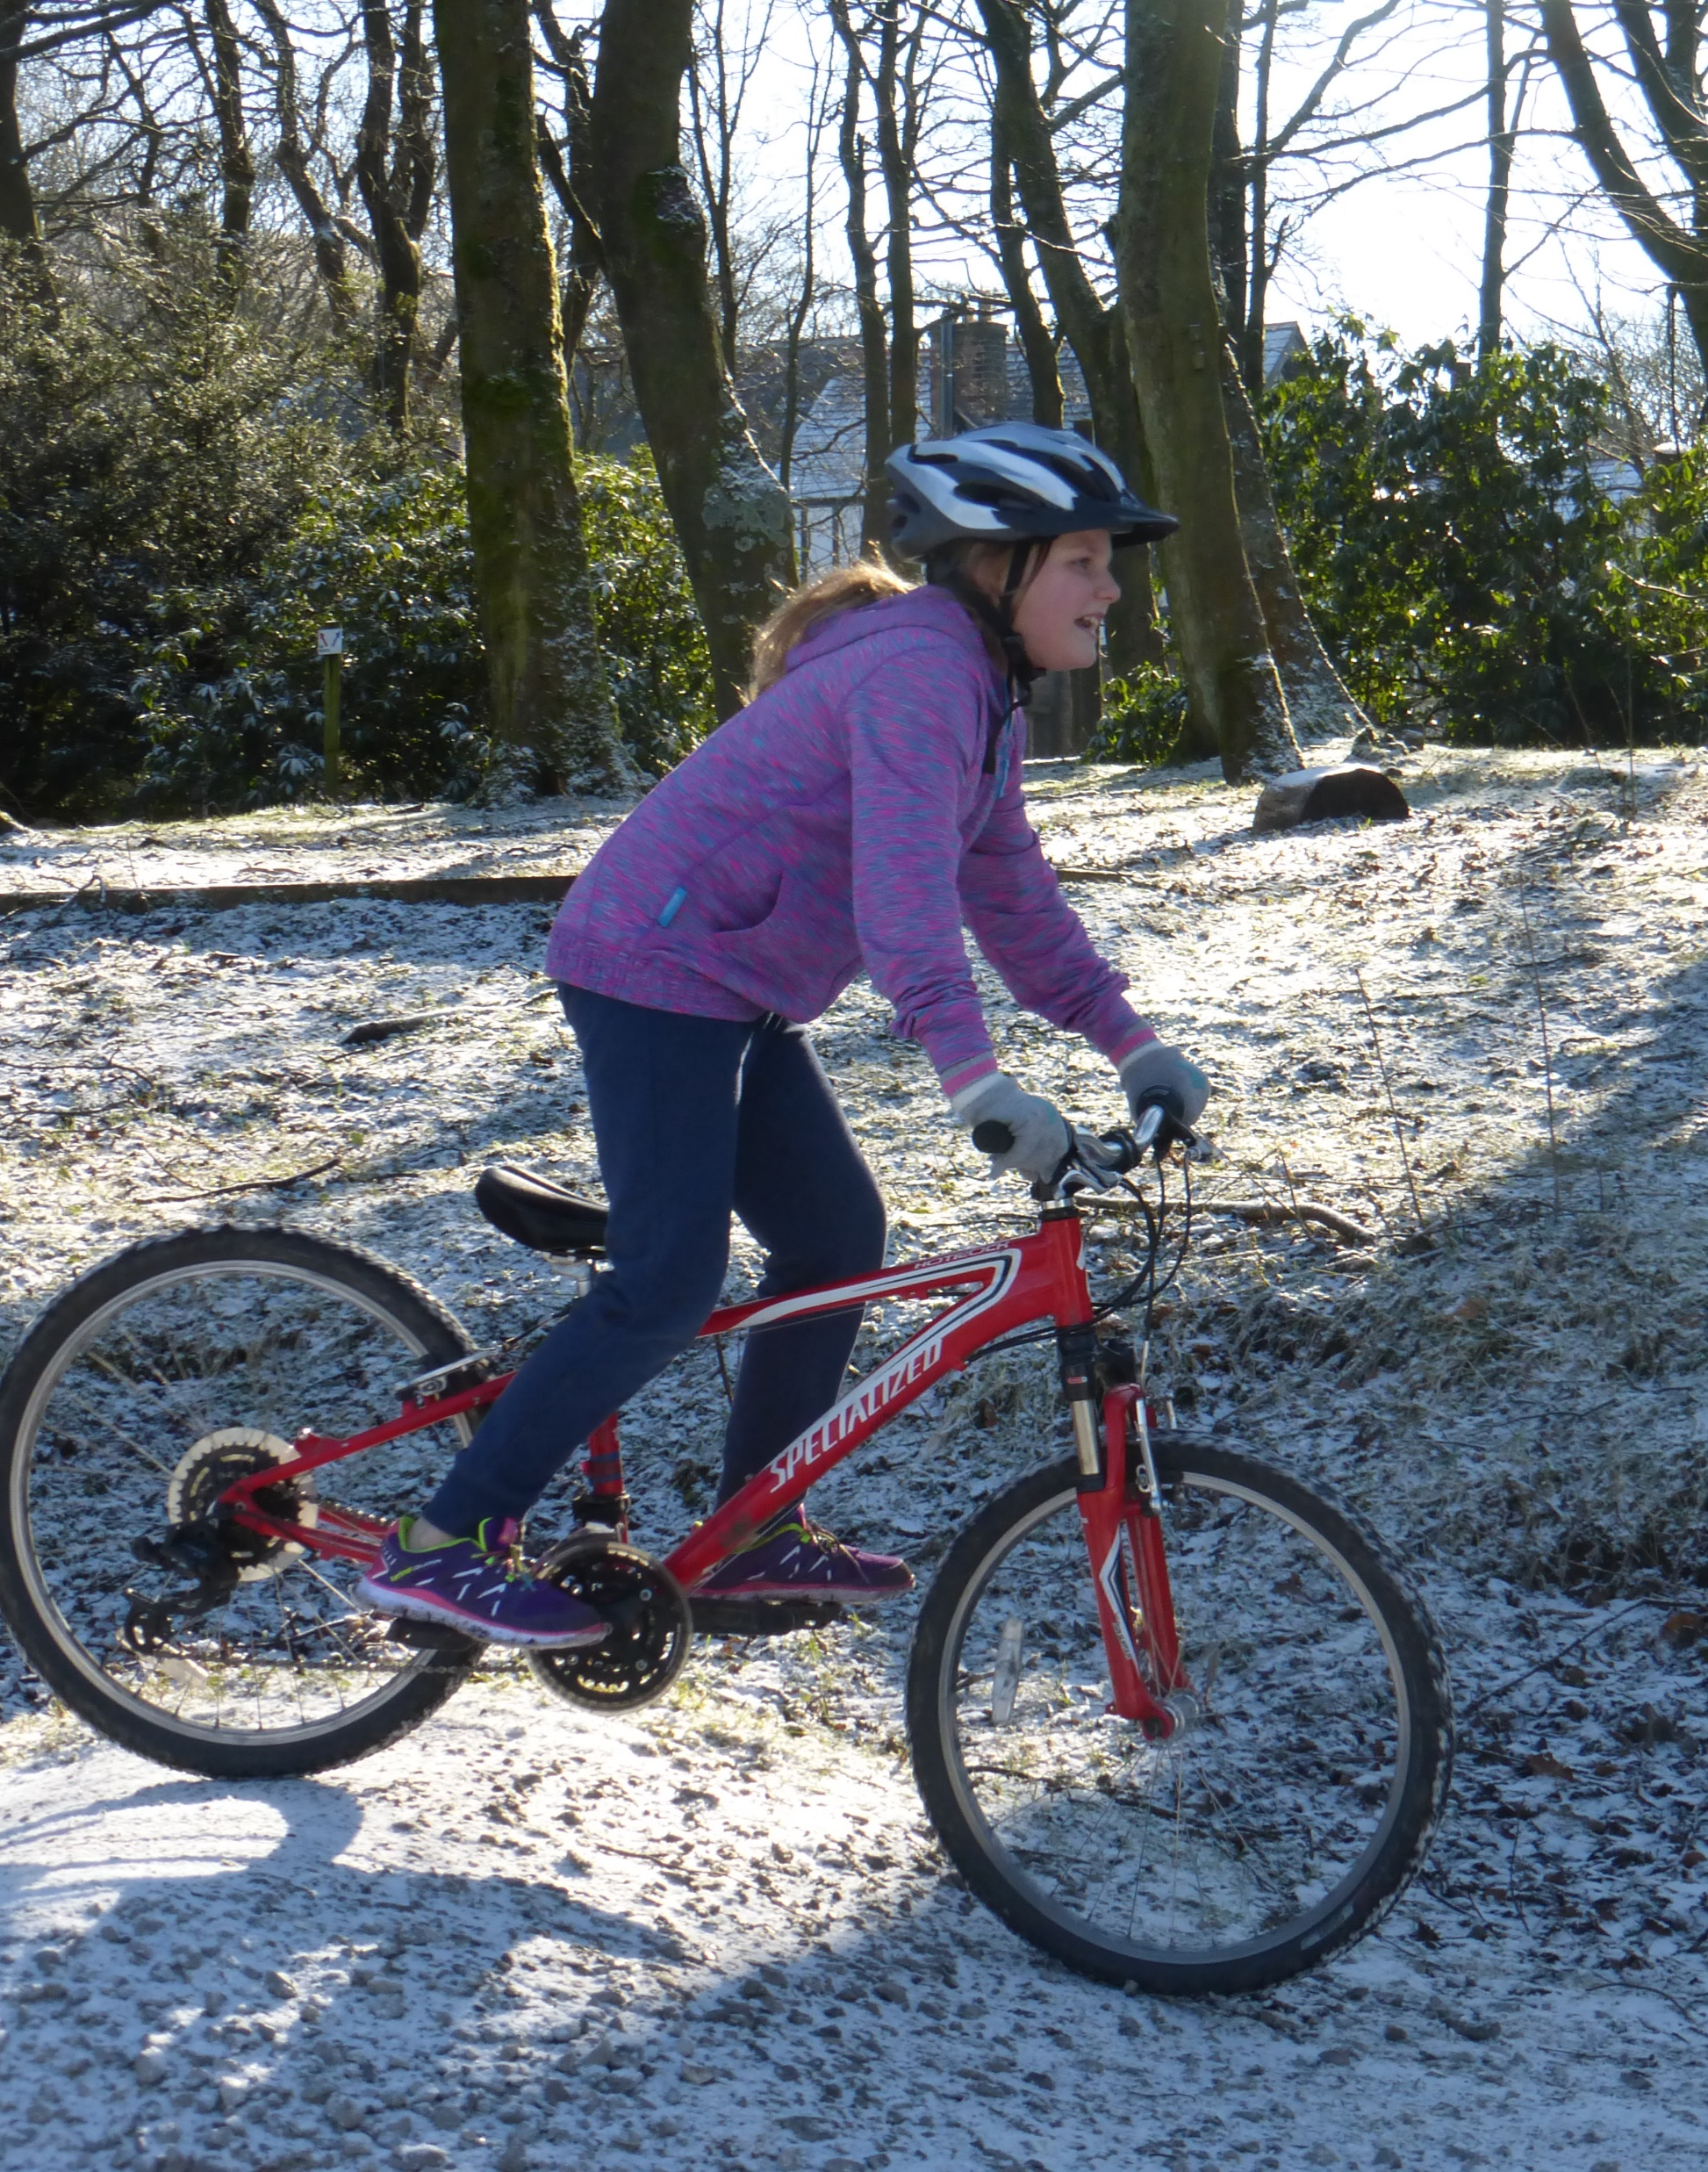
Mountain Biking
Riding a bike can be hard, if I start to feel tired I can ask to have a break
I may want to bring a drinks bottle out with me and put it close by
If I'm worried about anything, then I can always tell my instructor so they can help me.

Slide 6
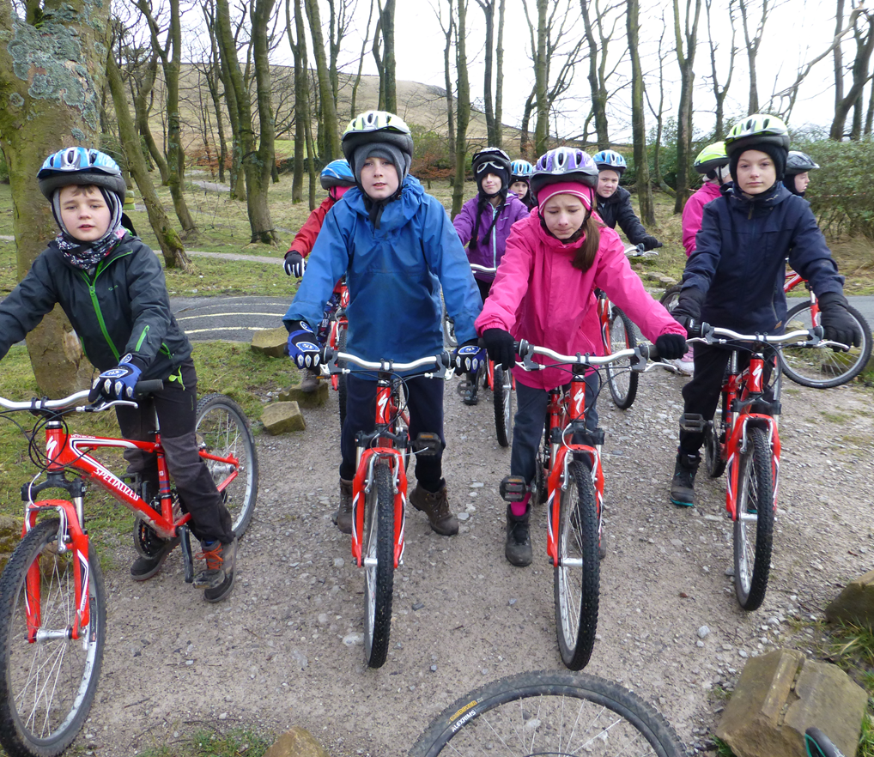
Mountain biking
I should feel proud that I have completed the session

