Slide 1
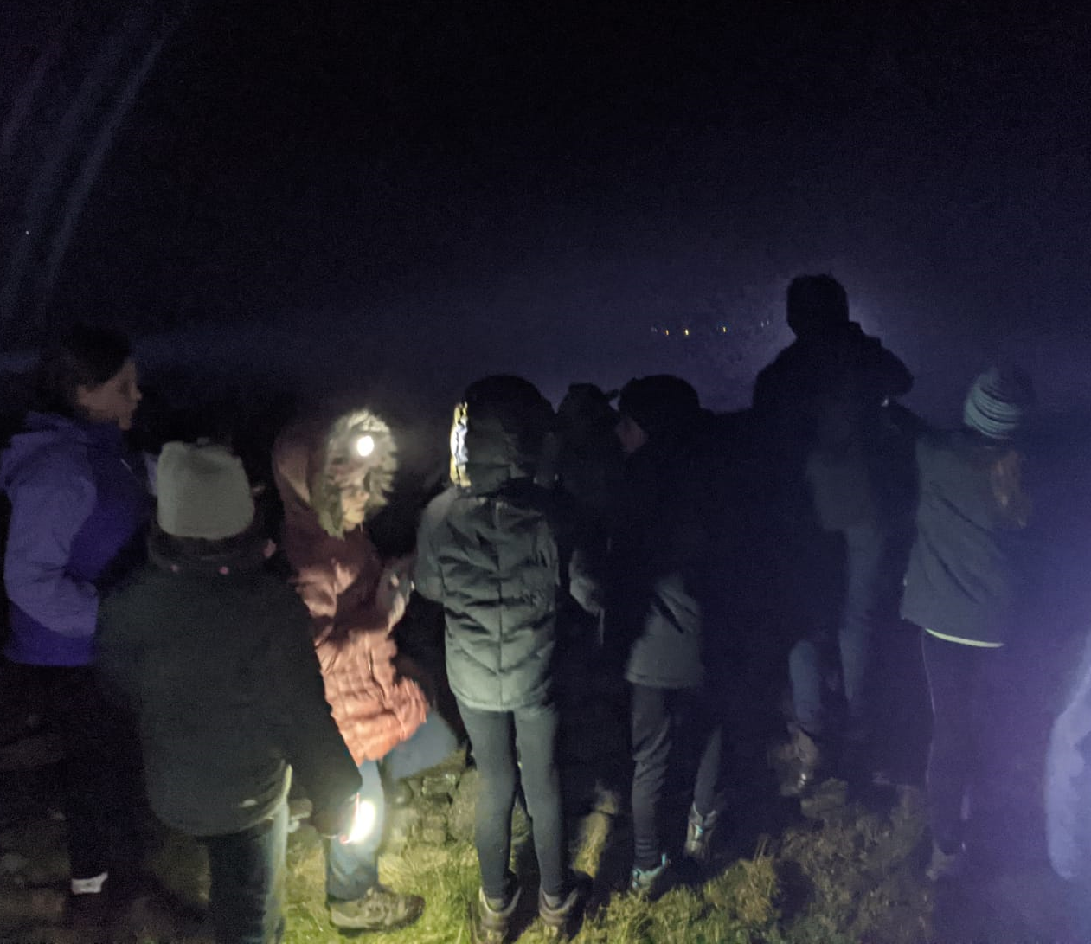
Night Hike

Slide 2
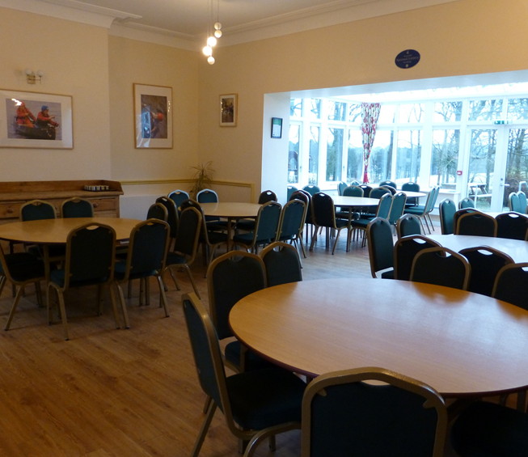
Night Hike
We’ll leave for our night hike after we’ve finished the evening meal
I’ll be told what to wear and I’ll have time to get myself ready
I’ll be told what time to meet for the walk. I need to make sure I’m listening

Slide 3
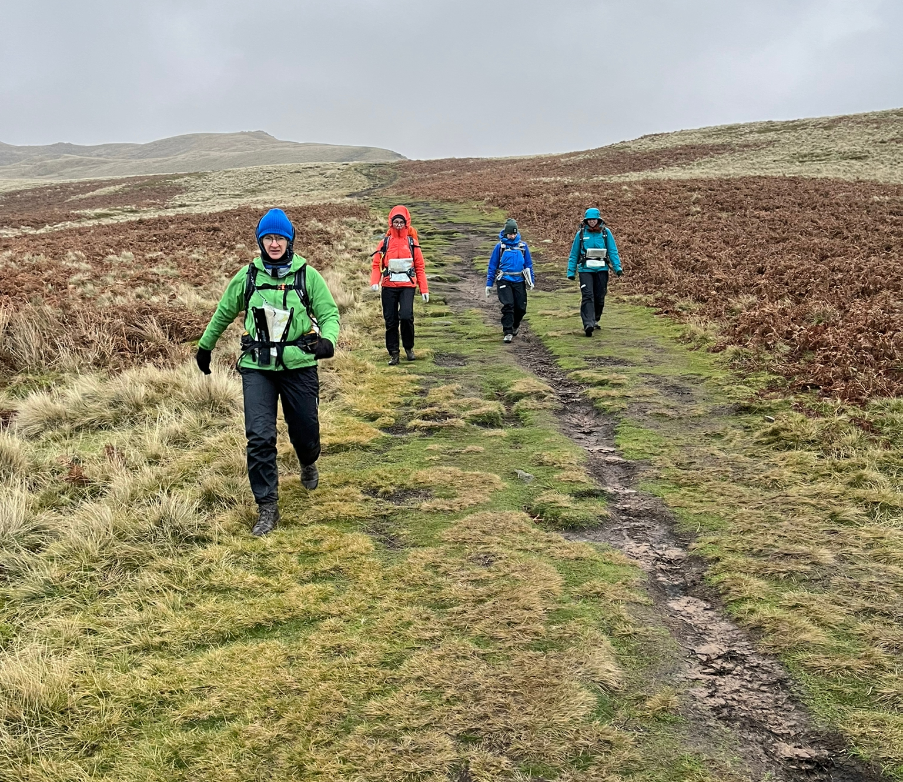
Night Hike
If it’s cold, I’ll need to wrap up warm. I might need to wear waterproofs
If it’s dark, I should take a torch
I should wear walking boots or good trainers. My instructor will tell me if my shoes are ok

Slide 4
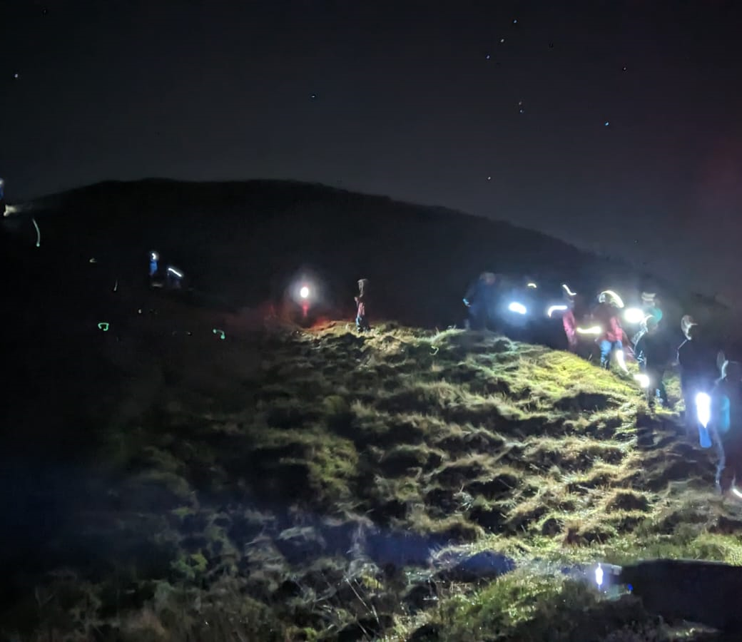
Night Hike
Everyone’s torches might be quite bright. I can tell the people in my group if I don’t like them shining their torch on me
I will have an adult with my group the whole time. I’ll never be on my own

Slide 5
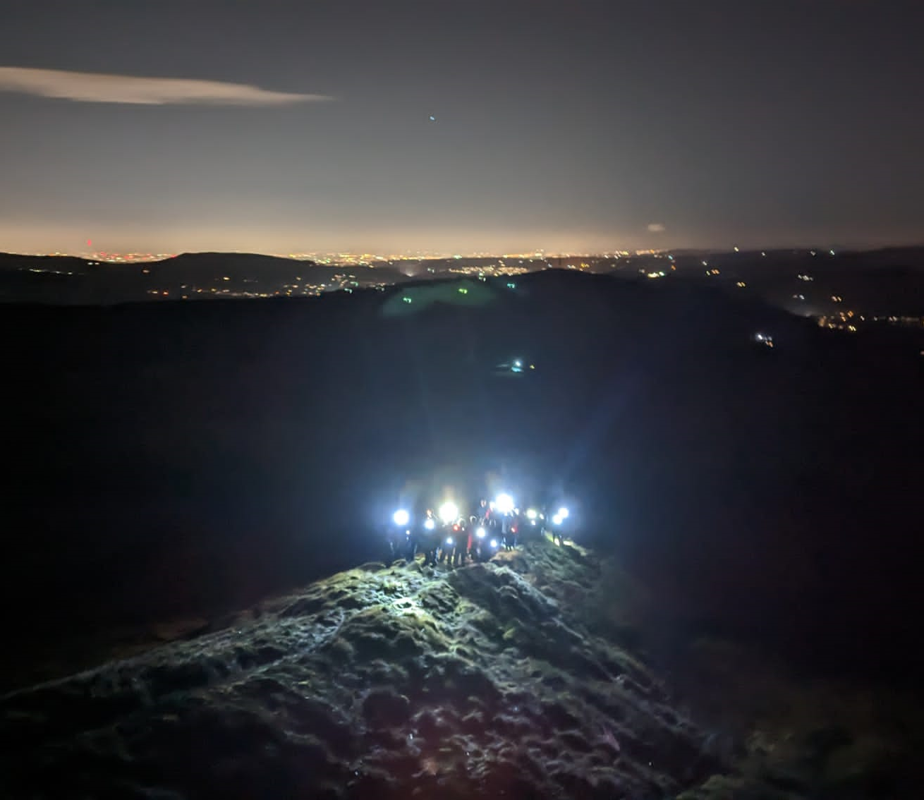
Night Hike
I will probably see some nice views from the walk, and I might hear or see some wildlife
The walk may be hard work, but I should be proud that I’ve completed it

