Slide 1
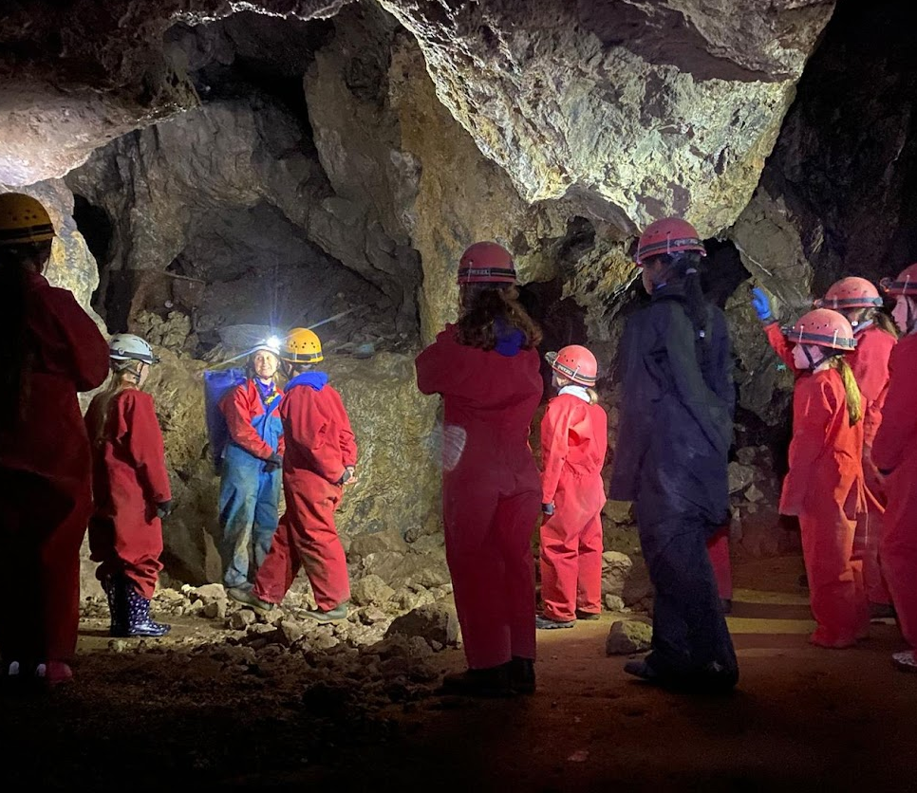
Caving

Slide 2
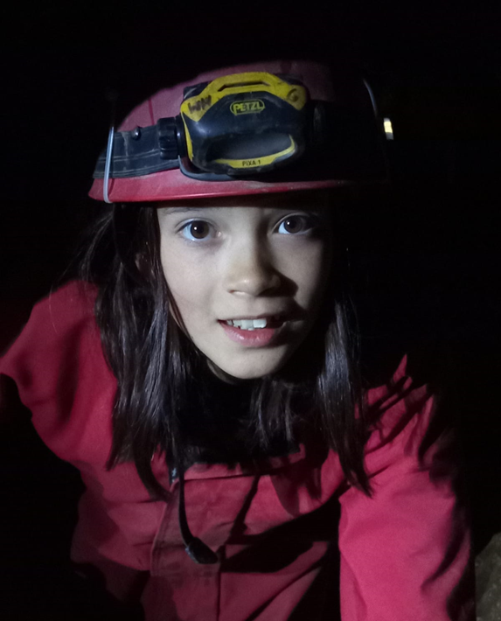
Caving
I will wear a helmet with a light on it
I’ll also wear a caving suit and some wellies which will protect me and my clothing

Slide 3
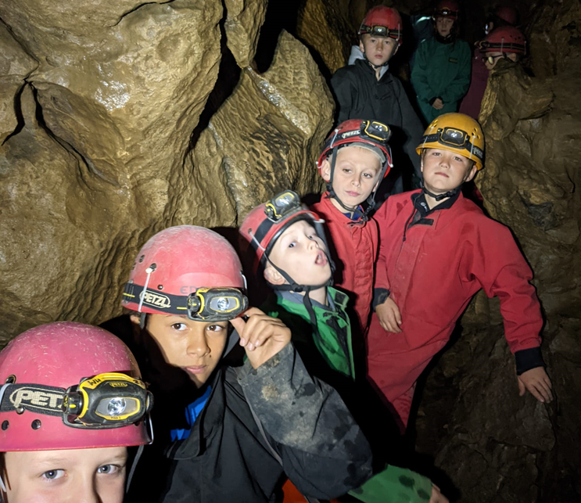
Caving
I will have to get onto a mini-bus to travel to the cave. It might take up to 40 minutes depending on which cave we go to
I will have to make sure my seat belt is on

Slide 4
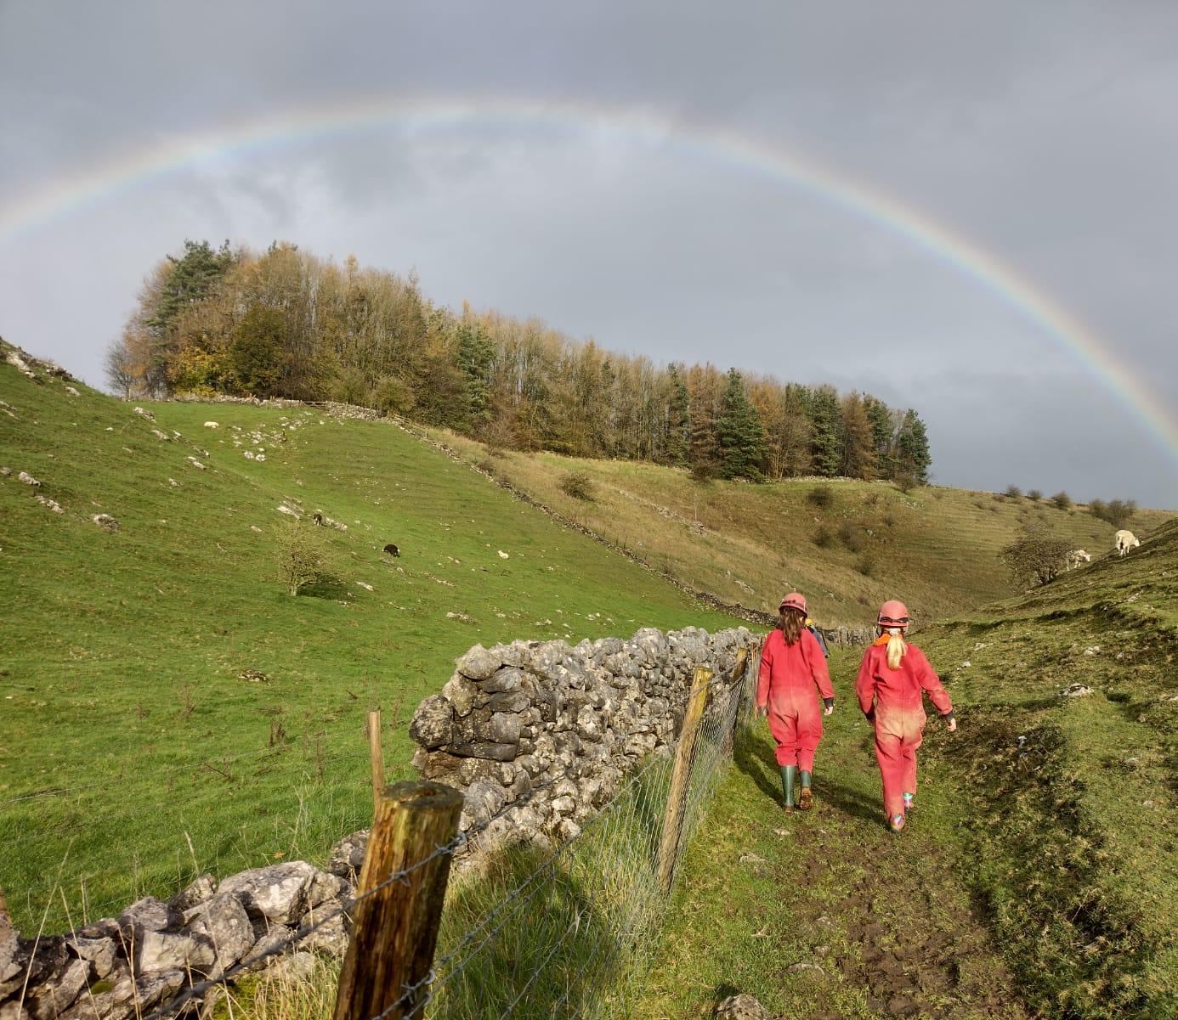
Caving
We may have to cross a busy road to get to the cave. I will have to listen carefully to my instructor
We will then need to walk to the cave entrance which might take around 10 minutes
Once we have arrived at the cave I will need to listen to the instructions

Slide 5
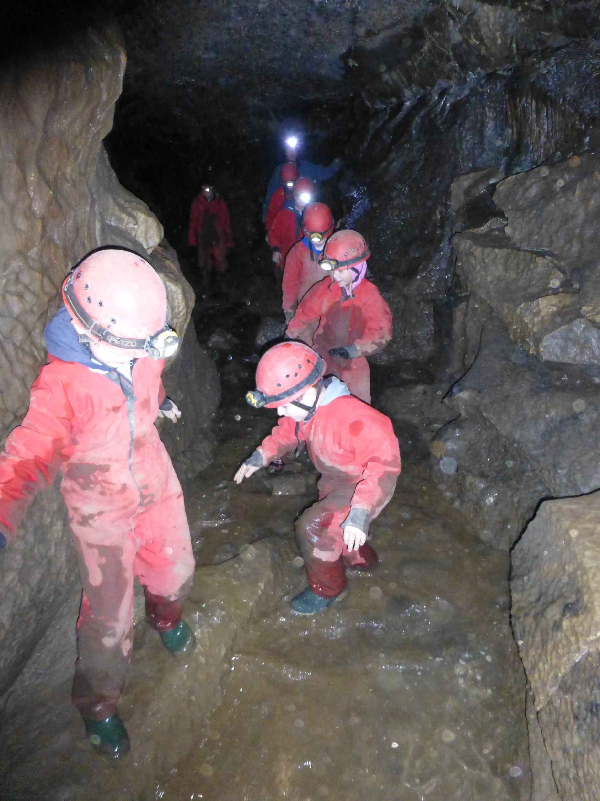
Caving
When I go into the cave it might feel cold but if I keep moving, I will stay warm
It might be a bit wet and muddy, but the cave suit and wellies will keep my clothes clean
I might be nervous about going through small spaces, but I don’t have to do all of the small challenges. I can go around the ones I don’t like
If I start to feel nervous, I can always ask for help

Slide 6
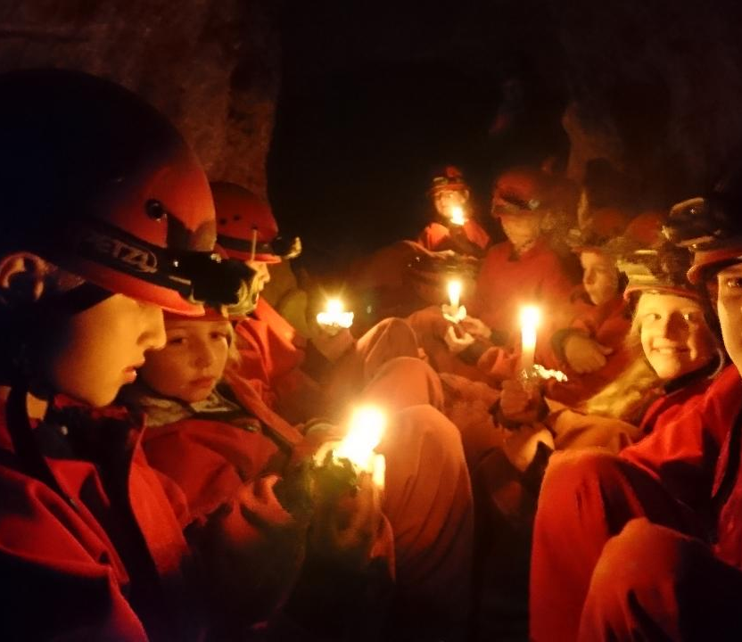
Caving
We might get a chance to turn our torches off, to experience the dark
We might light candles
If I have any caving questions, I can ask my instructor
When it is time to leave the cave, we will have to walk back to the bus

Slide 7
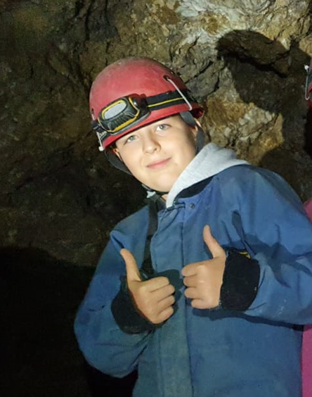
Caving
Once we have finished caving we will travel back to White Hall
I should feel proud that I have completed the session

