Slide 1
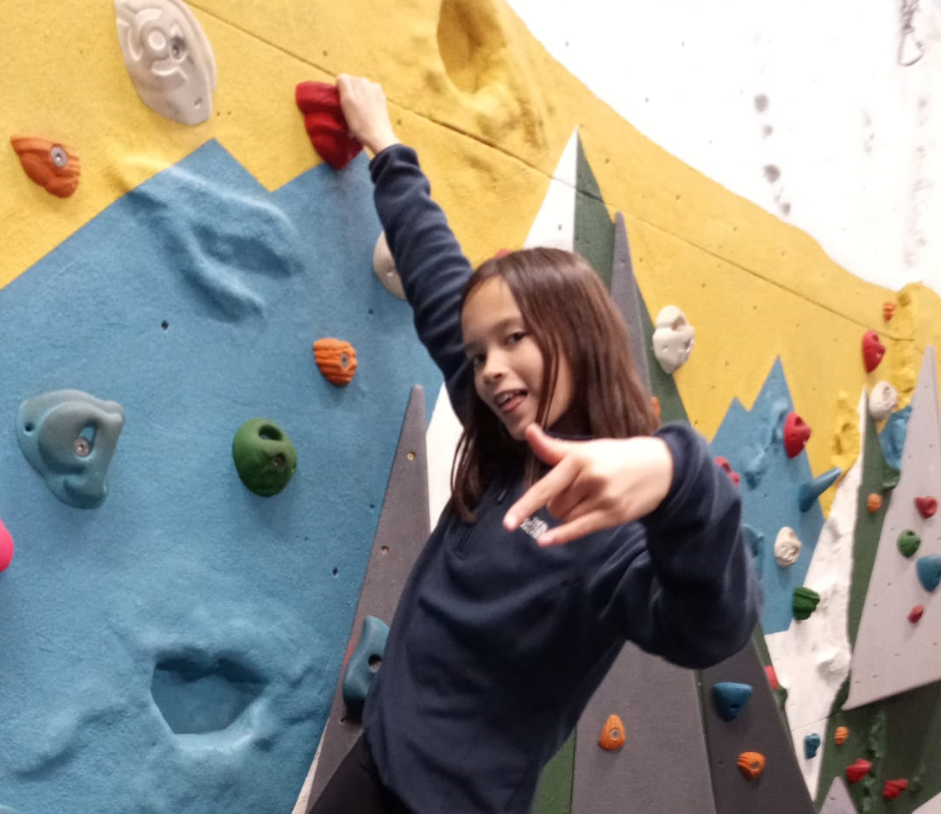
Climbing Wall

Slide 2
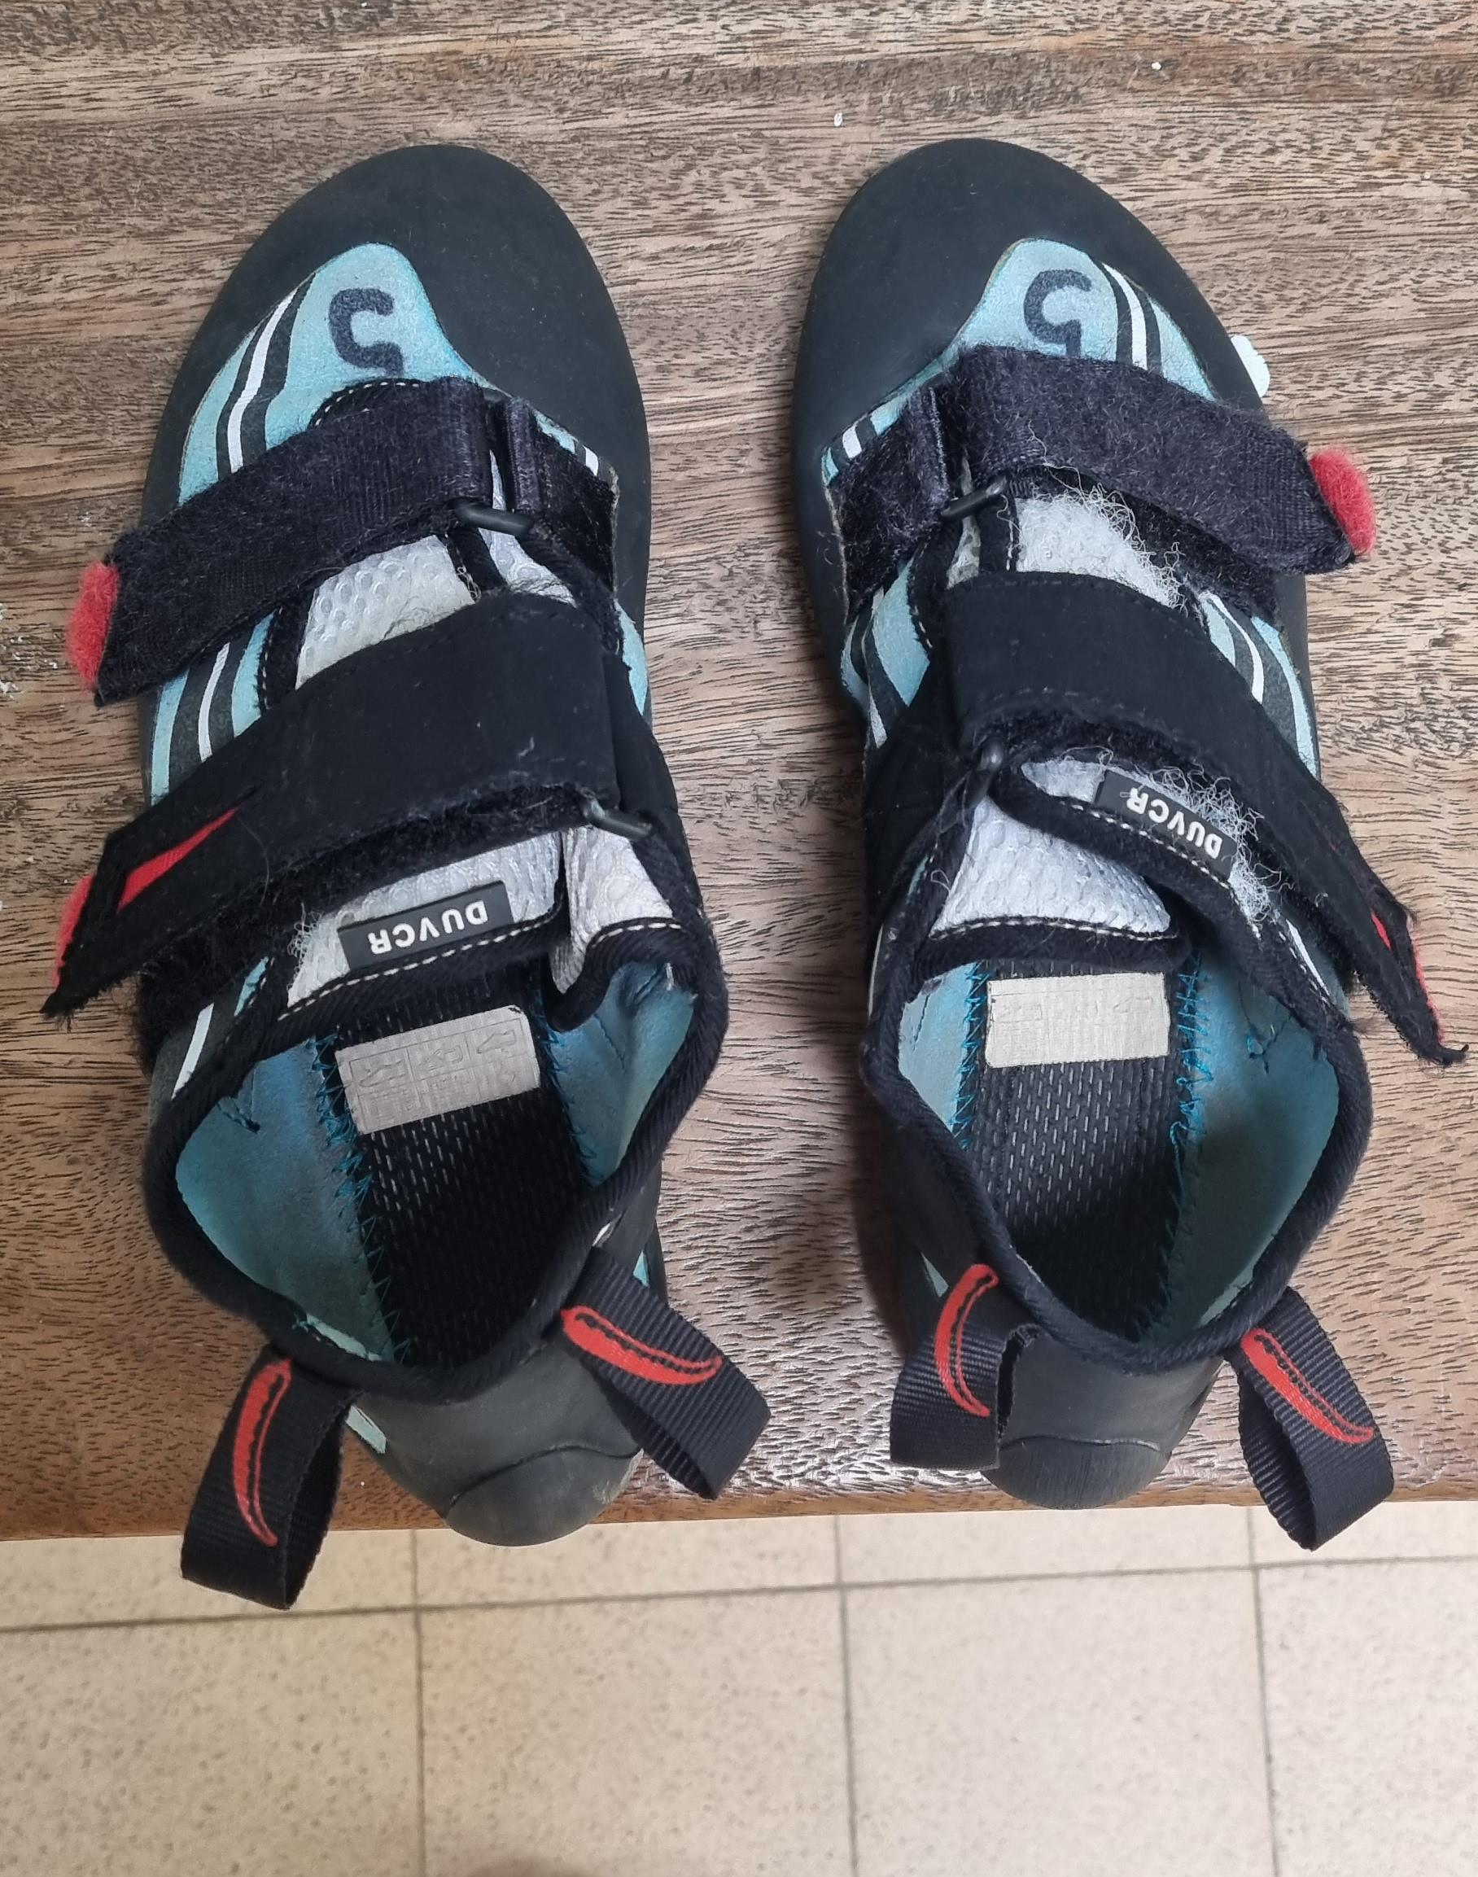
Climbing Wall
I may need to put on a pair of climbing shoes.
The climbing shoes may feel tight to make me climb better
The shoes might feel and smell different to trainers

Slide 3
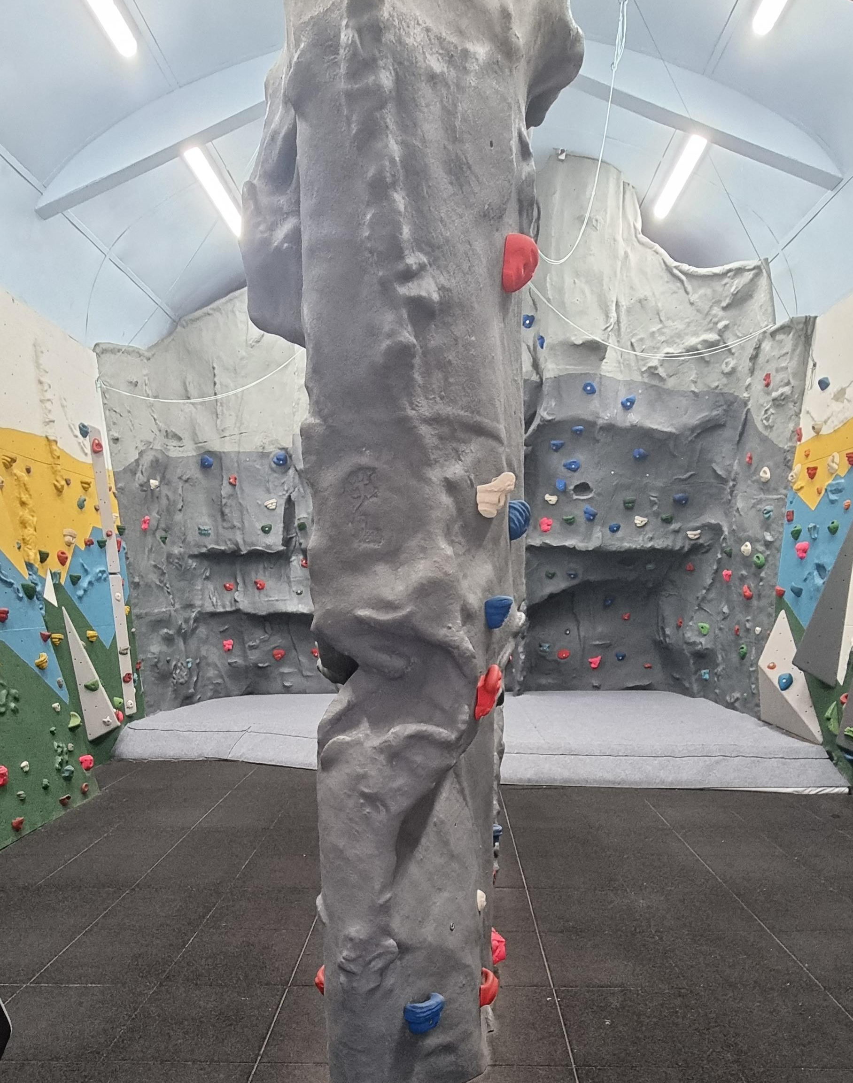
Climbing Wall
I will need to listen to the instructions to keep me safe
The climbing wall may smell different and feel a bit cold. I’ll soon warm up once I start climbing

Slide 4
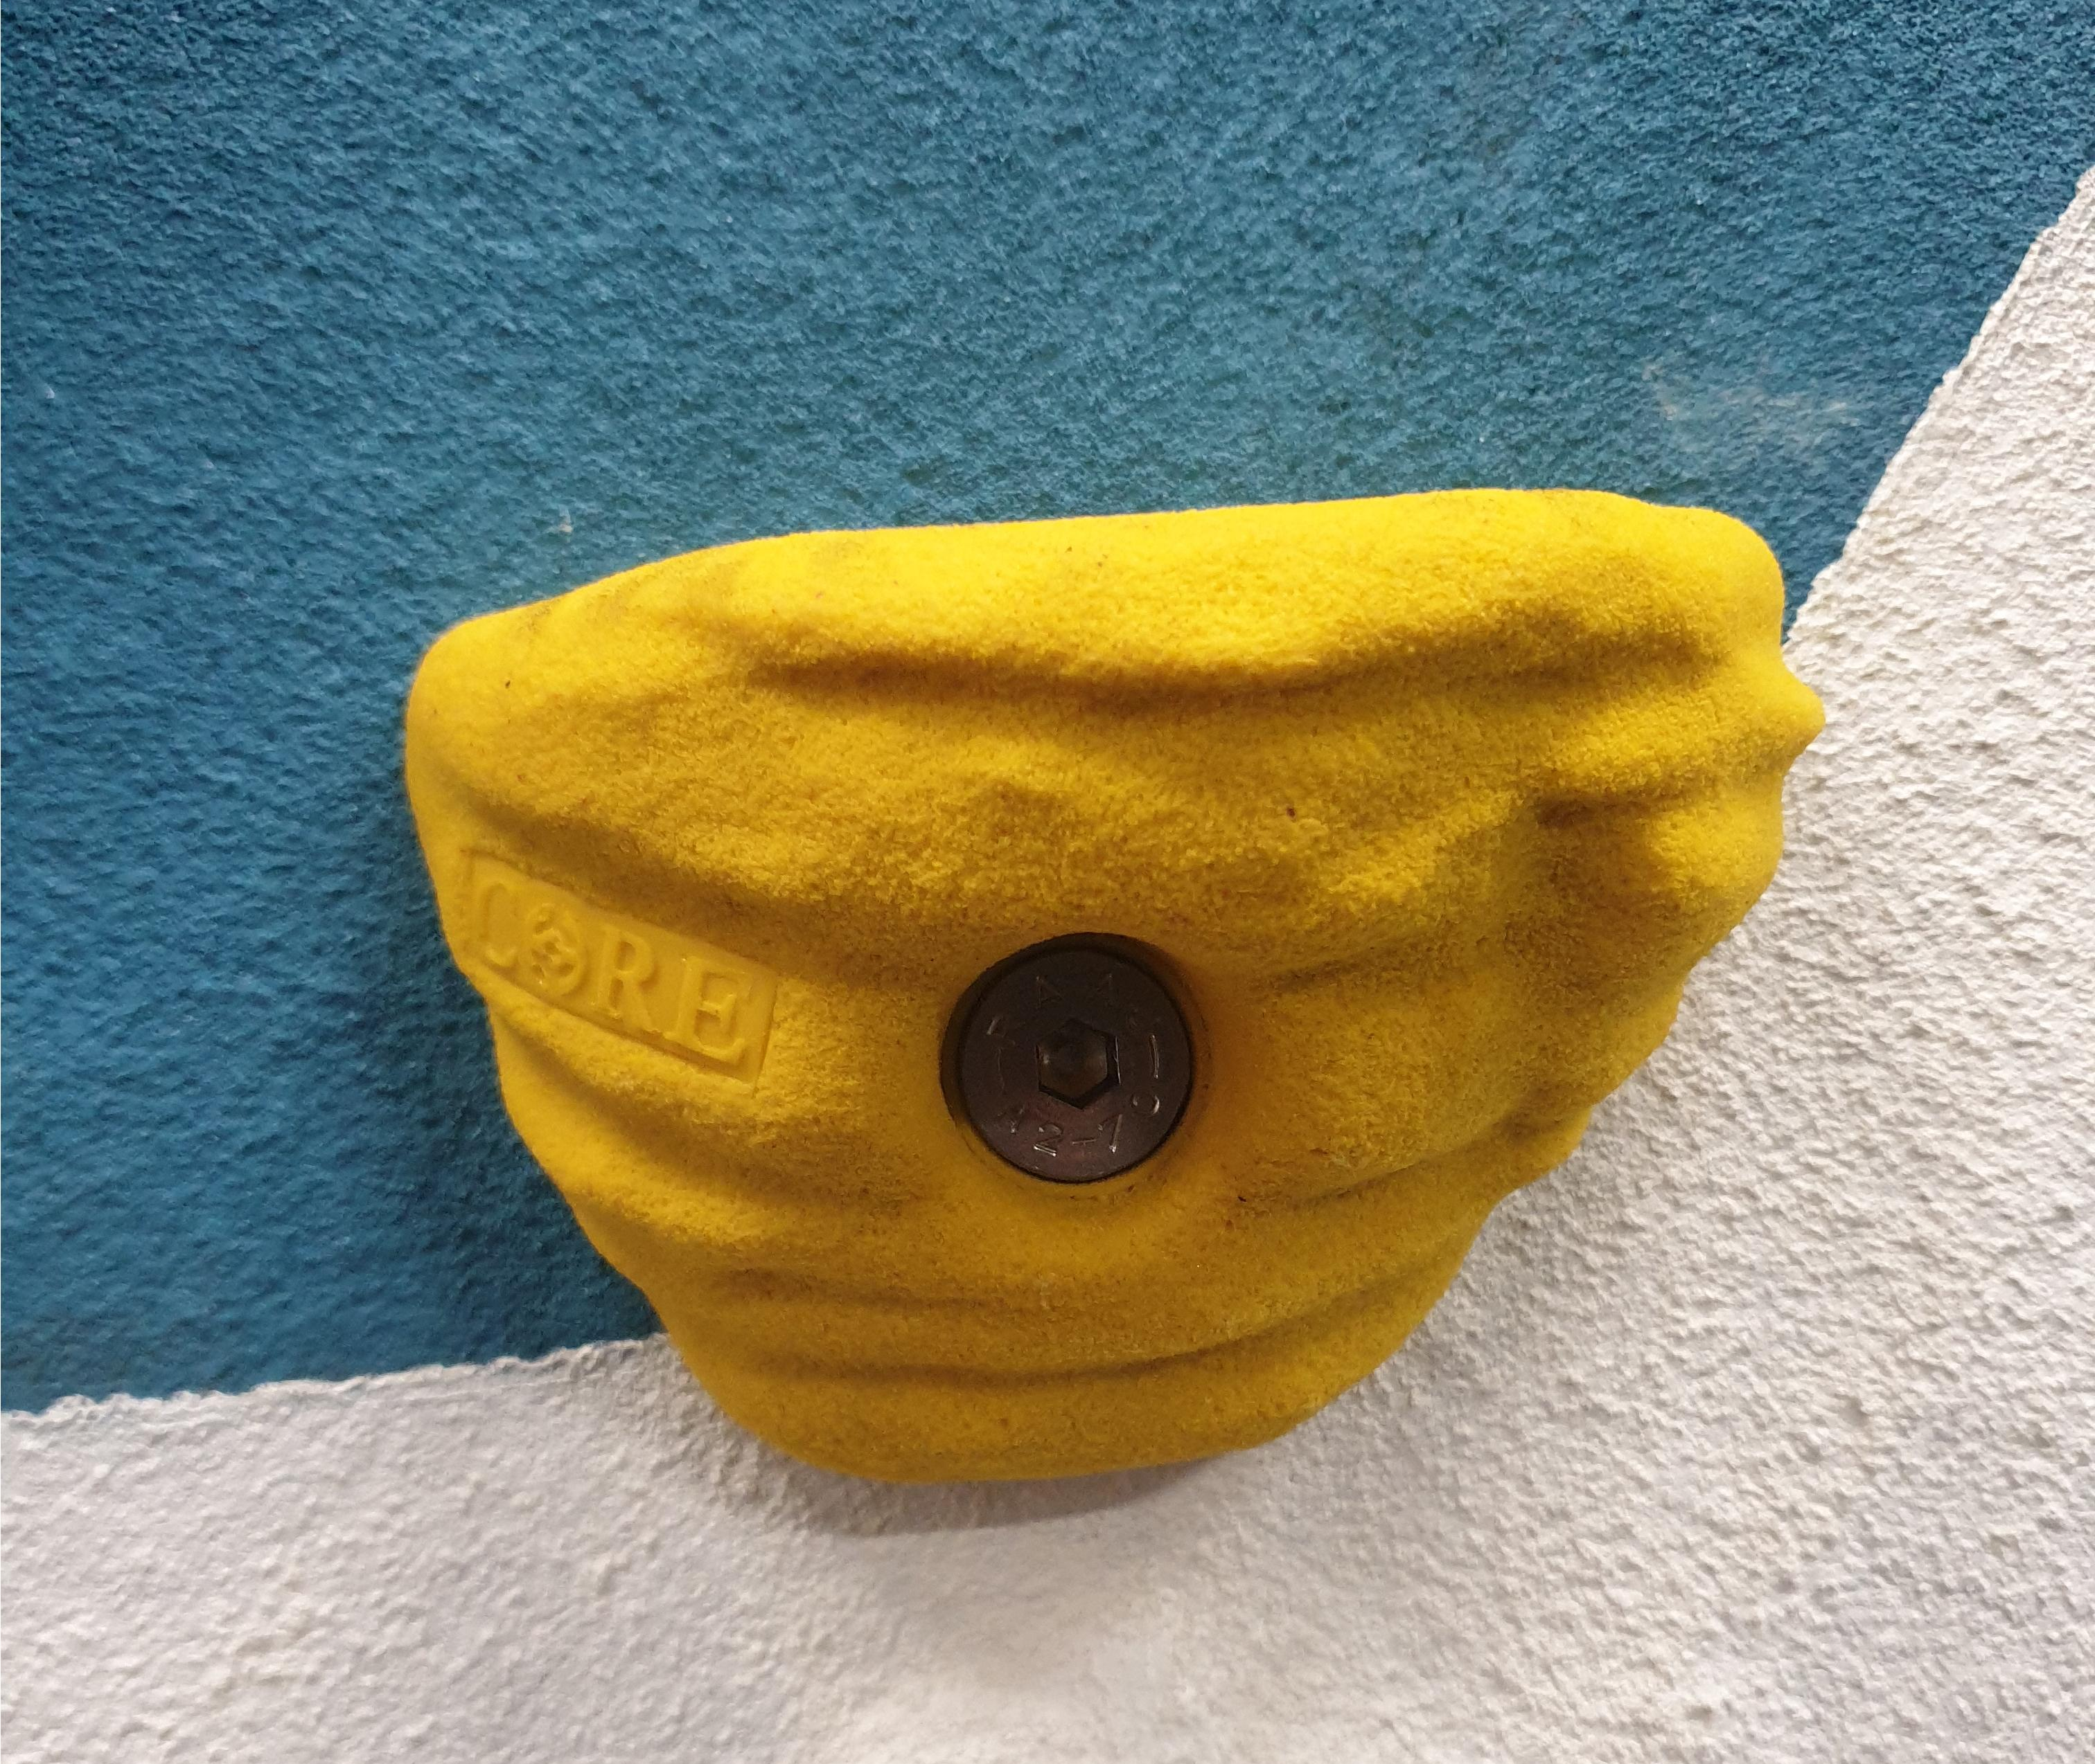
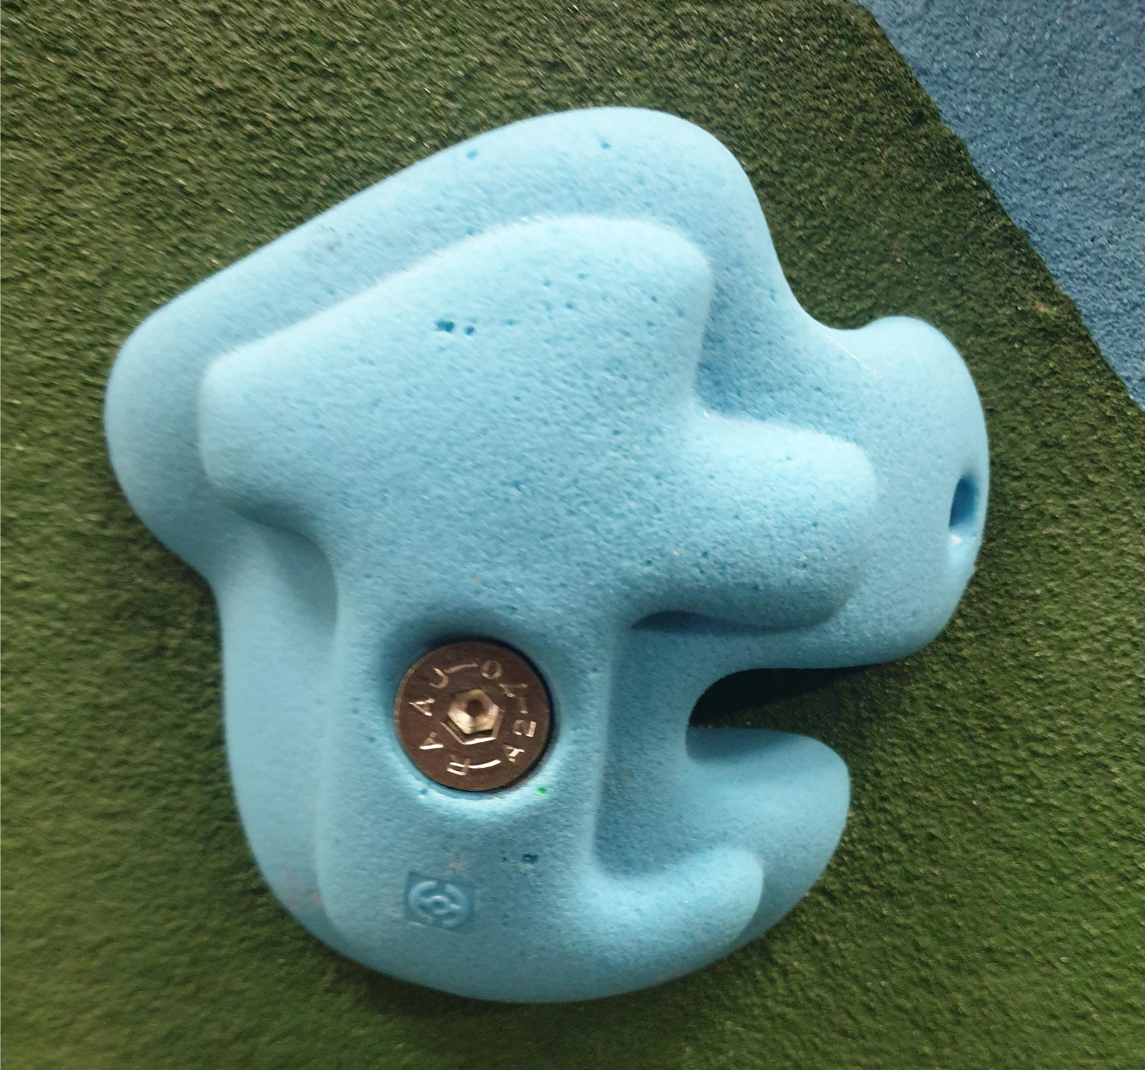
Climbing wall
In the climbing wall there are a lot of different colours on the walls and on the climbing holds
The climbing holds will feel rough which helps you have a good grip

Slide 5
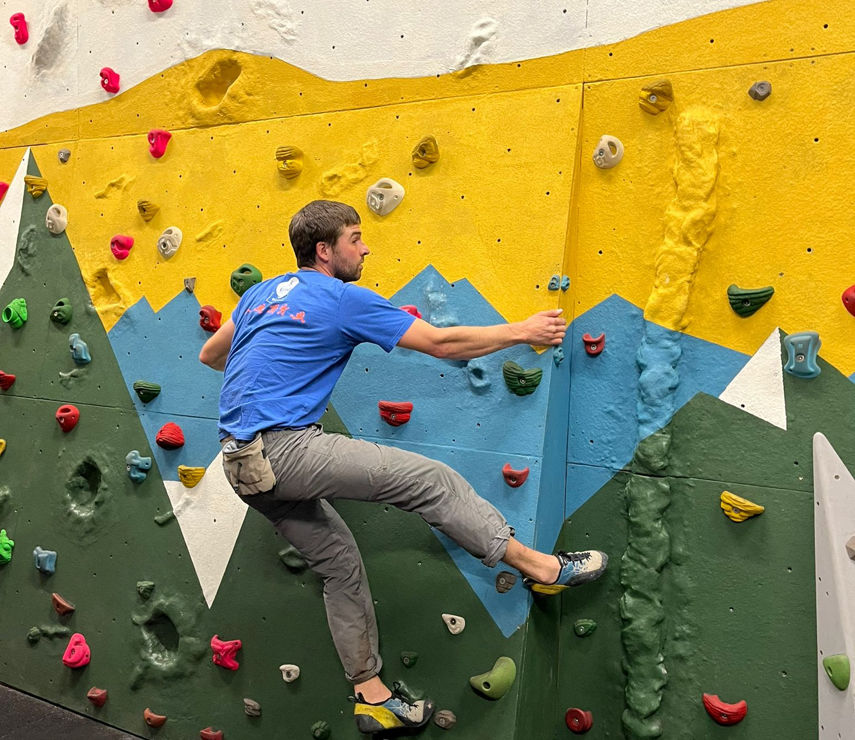
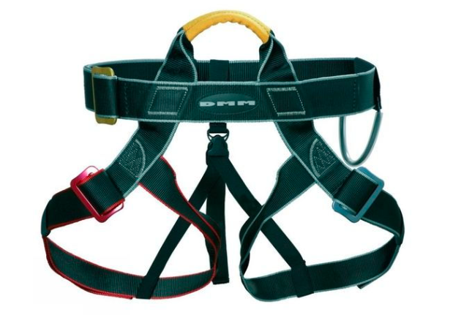
Climbing wall
The floor will be spongey this will keep me safe
I might climb on the low walls without any ropes, or we might put a harness on and climb on the big walls with a rope
In the climbing session I may play some games

Slide 6
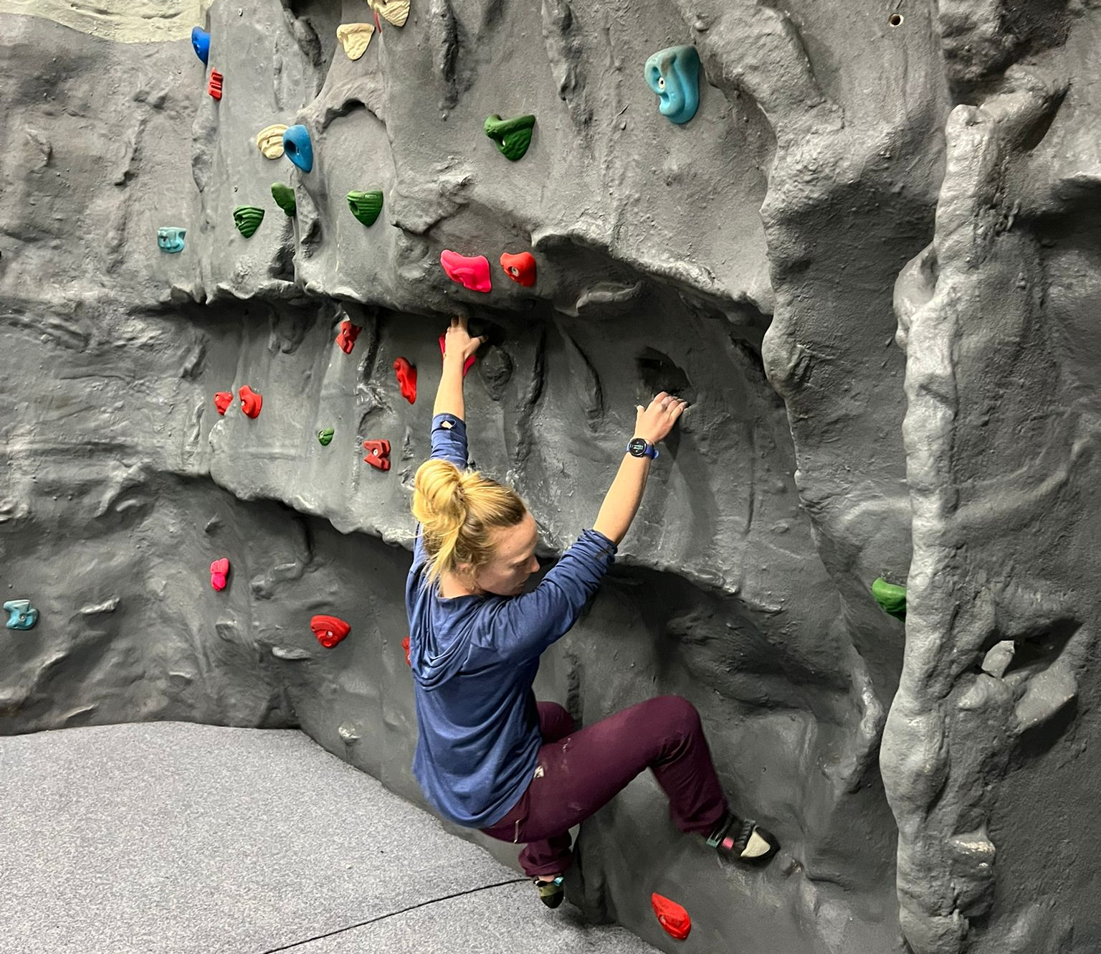
Climbing wall
Once we have finished the climbing wall we will put our climbing shoes away
I should feel proud that I have completed the session

