Slide 1
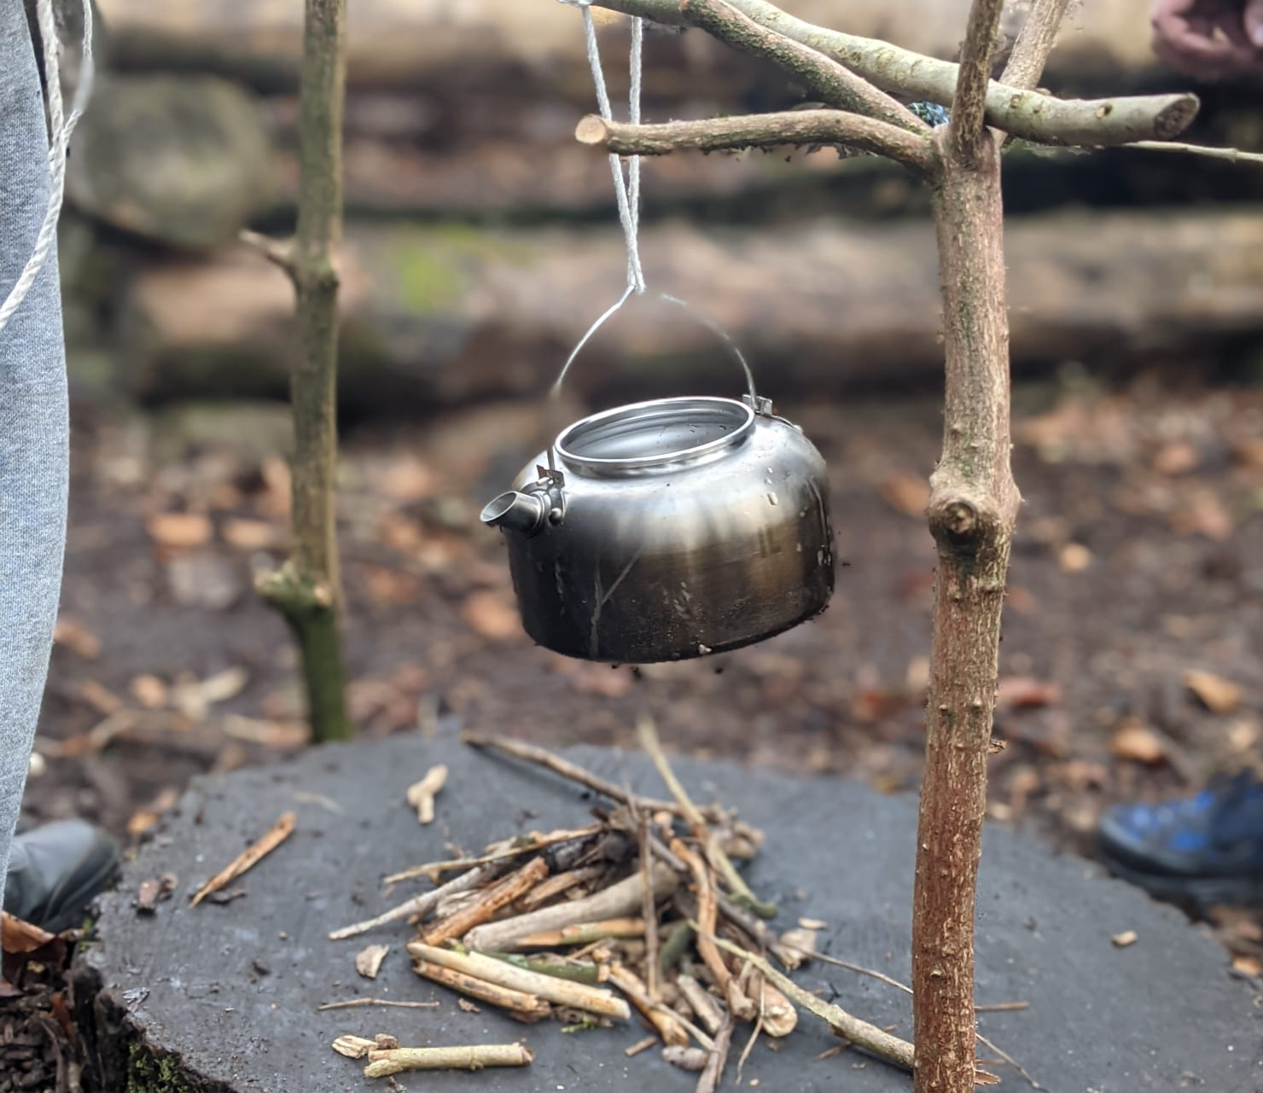
Bushcraft

Slide 2
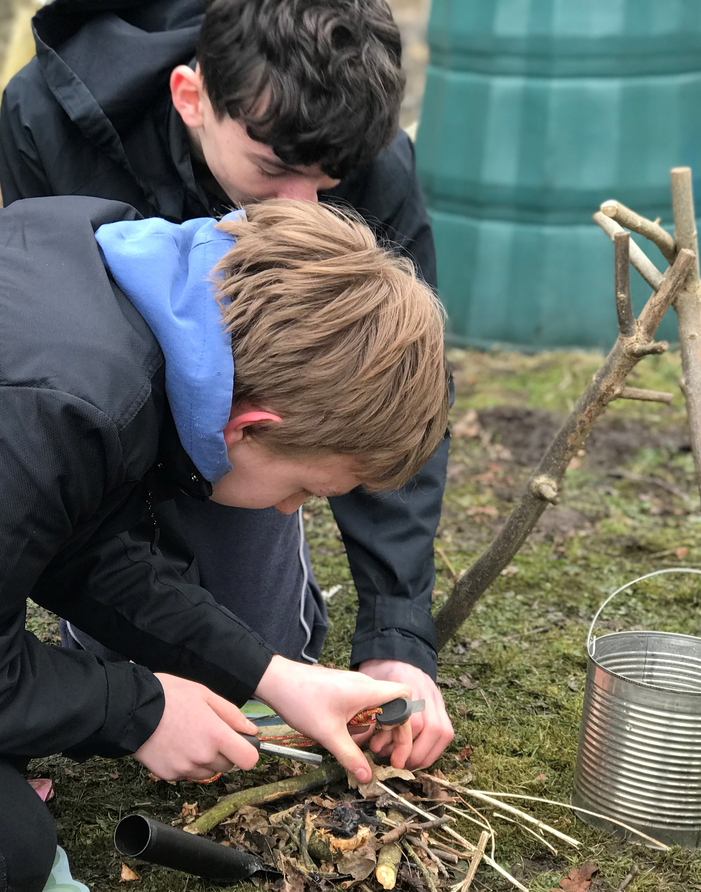
Bushcraft
I will need to wear clothes I don’t mind getting dirty or smelling of smoke
I might need to help my instructor carry some equipment for the session

Slide 3
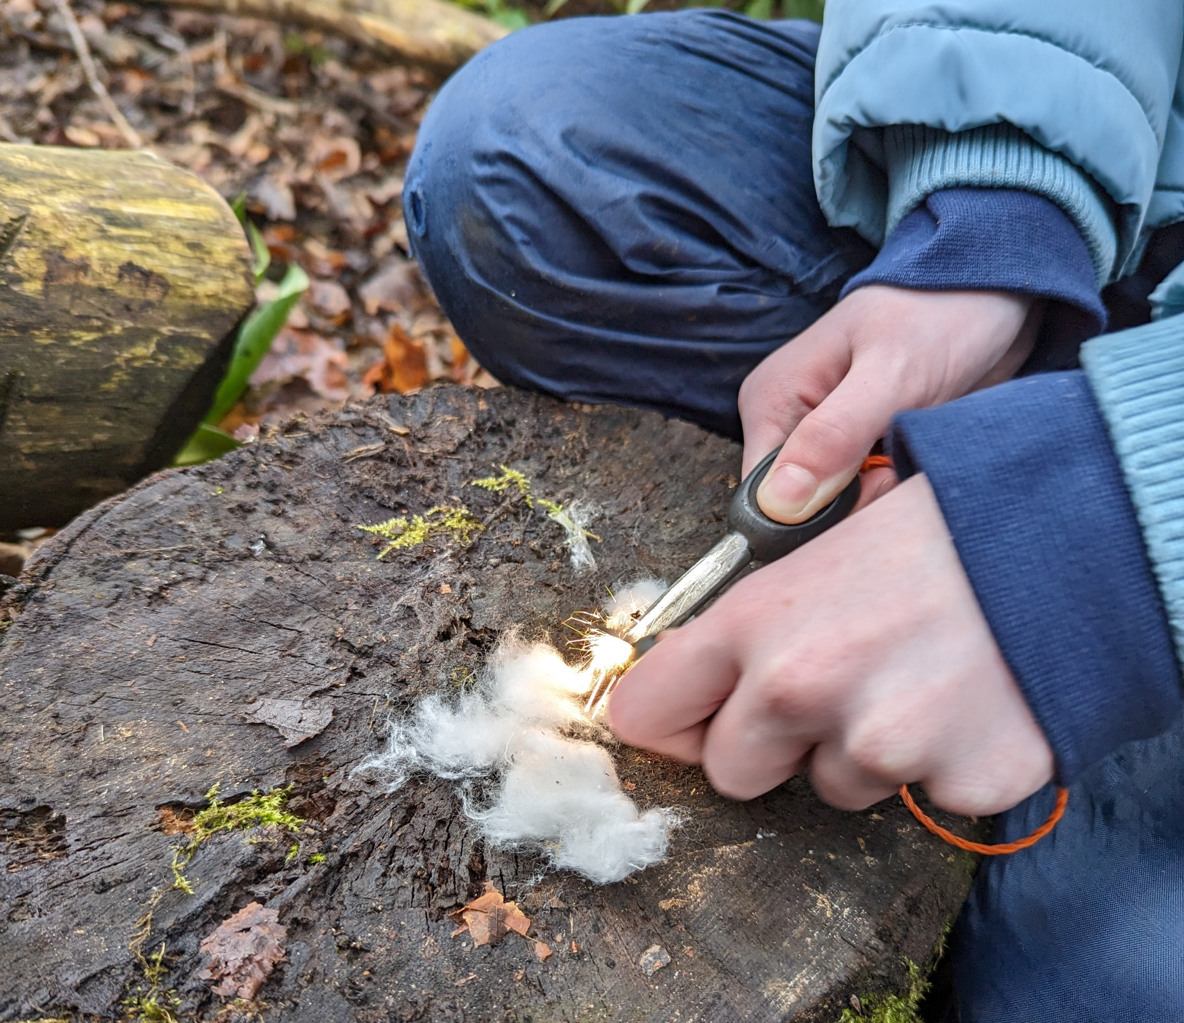
Bushcraft
My instructor will give me a safety briefing before we start
I will have to listen carefully

Slide 4
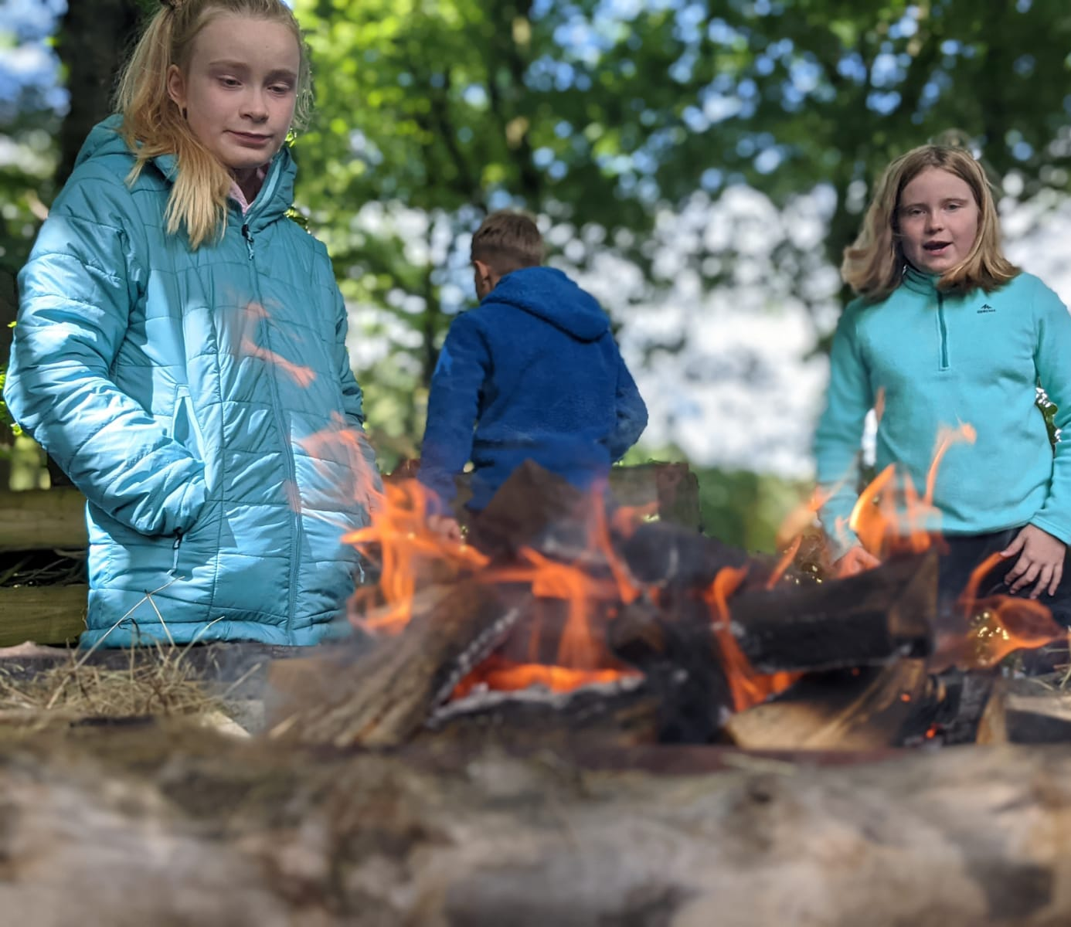
Bushcraft
I will learn lots of different skills, this may include fire lighting
If I don’t feel comfortable lighting a fire, then I can tell my instructor
If I manage to light a fire, I will smell the smoke coming and feel the heat
I must always keep away from the fire unless my instructor tells me

Slide 5
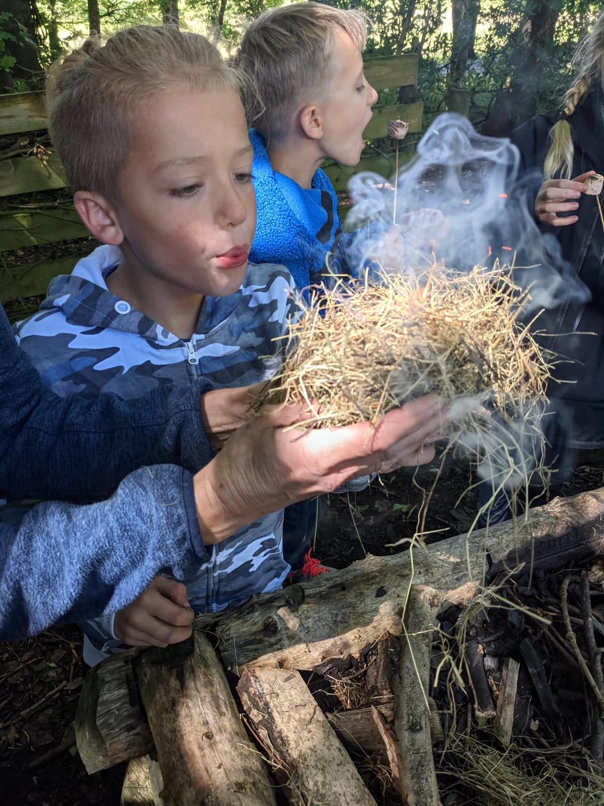
Bushcraft
During my session I will feel different textures, like sticks, branches and cotton wool. I might get sticky fingers if we get to make some food
I will also smell different things I may not have smelt before

Slide 6
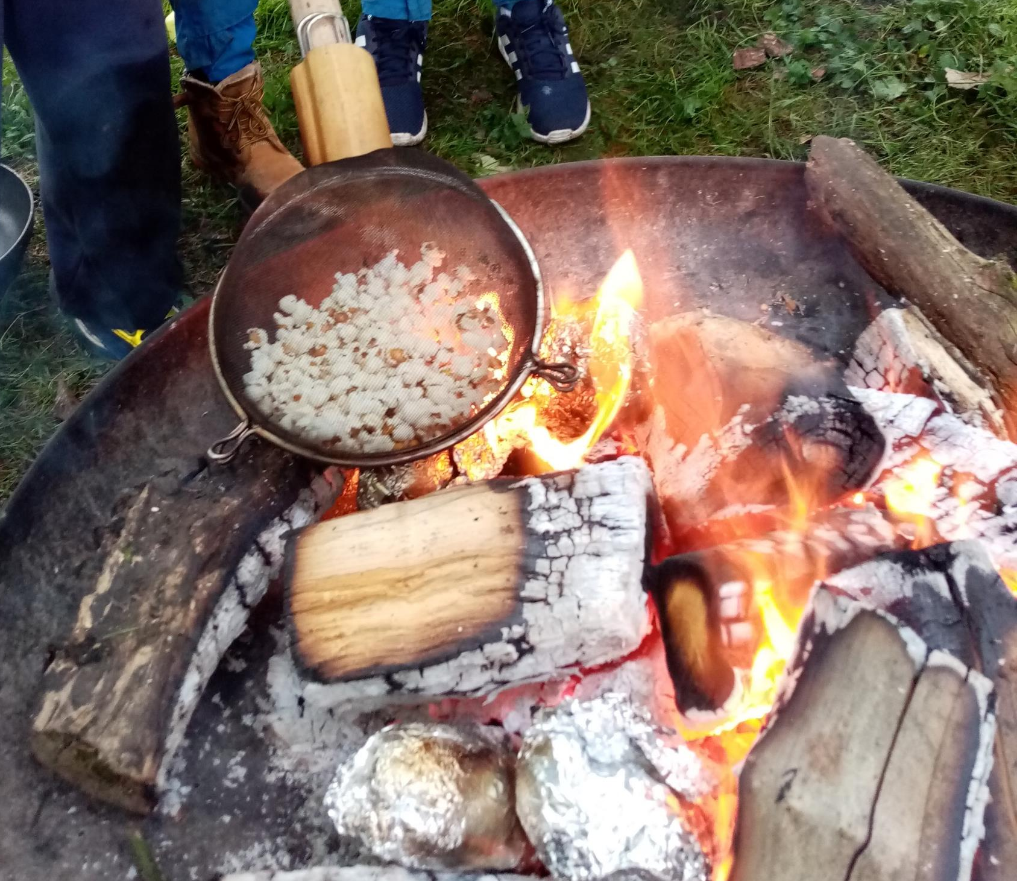
Bushcraft
I might get to cook some food over the fire, like marshmallows or popcorn

Slide 7
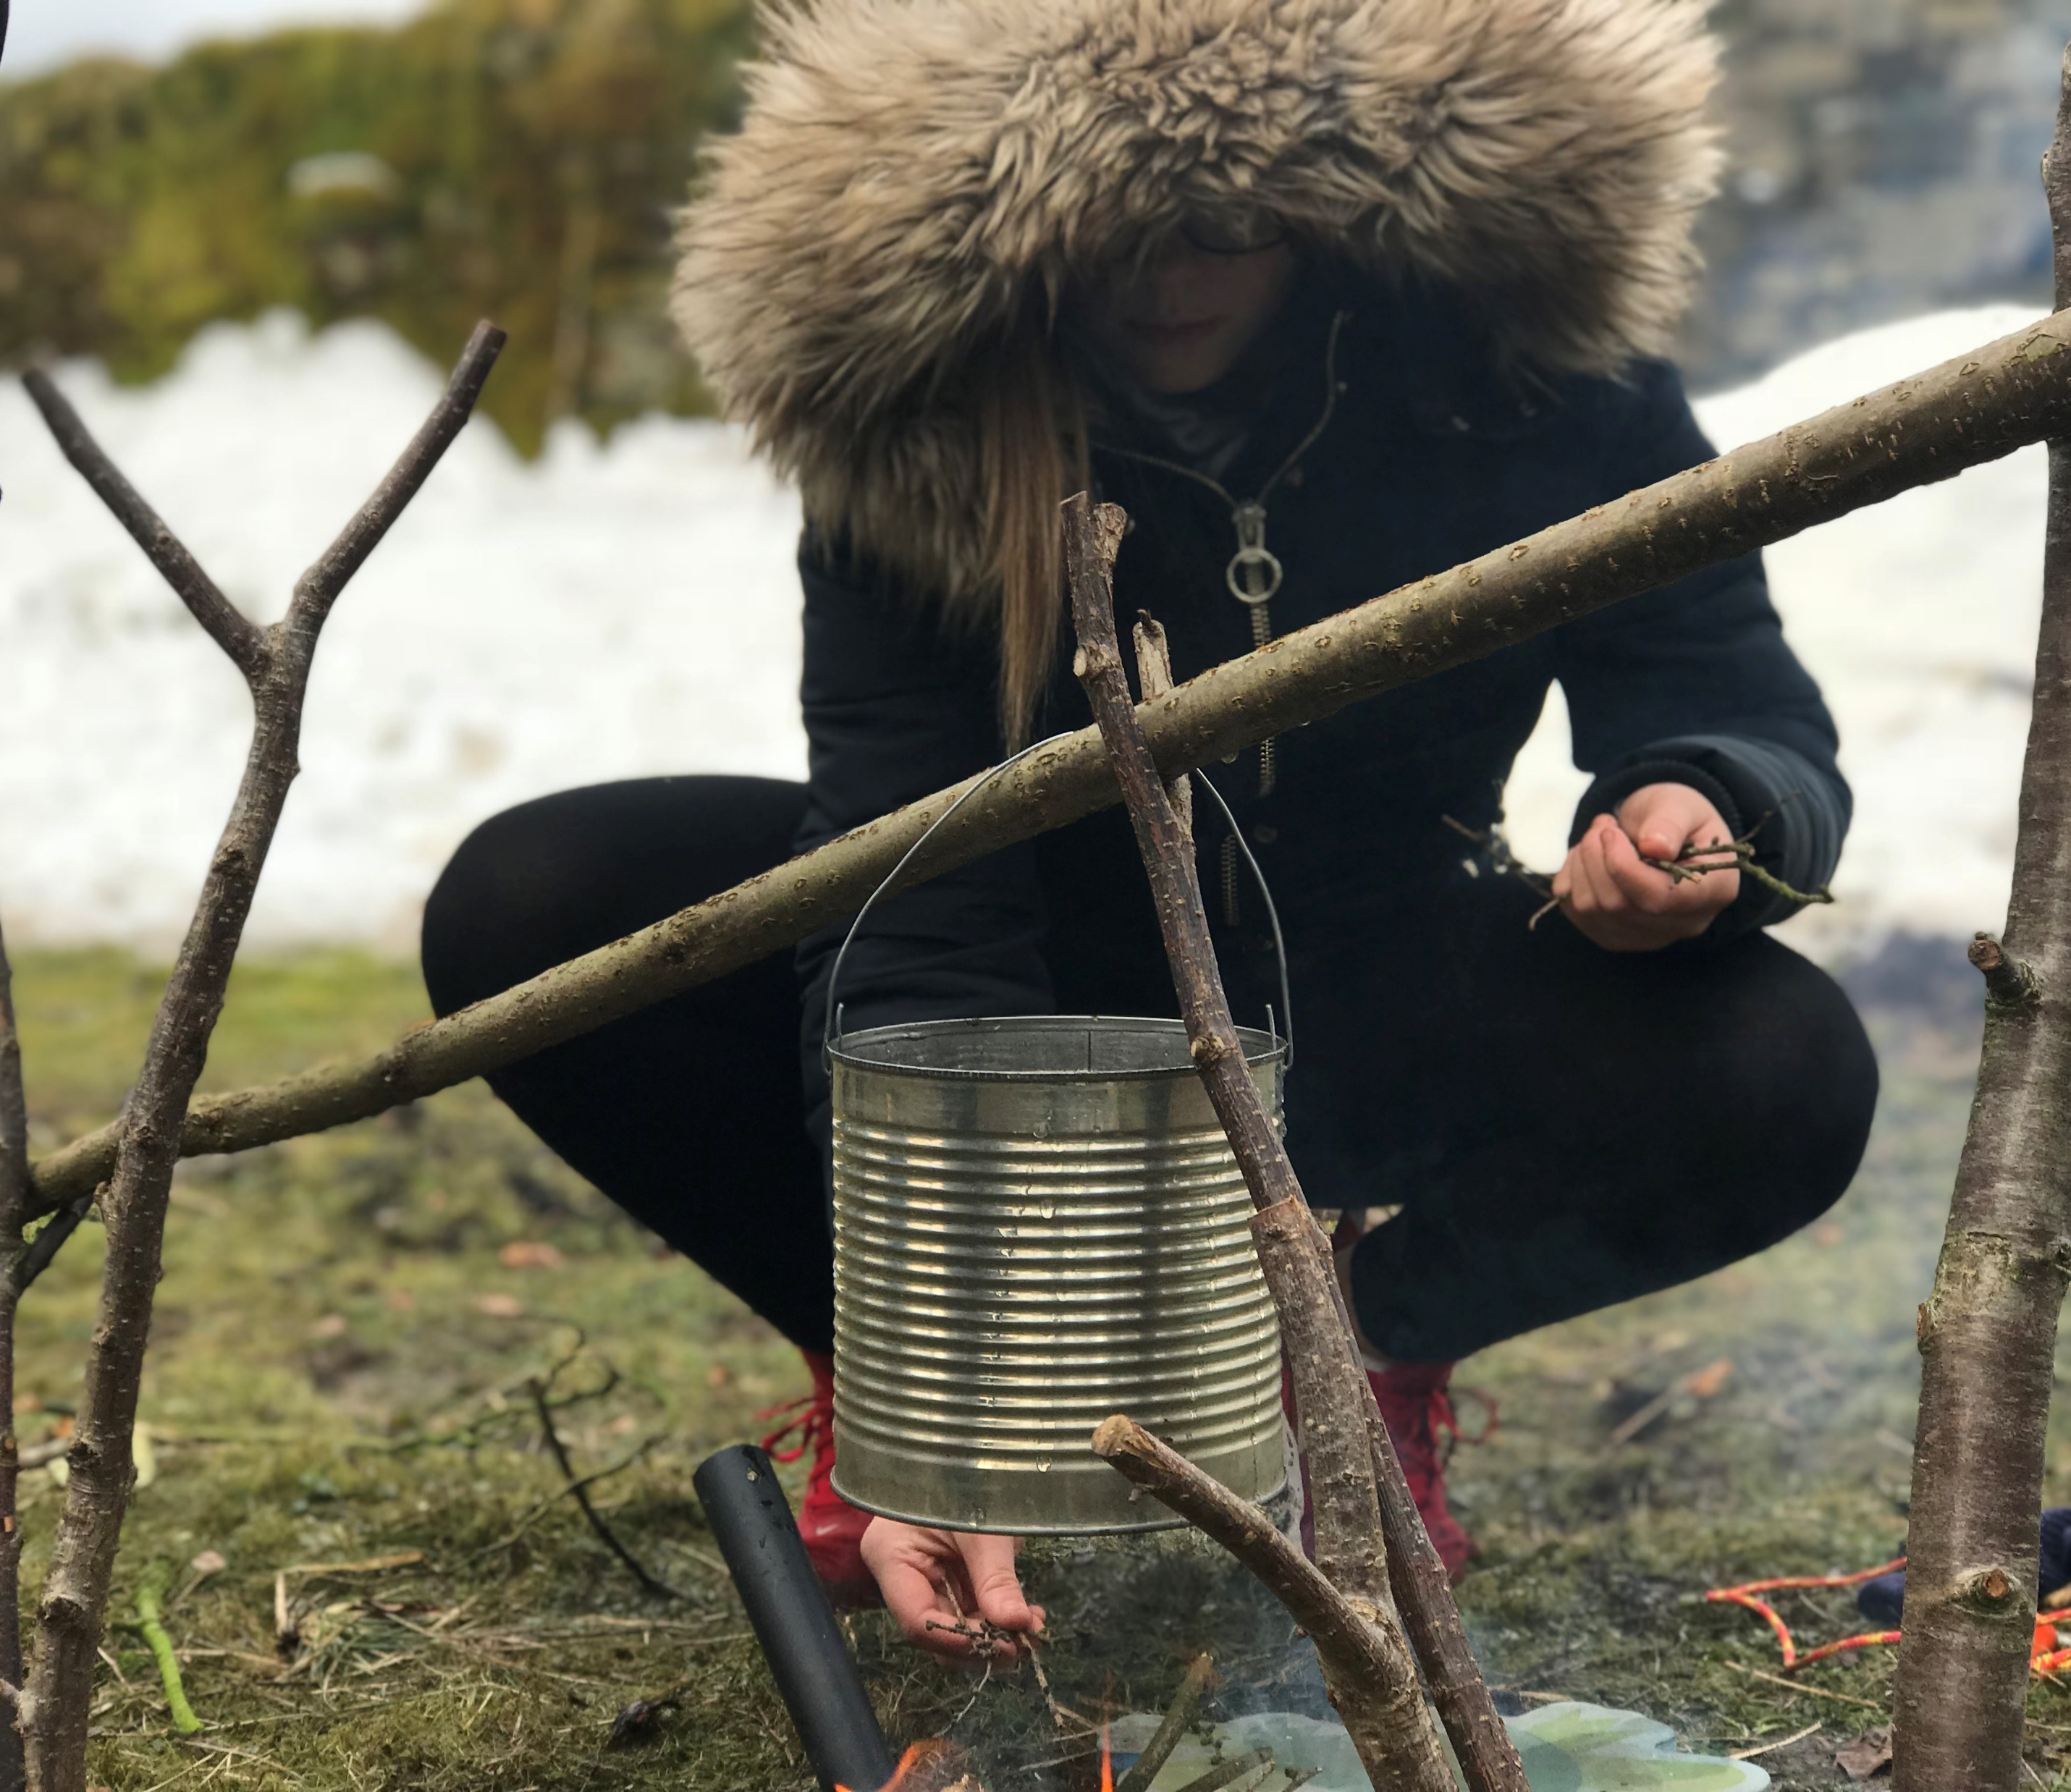
Bushcraft
Once the session is finished, I will have to help clear the equipment away
I should feel proud that I have completed the session

