Slide 1
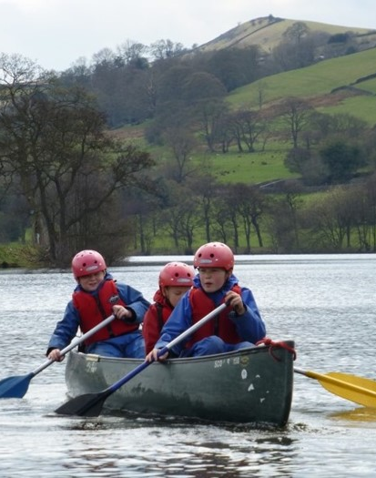
Canoeing

Slide 2
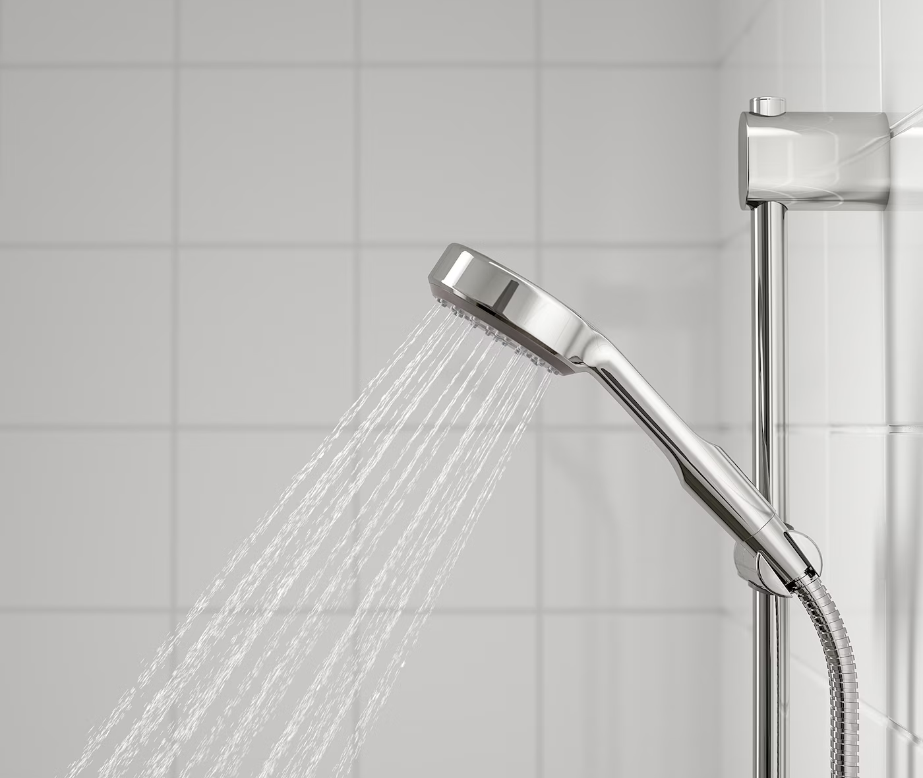
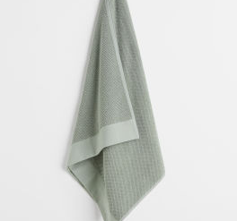
Canoeing
I will have to put a spare change of clothes and a towel in the shower room before we go, so I can have a shower afterwards if I get wet

Slide 3
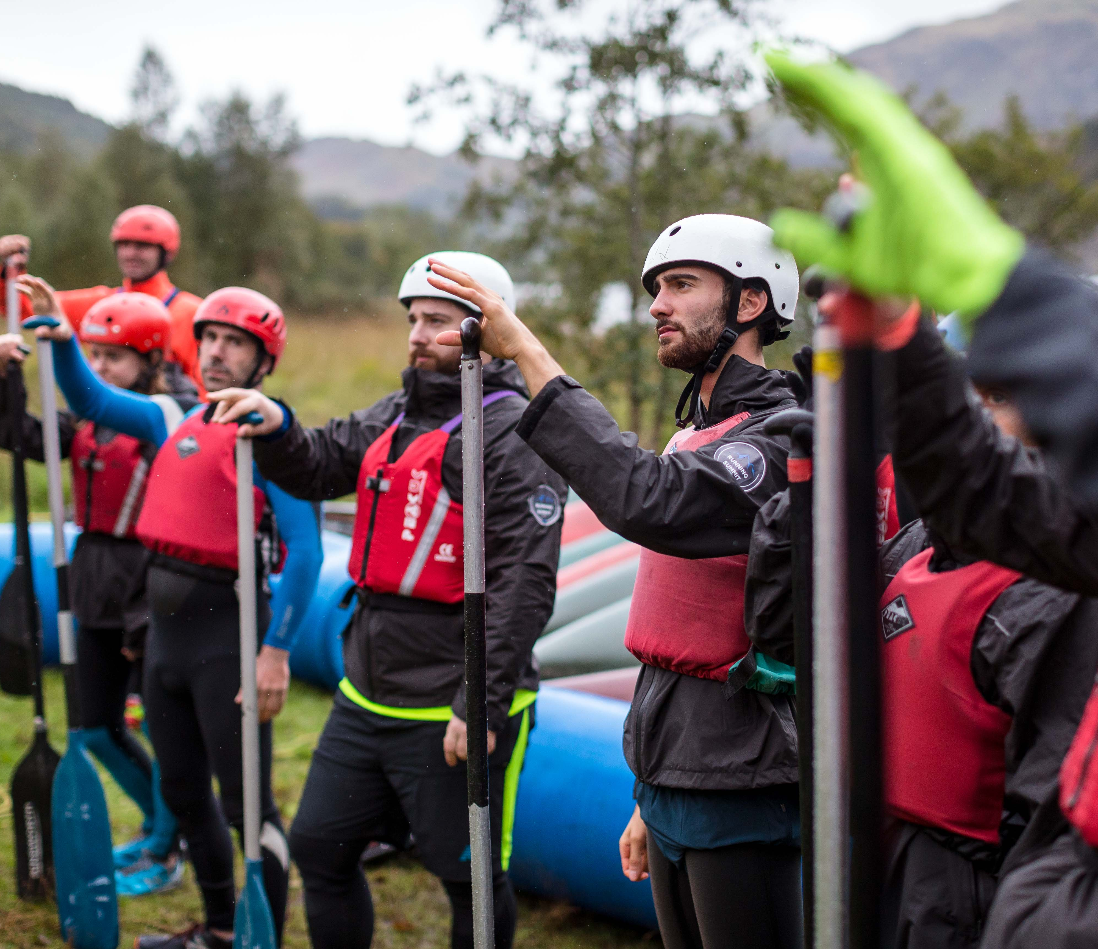
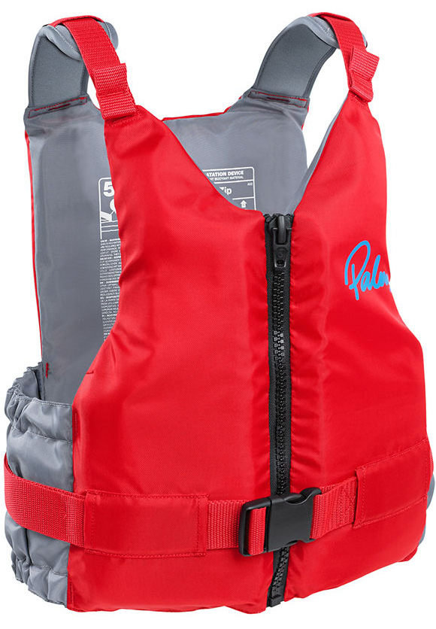
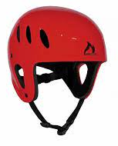
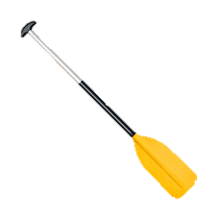
Canoeing
I should wear clothes and shoes that I don’t mind getting wet
A buoyancy aid will keep me floating in the water
A helmet will protect my head
I will use a paddle to move the canoe through the water

Slide 4
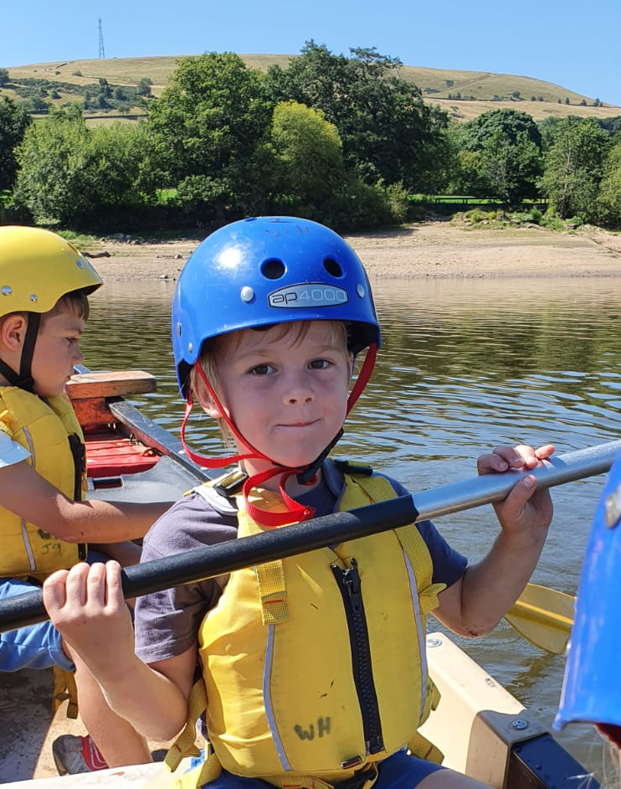
Canoeing
The equipment may feel tight and the paddle might have a different texture to what I m used to
I will probably get wet feet
The water might be cold

Slide 5
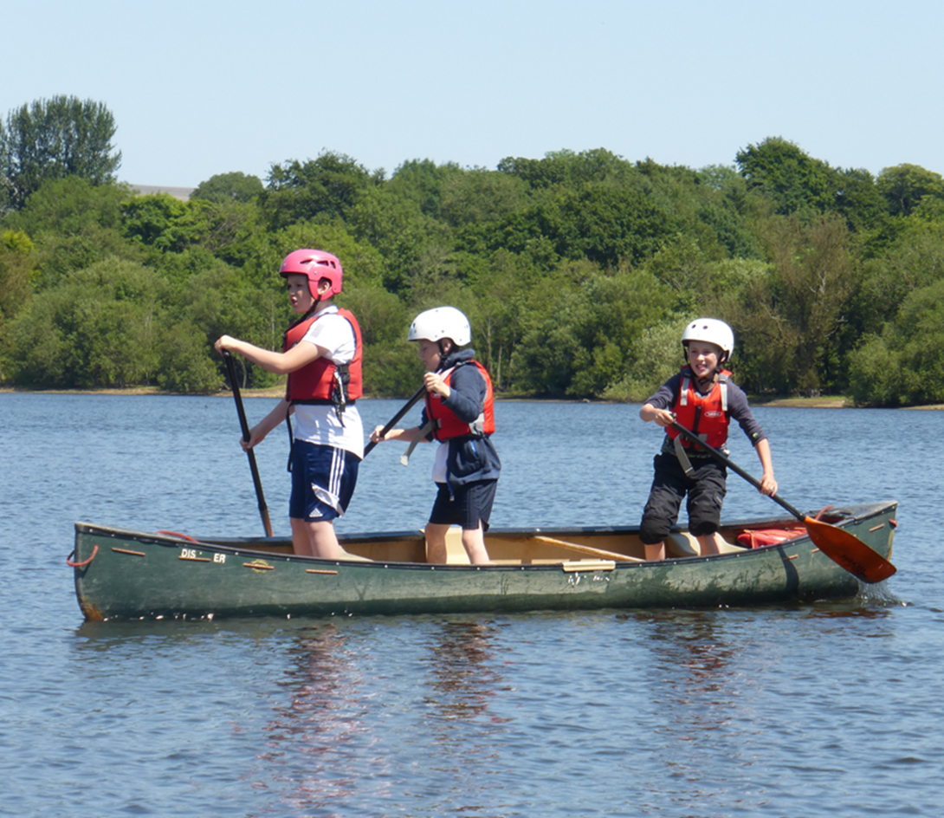
Canoeing
When we arrive at the reservoir, I may have to help carry some equipment or canoes
Once we have carried everything to the water, my instructor tell me how to stay safe while canoeing

Slide 6
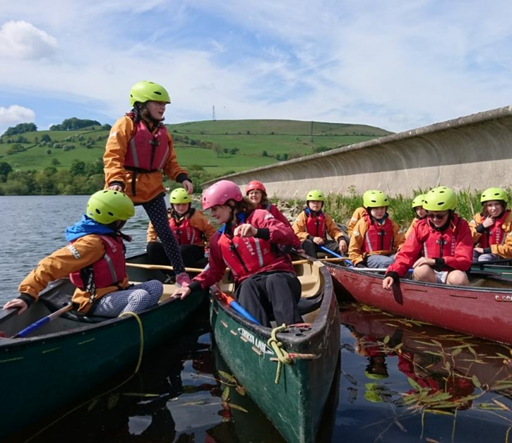
Canoeing
The boat might feel a bit wobbly on the water. It’s ok to feel nervous, but I should get used to it in a few minutes

Slide 7
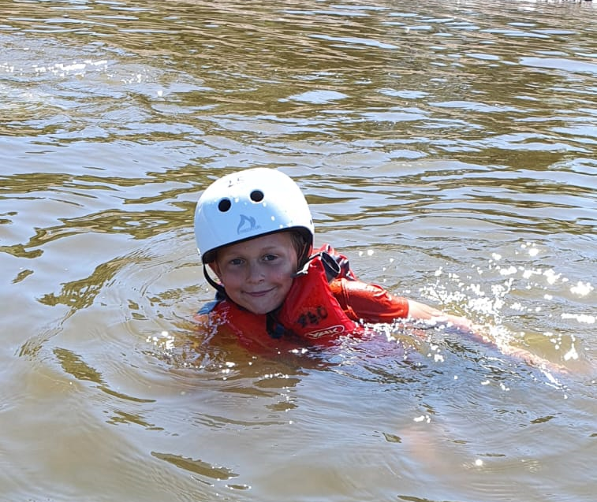
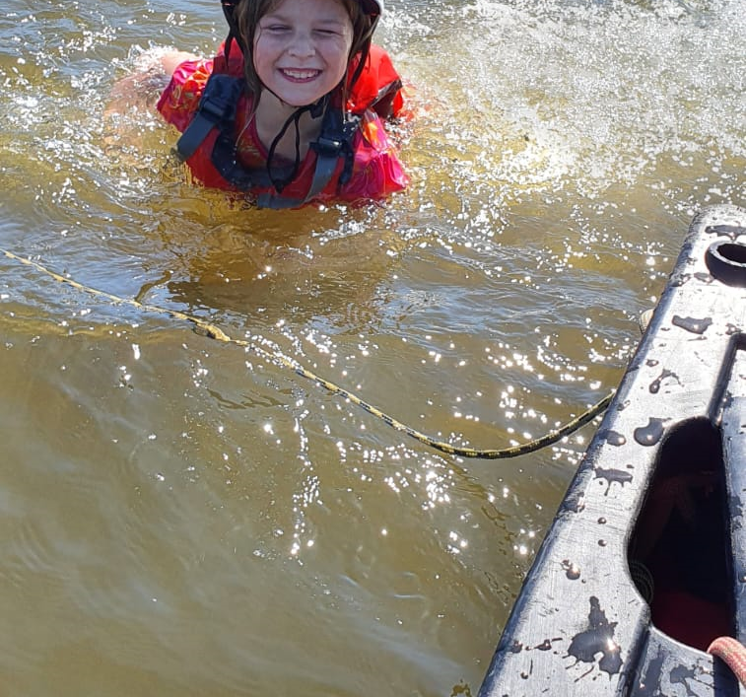
Canoeing
During the session I will learn some skills and will play some games.
When we have finished canoeing, we might be able to go for a swim.
Before we leave, I will have to help take some equipment back to the bus or help carry the canoes.

Slide 8
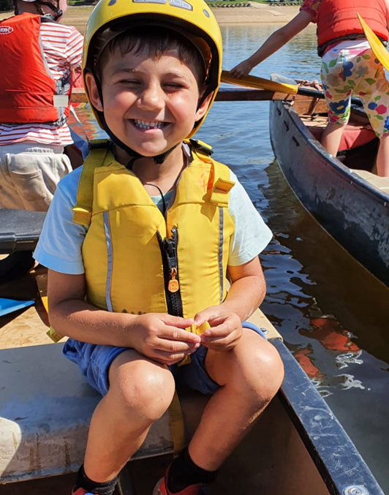
Canoeing
Once we have finished canoeing I will travel back to White Hall and go for a shower
I should feel proud that I have completed the session.

