Slide 1
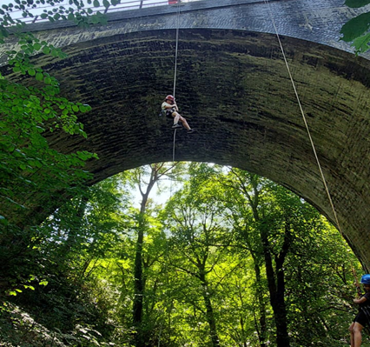
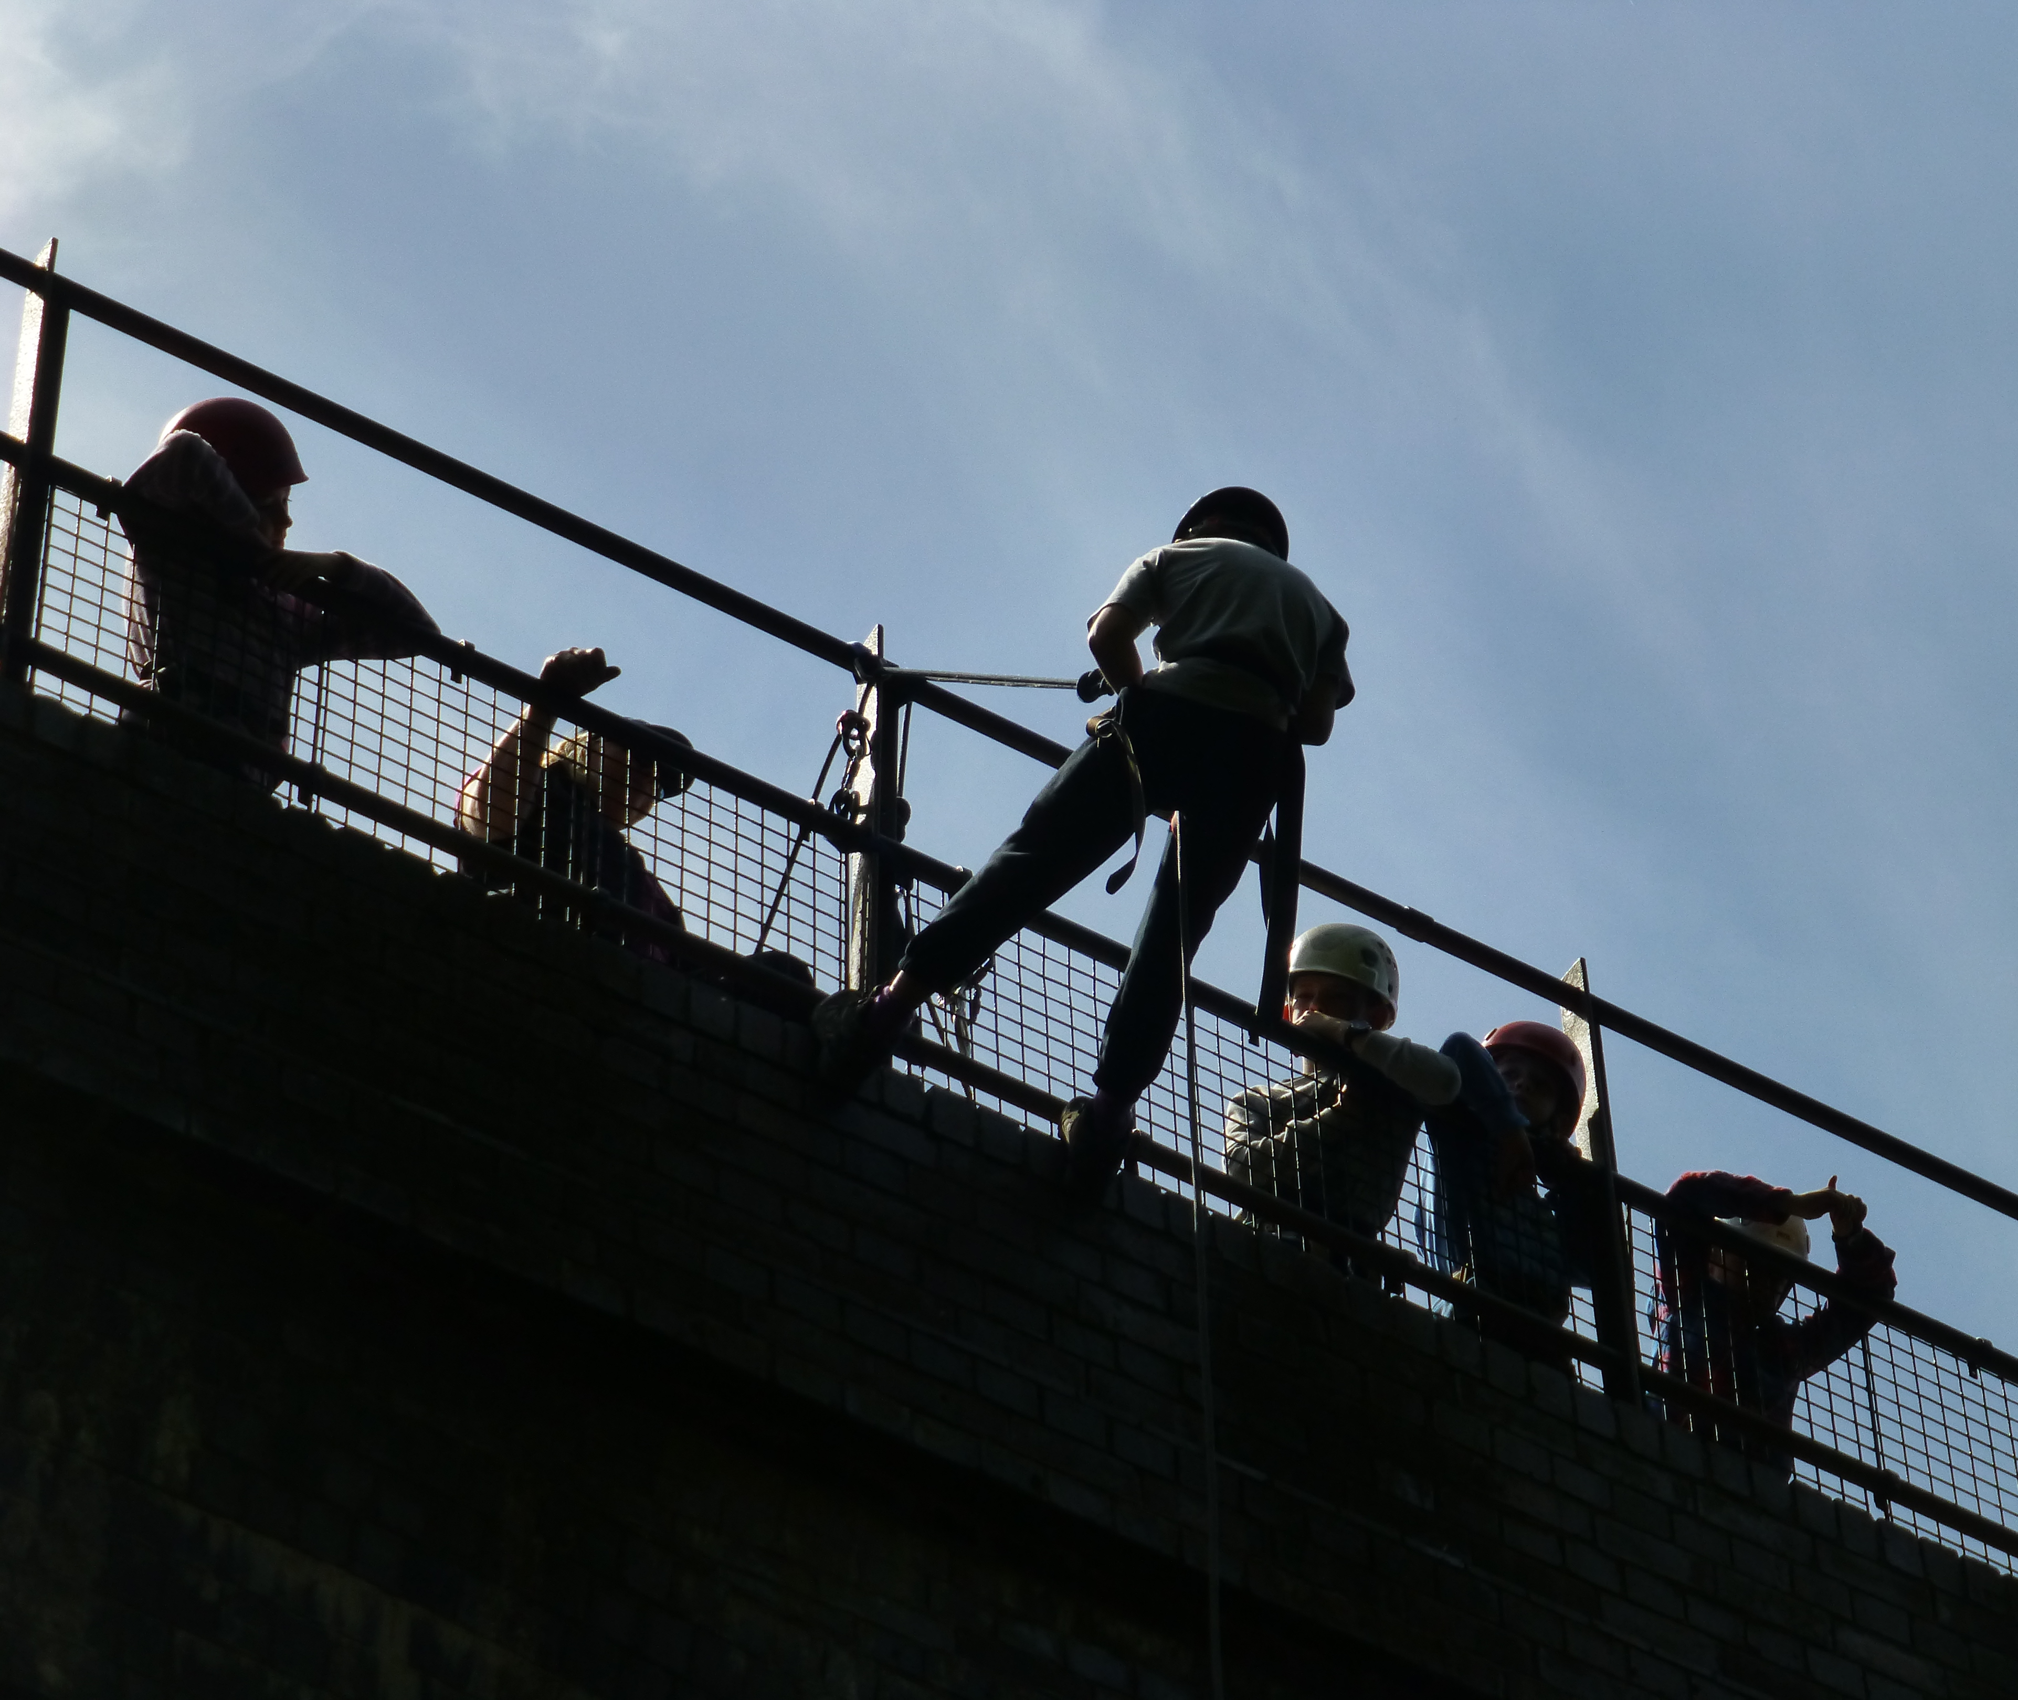
Abseiling

Slide 2
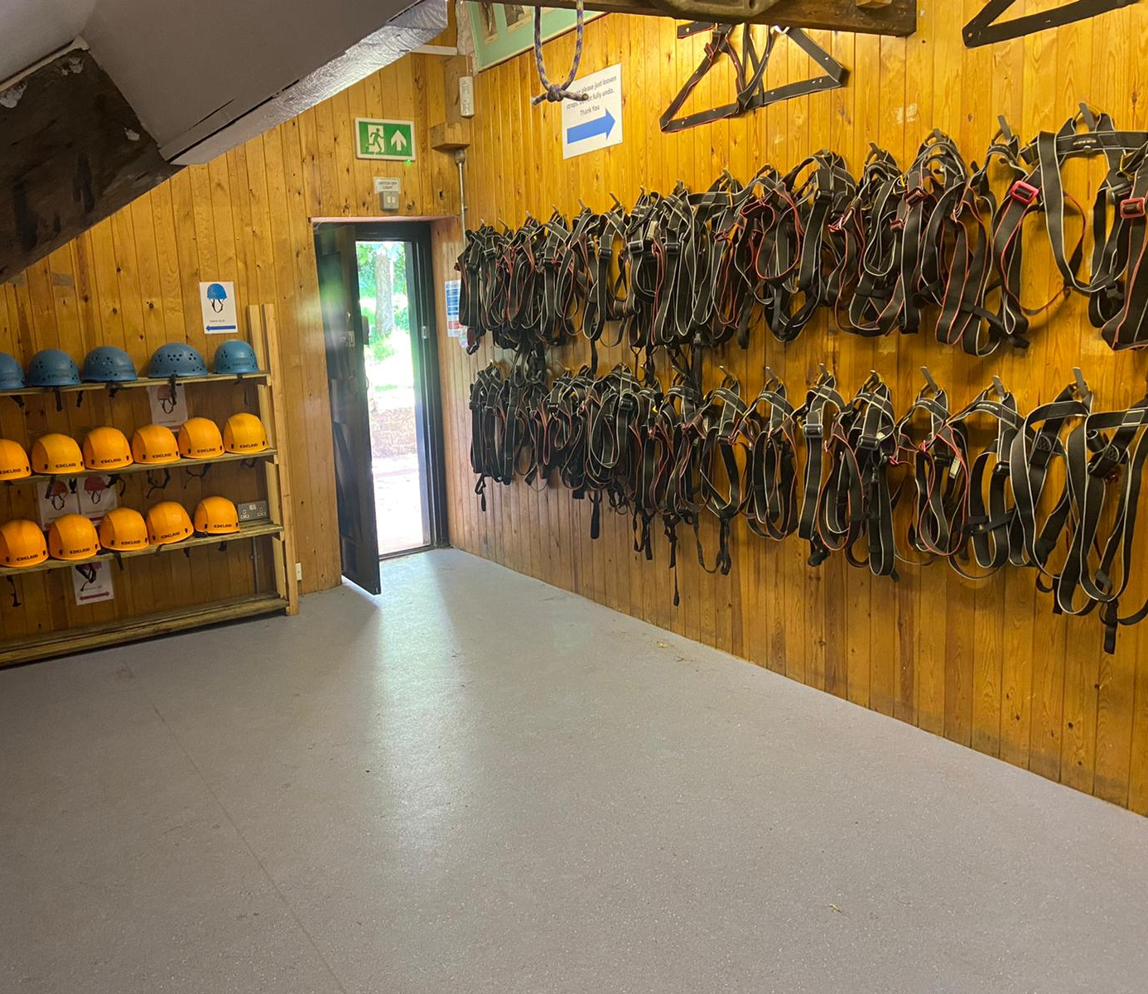
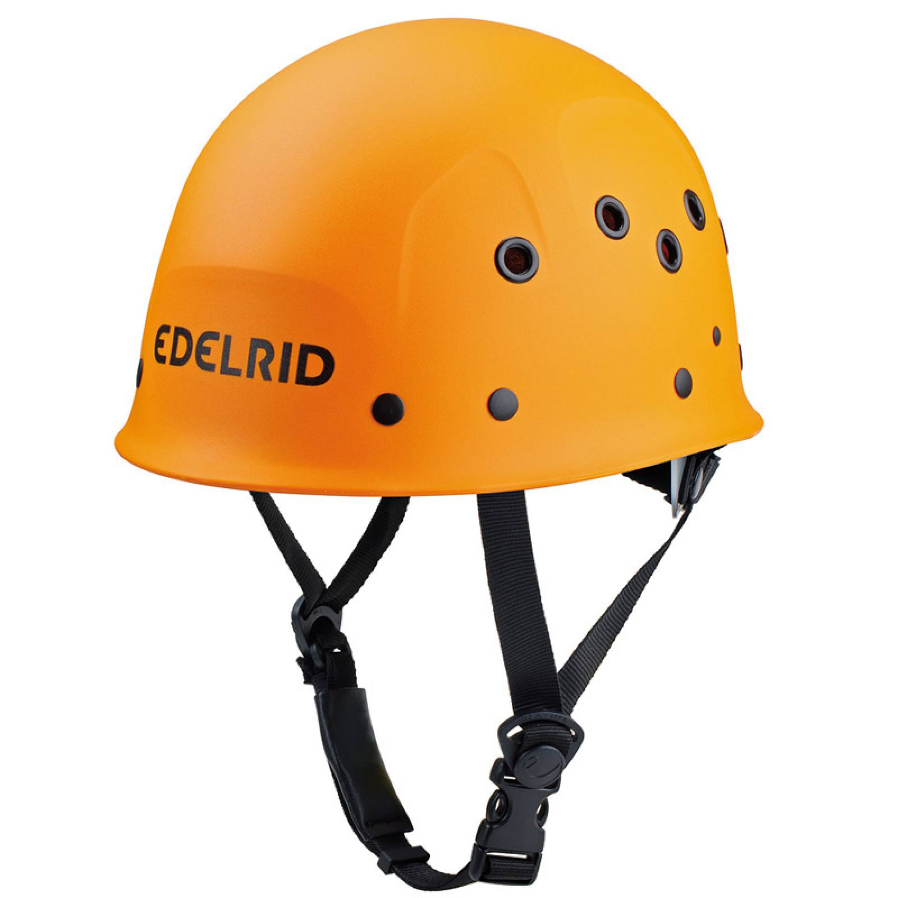
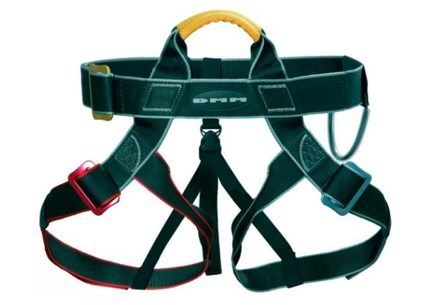
Abseiling
I will go to the rock store to get a harness and helmet
My instructor will show me how to put on my harness and helmet

Slide 3
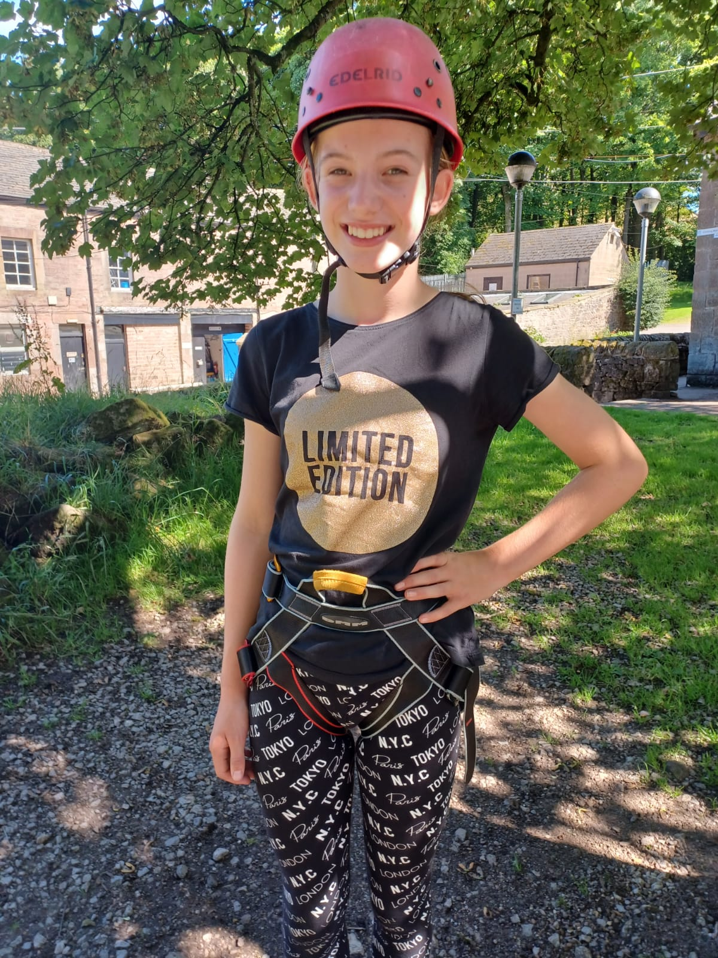
Abseiling
My instructor may need to get closer to help me put my harness on
The harness and helmet may feel a bit tight

Slide 4
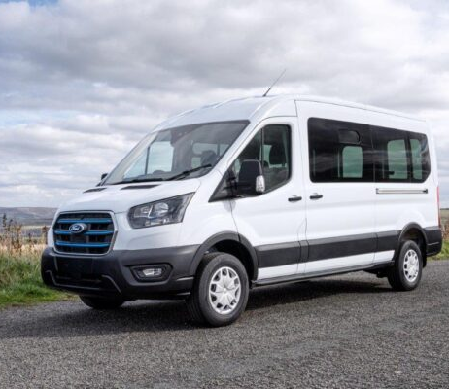
Abseiling
We travel to abseiling on a mini bus. I’ll need to put my seatbelt on
The journey will take around 20 minutes

Slide 5
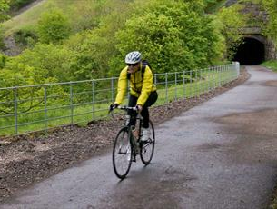
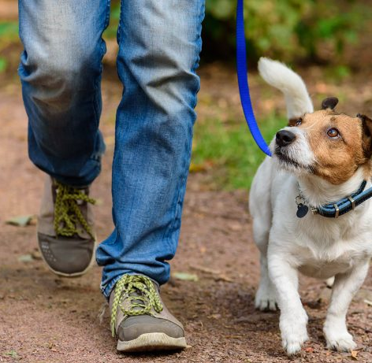
Abseiling
When we arrive, we’ll need to walk for about 10 minutes to the bridge
As we walk along the trail we may see people walking their dogs or riding bikes. We will stay out of their way

Slide 6
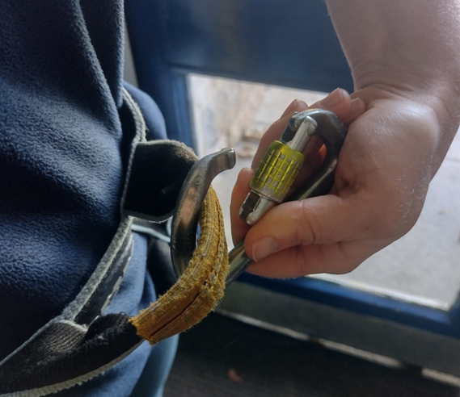
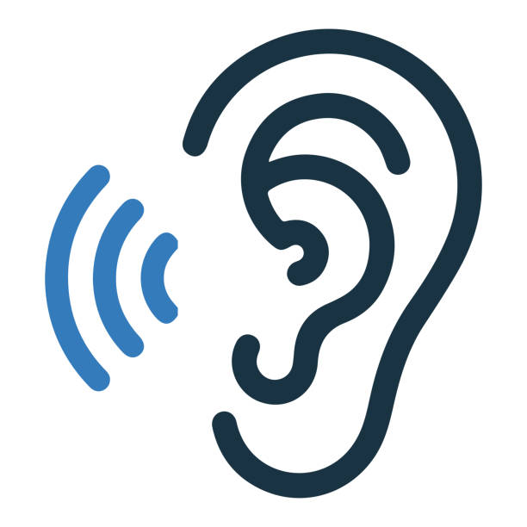
Abseiling
My instructor will set up the abseiling ropes
I will have to listen carefully so I know how to stay safe
When it is my turn I will have to attach a karabiner to my harness
I can only start when my instructor tells me

Slide 7
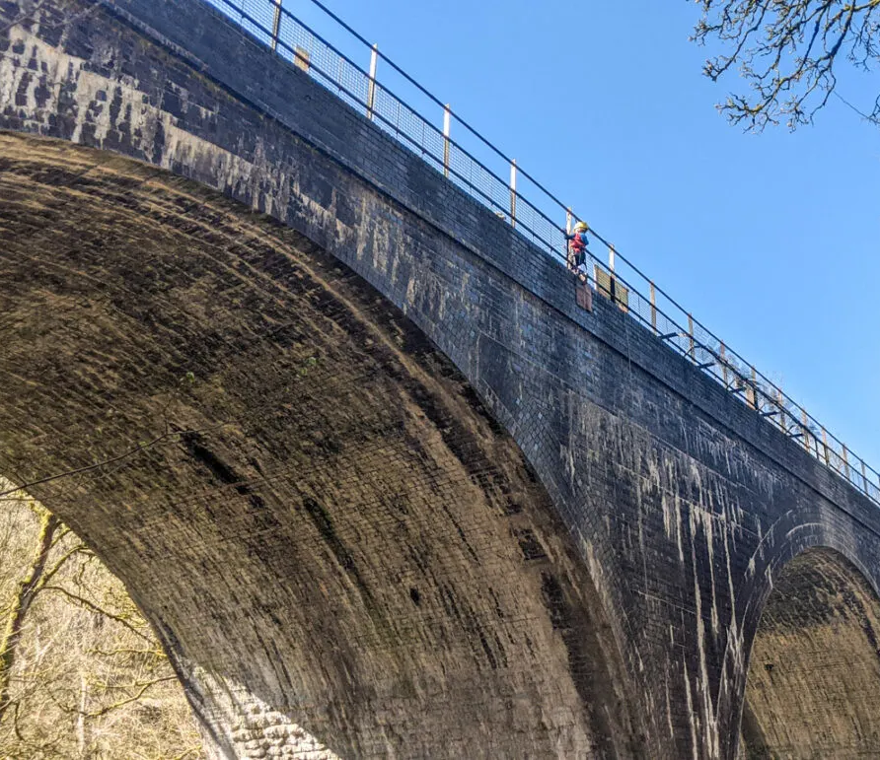
Abseiling
I may hear a clicking sound when putting the karabiner on
Once I’m ready my instructor will tell me to climb through the railings, this might make me feel nervous but that is okay

Slide 8
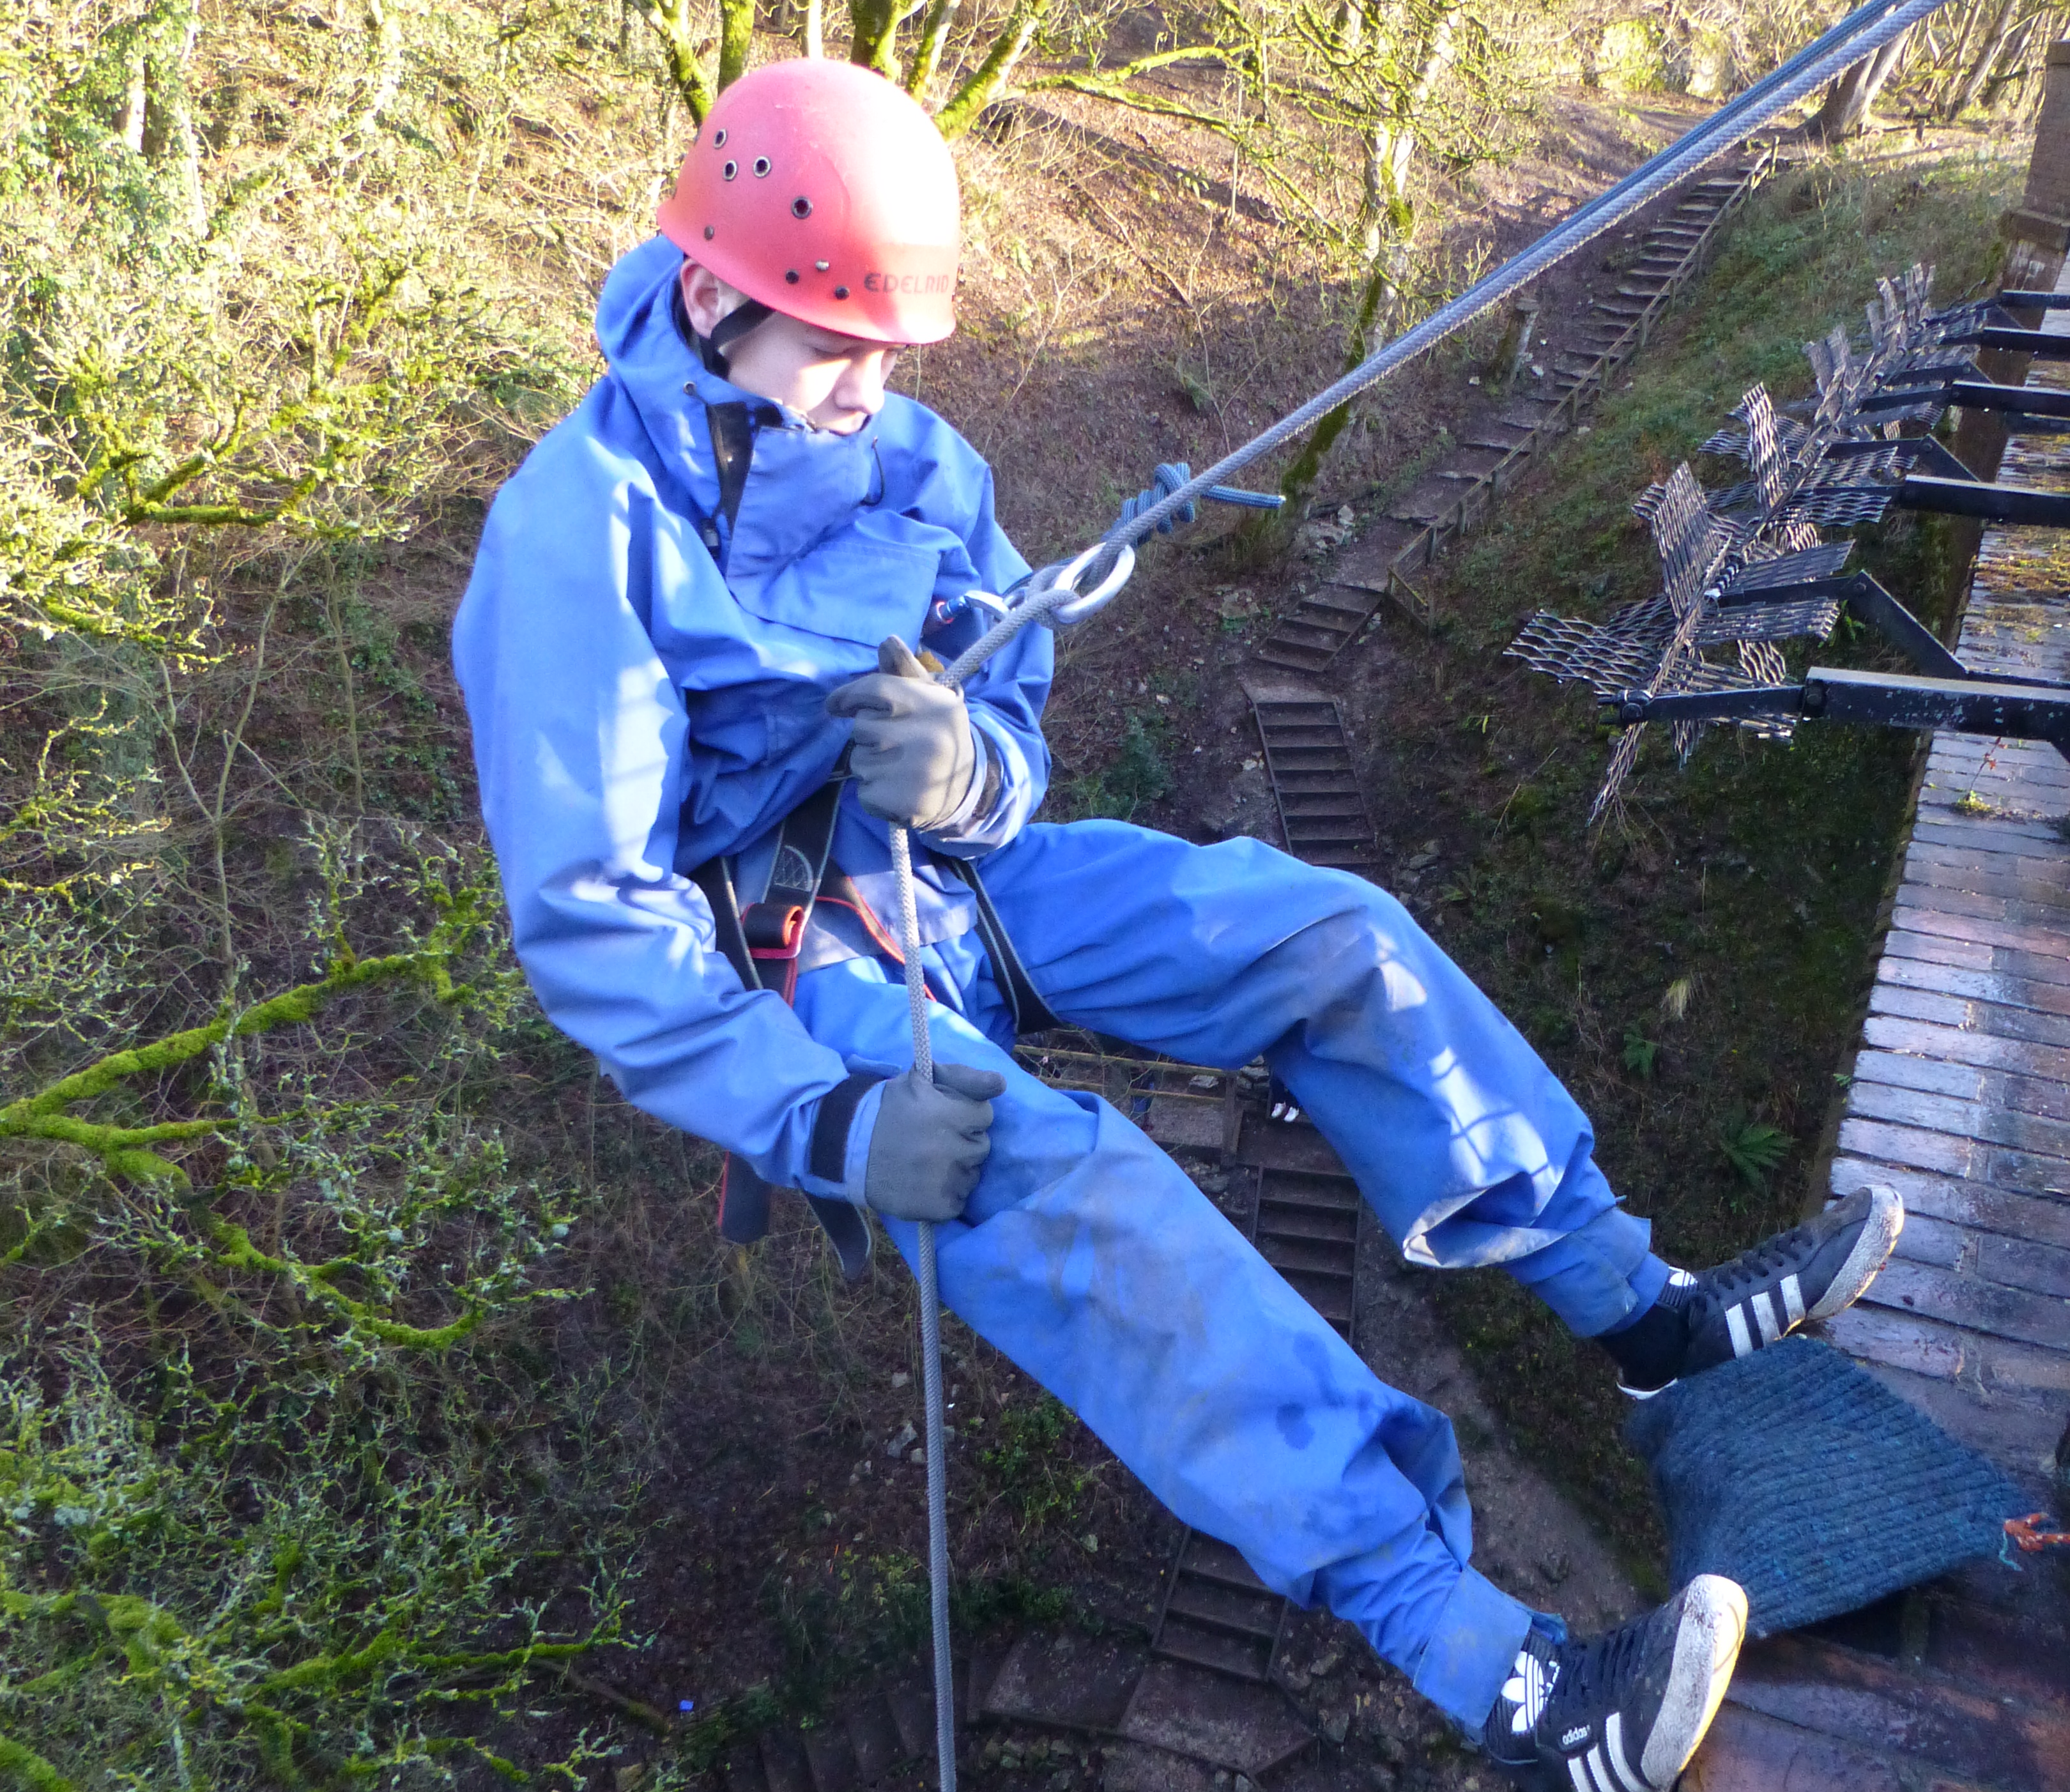
Abseiling
Once on the other side of the railings I will lean back and my instructor will explain what I need to do
When I have reached the ground, I will need to unclip myself from the rope. I can then watch other people have their turn
I may be able to have a second go if there is enough time

Slide 9
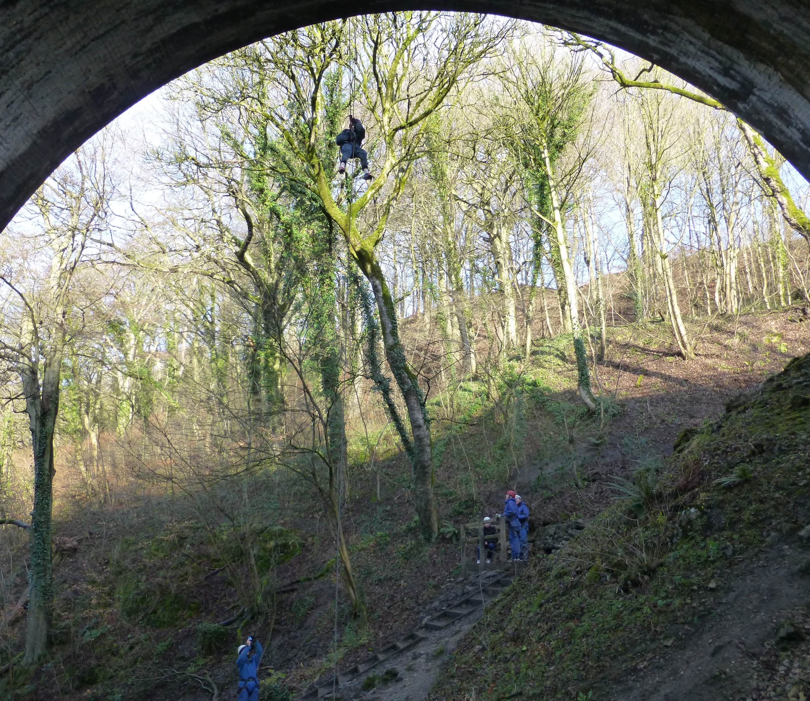
Abseiling
Once we have finished abseiling, I will travel back to White Hall on the minibus
I should feel proud that I have completed the session

